Slide 1
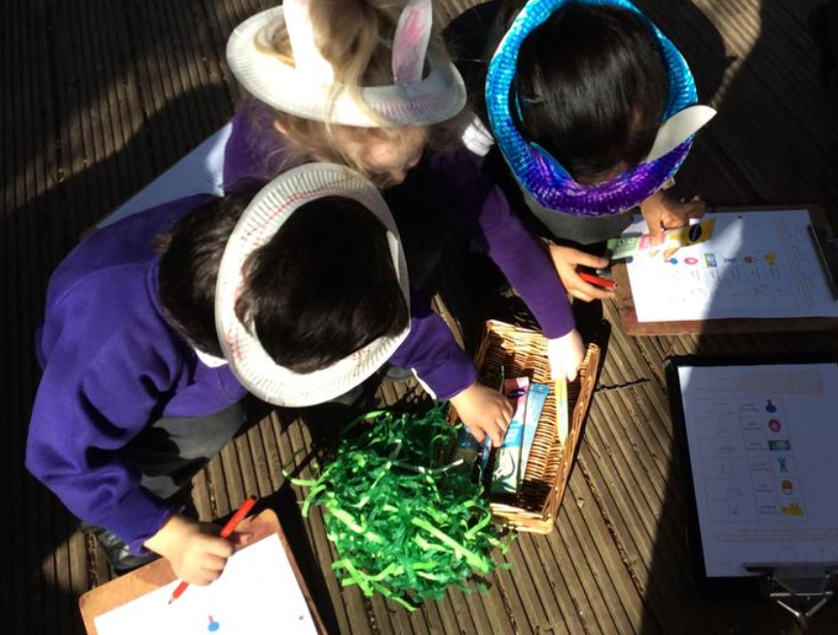

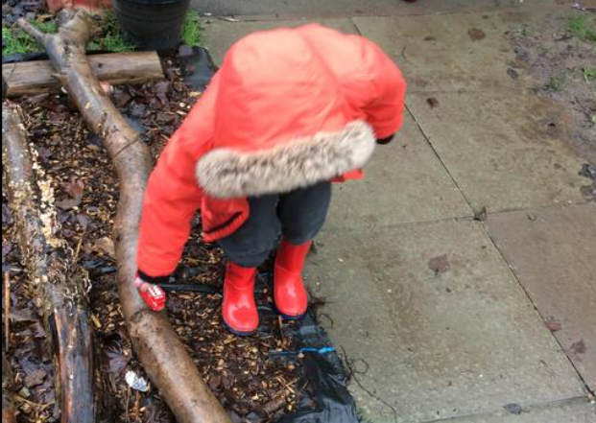
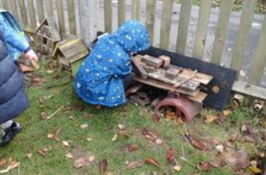
Nursery
Welcome Meeting
Monday 8th June 2026
5.00 P.M.

Slide 2


GROWING AND LEARNING TOGETHER TO BE THE BEST WE CAN BE!
We always…
ASPIRE for excellence
ENJOY learning
ACHIEVE success
CHALLENGE ourselves further.

Slide 3

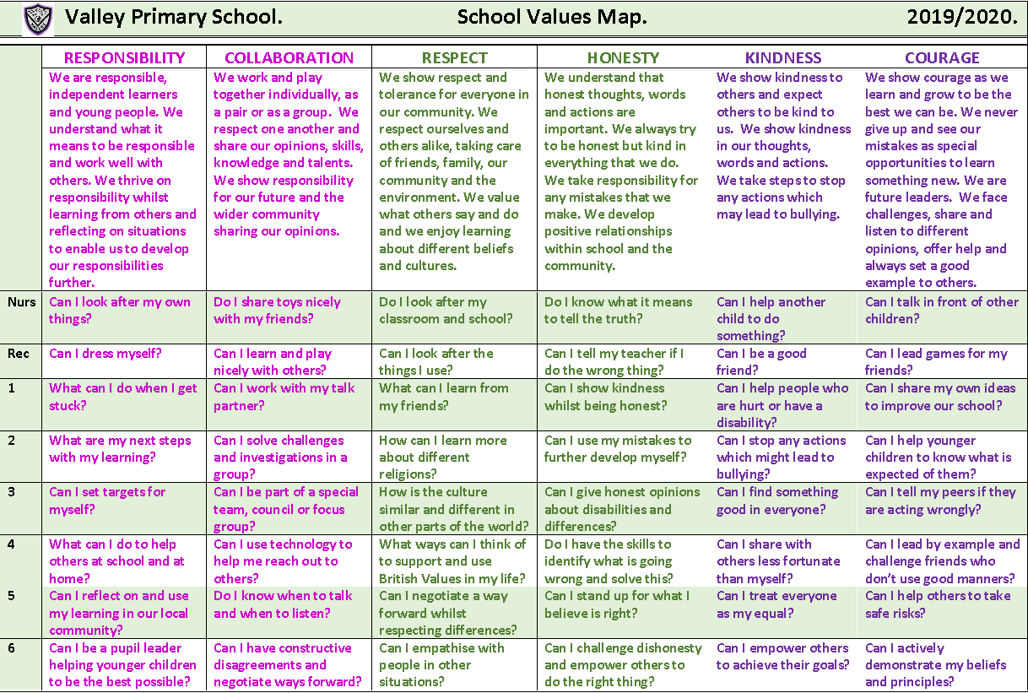
Valley Values

Slide 4
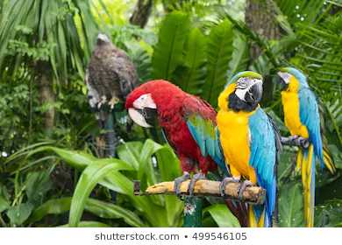
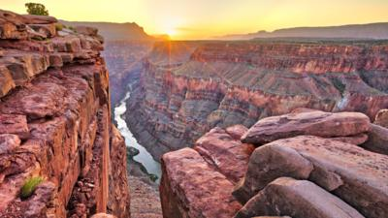

House Points…
Amazon Rainforest (Green)
Grand Canyon (Red)
Great Barrier Reef (Blue)
All our children try and earn house points.
House points are given for great work, living our values and being kind.
A House reward is given at the end of each half term for the winning house.

Slide 5
Admission Arrangements
Step 1. Today’s Welcome to Nursery Meeting. Polite reminder that you were asked to share your child’s birth certificate to the school office. If you have not yet done so, please present this ASAP to secure your place.
Step 2. A parent / teacher information sharing sheet was emailed to you. If you have not emailed it or brought it with you this evening, please bring it to the school office ASAP. There are spare copies to collect.
Step 3. You are invited to a Stay and Play session on Wednesday 24th June.
Girls are invited 9am-10am
Boys are invited 10.30am – 11.30am.

Slide 6
Nursery
We have three family groups in
Nursery:
Royce N
Starley N
Whittle N
We have two full time members of staff in Nursery. Each member of staff will be the named key worker for one family group and this will rotate throughout the year.
However, the children and staff mix across all of the classrooms and the outdoor area.

Slide 7
Phased start in September
Tuesday 1st INSET day – School closed
Wednesday 2nd Thursday 3rd
Your child will attend settling in sessions.
Royce – 8.45 – 9.45
Whittle – 10.30 – 11.30 on Wednesday
10.30- 12.30 (includes lunch) Thursday
Starley – 1.30 – 2.30
Friday 4th All children 8.30 – 10.30

Slide 8
Normal Nursery hours from 8th September
From Monday 7th September: All children in for normal hours from this point onwards. Explorers before and after school restarts.
Starley: Monday, Tuesday 8.30-11.30
Wednesday, Thursday 12.20-3.20
Friday 8.30- 11.30
Royce: Monday, Tuesday 12.20-3.20
Wednesday, Thursday 8.30-11.30
Friday 8.30- 11.30
Whittle: Monday- Thursday 8.30- 3.20
Friday 8.30-11.30

Slide 9
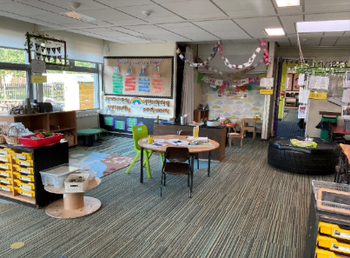
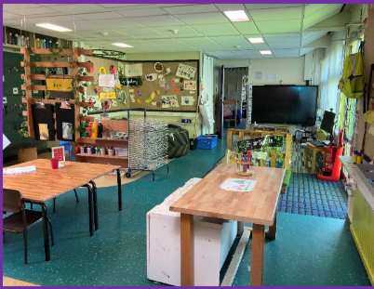
Our Classrooms

Slide 10
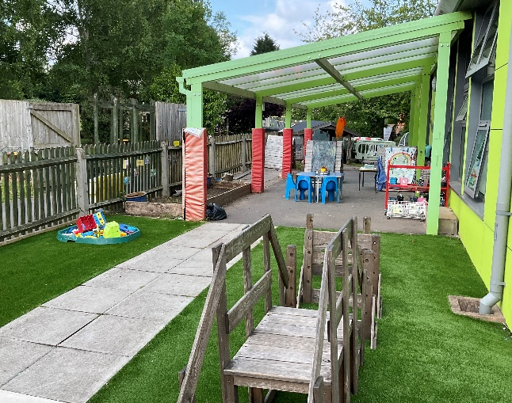
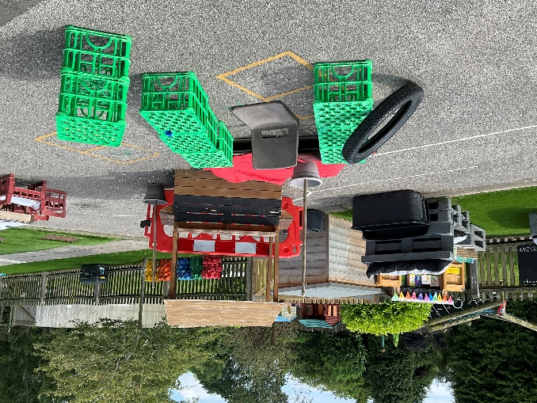
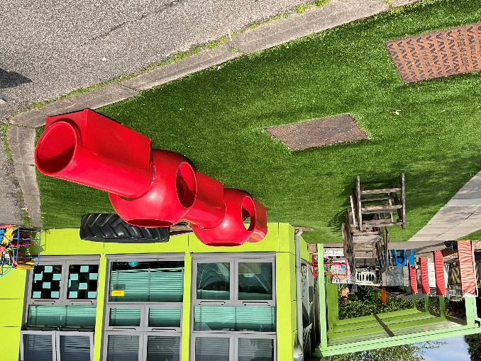
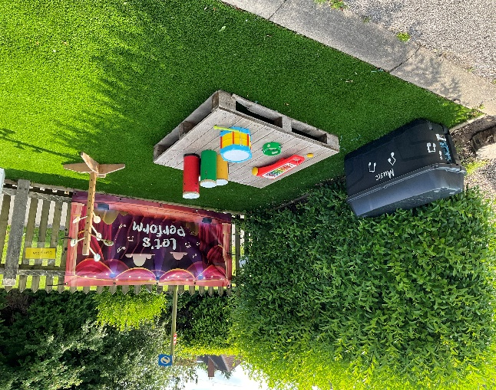
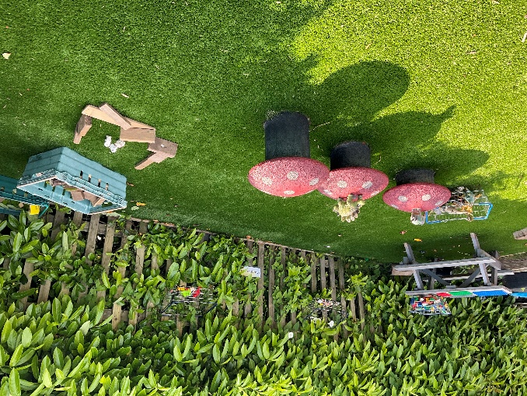
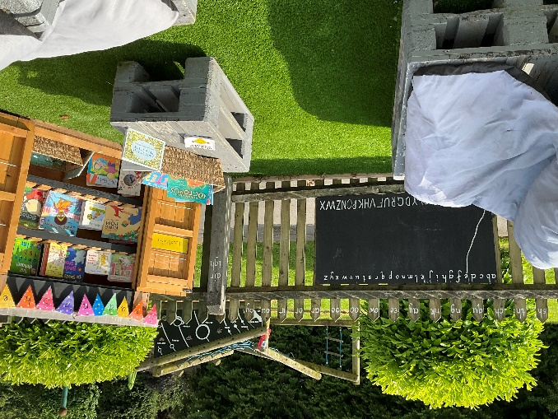
Outside Area
“The best classroom and cupboard is roofed only by the sky.” Margaret McMillan

Slide 11
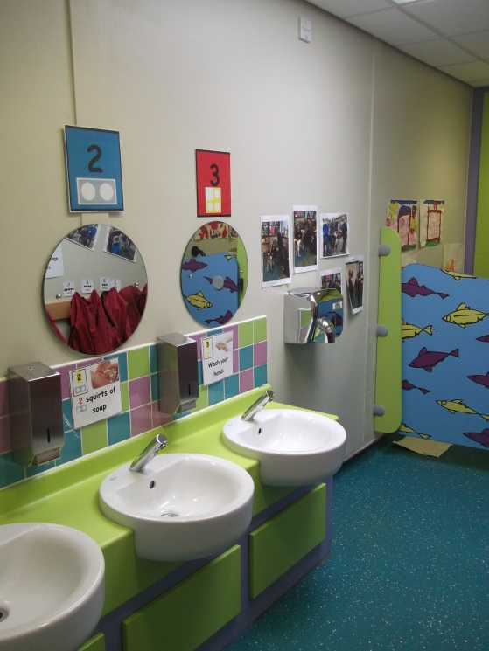
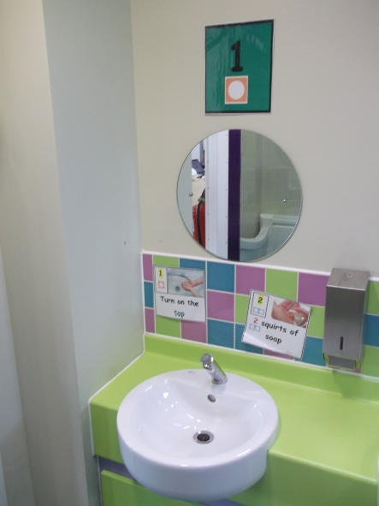
Toilets
Child friendly toilets
Support your child over the summer to become independent when going to the toilet
Accidents happen
Please provide spare clothes and underwear in purple or black drawstring bag.
Solihull Health Visiting and School Nursing Team drop in
Toilet training advice
Tuesday 23rd June at 9.15am - 10.45am at Hatchford Brook Family Hub, Old Lode Lane, B92 8JE.
Please feel free to pop along.

Slide 12
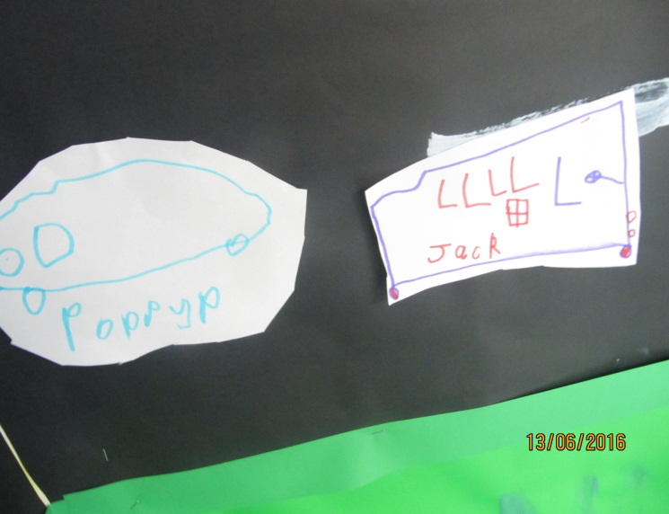
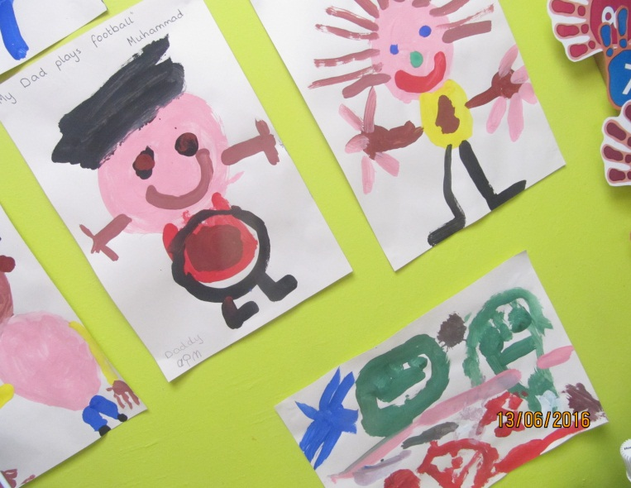
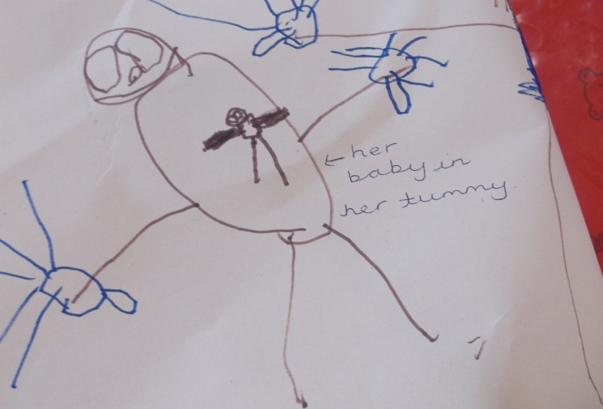
Early Years Curriculum
Prime Areas of Learning
Personal, Social and Emotional Development
Communication and Language Development
Physical Development
Specific Areas of Learning
Literacy
Mathematics
Understanding of the World
Expressive Arts and Design

Slide 13
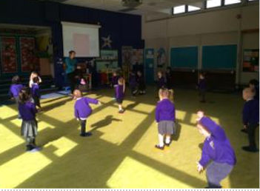
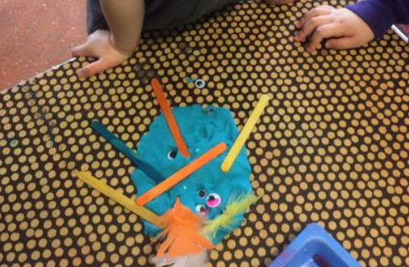
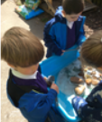
A Typical Day in Nursery
Welcomes and Registration
Carpet times to explore key aspects of the curriculum
Learning through play (Free flow inside & outside)
Milk & Fruit available
Story times
Once a week we go into the hall for PE
Look at the Year Group pages on the school website to see what this year’s Nursery children have enjoyed.

Slide 14
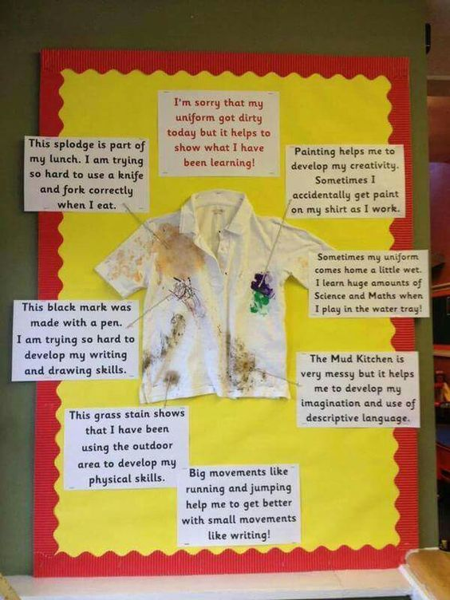

Learning can be messy but fun!

Slide 15
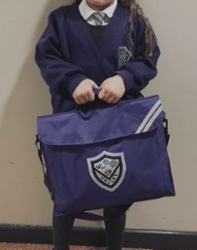
Uniform
Winter Uniform:
Grey skirt, pinafore dress or trousers.
Purple and grey striped school tie (elastic ones best
for Nursery usually).
White shirt/ blouse (no polo shirts).
School logo V neck sweatshirt/ cardigan or plain
purple V neck jumper/ cardigan.
Grey/ white socks or grey tights.
Black flat heeled shoes.
Purple, school logo or plain purple fleece (optional on non PE days)
Purple, grey, black or white head scarf (optional).
Summer Uniform (Summer Term and Autumn First Half term only):
Dress with purple check or smart grey shorts with short sleeved white shirt with logo or with purple and grey striped tie (no polo shirts).
School logo V neck sweatshirt/ cardigan or plain purple V neck jumper/ cardigan.
Grey/ white socks.
Black flat heeled shoes.
Purple summer sun hat or cap (optional).
Purple, grey, black or white head scarf (optional)
N.B. All items of clothing, including shoes, MUST be clearly labelled with your child’s name.
Only stud earrings are permitted.

Slide 16
P.E.
Children in Nursery will have P.E. once a week and we ask that they come to school in their P.E. kits that day.
Nursery P.E. Day will be confirmed first week in September.
On P.E. Days children should wear:
Purple logo polo shirt or plain purple polo shirt.
Black tracksuit bottoms, black gym leggings, black skort or black shorts.
Grey/ white socks.
Plain black trainers.
School logo or plain purple fleece.

Slide 17
What else will children need in Nursery?
Change of clothes and underwear to be kept in a drawstring bag on their peg.
Purple school book bag.
Sensible shoes
A coat in school every day – we go outside every day.
Water bottle.
PLEASE NAME EVERYTHING - Lost Property can only be returned if it is named.
Support with the cost of School Uniform:
Please contact our pastoral team who will be happy to help or signpost the appropriate bodies if you are struggling to afford uniform for your child.
Our pastoral team can be contacted via our parent liaison lead:
parentliaison@valleyprimary.org

Slide 18


Snack Time & Milk
Promoting Healthy Lifestyles
All children receive free fruit and milk.
All children get offered a piece of fruit and a cold milk carton during the morning. There is no need to send in any snacks into school.

Slide 19
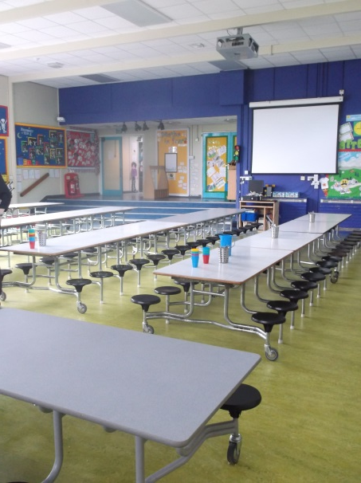
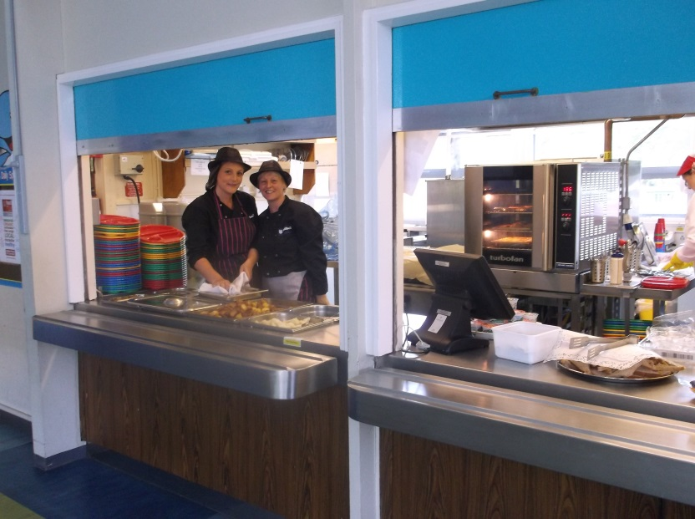
Lunchtime for 30 hour Nursery
30 hour Nursery children can purchase a hot meal (£3.00 per day) or bring a packed lunch from home.
The 30 hour children will have their own Nursery lunch time supervisors to support them in the hall and outside.
Lunches will need to be pre chosen and booked through School Grid. Further information will follow. Menus are saved on our school website. This usually changes termly.

Slide 20
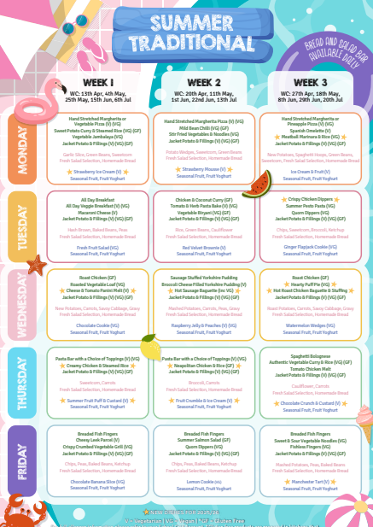
This is what the menu looks like at present.
3 week rotation
The menu caters for:
halal, vegetarian, vegan, gluten free

Slide 21
Home to School Links
Parental support is one of the biggest positive influences on children’s education.
September Curriculum Evening
Individual Learning Journals
Parent consultation meetings
Talk to your child about their day – photographs are added to the year group pages each week to aid your discussions
Curriculum newsletters sent home half termly
Topic home learning tasks
Library books sent home weekly
Express days
Trips/Experiences
We are always here to answer questions and offer support.

Slide 22

Good school attendance will help your child to:
Develop their knowledge of school routines and expectations meaning they will feel comfortable and secure in a new environment.
Develop social skills, friendship groups and positive relationships with staff and children, helping them to feel that they ‘belong’.
Take part in all aspects of the curriculum, building confidence and enjoyment of learning. There is a strong link between attendance and how well children do at school.
Develop their life skills, encouraging good habits for later life.

Slide 23

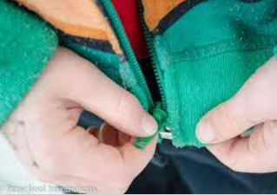
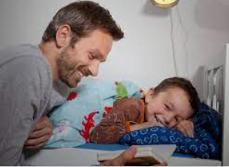
Getting Ready for September
Ways in which parents/carers can help prepare your child for Nursery.
Talk about starting Nursery and walk past the school as often as you can.
Support your child’s self-help skills so they learn to do things for themselves. E.g. using the toilet/ putting on coat.
Talk through your child’s feelings and different emotions.
Establish a good sleep routine – share a bedtime story.
Work through the ‘What children need in Nursery’ slide to ensure that your child has everything and it is named. Familiarise your child with all of their new belongings .

Slide 24
Our Valley Vision
“Learning and growing together to be the best we can be”.
We always…
ASPIRE for excellence
ENJOY learning
ACHIEVE success
CHALLENGE ourselves further.
Thank you
We look forward to beginning and continuing your child’s learning journey together.
10th July 2026 PTFA Summer Fayre
at our Old Lode Lane site
3.30pm - 6.30pm

