Slide 1


Year 6
Curriculum Evening

Slide 2
Year 6 Team
Mrs Curry & Miss Kelly (Ennis 6)
Miss Stock (Farah 6)
Miss Nunes (Simmonds 6)

Slide 3

Encouraging Brilliant Behaviour

Slide 4

VALLEY'S VISION
GROWING AND LEARNING TOGETHER TO BE THE BEST WE CAN BE!
We always…
ASPIRE for excellence
ENJOY learning
ACHIEVE success
CHALLENGE ourselves further.
Notes:
Jon

Slide 5
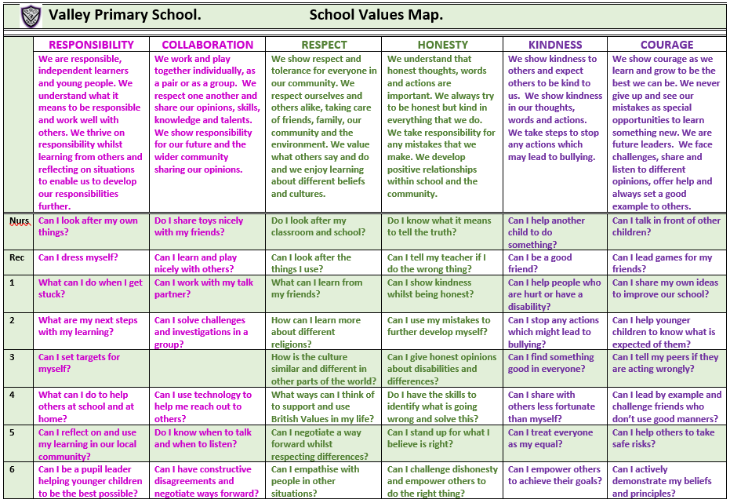
Valley Values
Notes:
David

Slide 6

Valley Life Skills
Valley Primary School. Life Skills Challenges.
 | MENTAL HEALTH MANAGEMENT SKILLS | PHYSICAL HEALTH MANAGEMENT SKILLS | TIME MANAGEMENT SKILLS | DECISION MAKING SKILLS | HOME MANAGEMENT SKILLS | INTERPERSONAL SKILLS
 | We have feelings and thoughts about ourselves and the world around us. These can affect how we cope with life’s challenges and stresses. | We promote growth in confidence and awareness of control. This supports communication and language using large and small movements and gestures to convey messages to others. | We show good time management. This process helps us organise and plan how to divide our time between specific activities. Good time management enables us to work smarter – not harder – so that we get more done in less time. | We promote effective decision making. This involves choosing between possible solutions to a problem. Decisions can be made through either an intuitive or reasoned process or a combination. | We promote good home management skills. This affects how we manage challenges and activities at home. | We think of the behaviours and tactics we use to interact with others effectively. This involves choosing good behaviour when interacting with others.
Nurs | Can I tell people if I am feeling sad, happy, angry, glad or excited? | Can I wash my hands and dry them? | Can I focus on one activity until it is finished? | Can I choose between two options? | Can I put my dirty washing in the washing basket? | Can I share when I am taking turns with my friends?
Rec | Can I say what I am good at? | Can I pick up my rubbish and put it in the bin? | Do I know who to ask for help if I am stuck on a task? | Do I know how to make a decision? | Can I tidy my room? | Can I be a good friend?
1 | Do I know who to go to if I need help? | Can I eat 5 portions of fruit and vegetables per day? | Can I say how I am organised? | Do I know who to go to in school or at home to help me with my decision? | Can I share my toys with a person at home? | Can I work as part of a team?
2 | Can I say what I am most proud of? | Do I know what a balanced diet is? | Can I be good with my time management? | Do I ask a friend if I am stuck? | Do I know how I can help my parents at home? | Do I know the behaviour I should show in class?
3 | Can I say what I enjoy most about being in the classroom? | Do I help myself to relax? | Do I know how to improve my time management? | Can I use my mistakes to further develop my decisions? | Can I recycle things which I have finished with at home? | Do I understand the kind gestures I can use to everyone?
4 | Can I say what I am good at and justify it? | Can I say why exercising is important? | Do I know the different types of equipment I can use to keep track of time? | Do I have the skills to identify what is going wrong and solve this? | Can I set home targets? | Do I understand why good manners are so important?
5 | Do I know why it is important to be a good role model and friend? | Can I have a balanced diet? | Can I give an example of when I show good time management? | Do I choose the easiest choice or the quickest choice? Why? | Do I know how I can be a good role model at home? | Can I help others to behave better?
6 | Can I be a positive role model and friend? | Do I know why it is imperative to wash and dry my hands? | Do I understand why good time management is important? | Can I describe a time when I made a great decision fast? | Can I justify which skills are important and why? | Can I challenge myself at school?
Notes:
David

Slide 7

We are powerful learners…
Resilient Robbie
Reflective Rick
Resourceful Rosie
Reciprocal Ruth

Slide 8
A Typical Day in Year 6
8.40 - Arrival
8.50 - Register
8.55 – Assembly
9.25 – Reading/English
10.45 - Playtime
10.55 – Maths
12.15 – ECaR (Every child a reader)
12.30 – Lunch
1.15 – Register and read aloud
1. 30– Foundation subject lessons - Geography, History, Science, PE, PSHE, Computing, Art, Music, French.
3.30 – Outside for home time

Slide 9
A Typical Day in Year 6
On a Friday, the children finish at 2pm.
Some children will attend enrichment clubs in school.
Those children going home are encouraged to access the brain booster and curious challenge each week.
These can be found on the school website under Children and then Feel-Good Friday or on the Year Group Page under Life Skills Activities.
Please feel free to send in pictures of your children completing these activities to the class email address or send any related notes or artistic creations to school on a Wednesday. We would love to see the fabulous things the children do and share in phase assembly.

Slide 10
English in Year 6
Each English lesson begins with the children having the opportunity to respond to any next steps and improve a sentence through upleveling work.
Power of Reading
Each half term, we will study a text. Power of reading sessions involve reading our text and answering questions on our reading. Our books this year are:
The Last Wild
Ice Trap
The Adventures of Odysseus
The Song From Somewhere Else
Suffragette: The Battle for Equality
Varmints
Pig Heart Boy
English Skills
Children read a section of the book and have time to discuss their understanding, answering questions based on prediction, vocabulary, inference, retrieval and summarising.

Slide 11
English in Year 6
Text types
The children will write for a range of purposes this year including:
Instructions
Newspaper reports
Non-chronological reports
Persuasion
Diary entries
Adventure and mystery narratives
Writing skills
Year six skills including:
Correctly punctuated subordinate clauses​
Relative clauses with correct relative pronouns
Using colons and semicolons for effect
Using dashes, commas and brackets for parenthesis

Slide 12
Spellings
Children will bring home spelling lists that include words to learn for weekly Friday assessments and half termly Wizard words.
Weekly spellings
- Spellings linked to a spelling rule.
- Lists will include up to 10 words and the children will be assessed on 5 of them on a Friday through dictated sentences so that teachers can assess if the children are applying new spellings or need further practise.
- Children will not be given a score at the end of the test but will move up the zone board if they get them all correct.
Wizard words
-These are the common exception words for each year group.
-Divided into half terms.
- The words will be talked about and used in school across the half term and should be learnt at home across the half term.
- All words will be tested at the end of each half term.

Slide 13


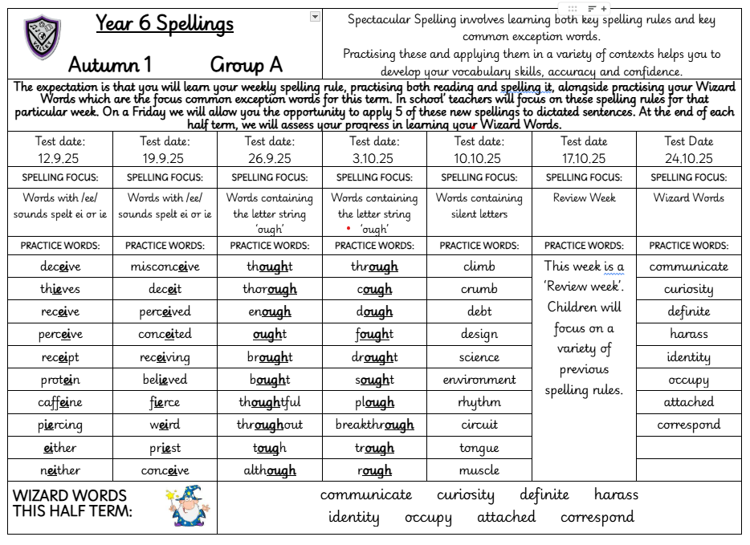
Spelling Sheet

Slide 14
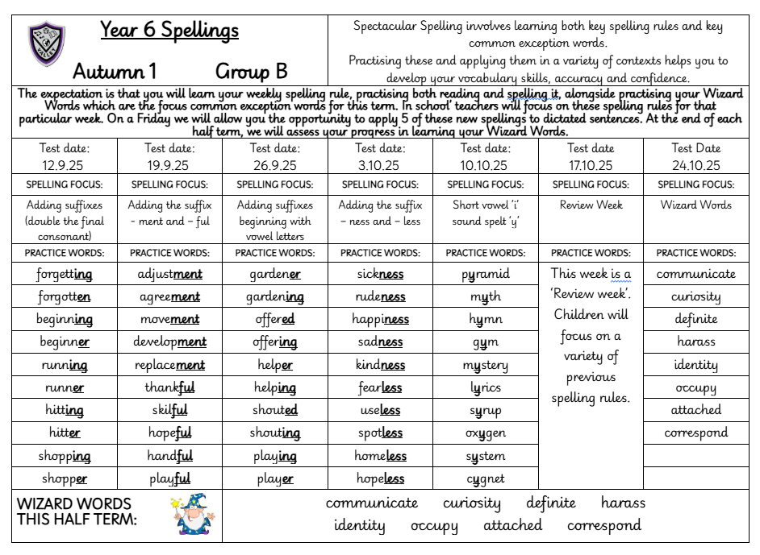

Slide 15
Maths
We follow the White Rose Maths scheme and use this to teach the main areas:
Place Value
Addition and Subtraction
Multiplication and Division
Fractions
Converting Units
Ratio
Algebra
Percentages
Decimals
Measure - perimeter, area, money and time
Geometry – properties of shape, position and direction

Slide 16
Maths
Key Skills
All Maths lessons start with opportunities for retrieval practice
These sessions focus on the areas of place value, addition and subtraction, multiplication and division and shape.
Maths skills sessions are also planned into the day. These include:
Counting and recognising numbers
Mental addition and subtraction
Formal written addition and subtraction skills
Multiplication facts for all times tables
Multiplication and division formal written methods
Recognising shapes and angles
They are designed to enable children to practise skills from the previous and current year and to build children’s confidence in applying the skills taught in lessons.
Each week they have a KIRF session, which supplements the practice they are doing at home and enables them to develop the skill further.

Slide 17
Science in Year 6
 | Autumn 1 | Autumn 2 | Spring 1 | Spring 2 | Summer 1 | Summer 2
Science | Electricity | Animals, including humans | Light | Living things and their habitats |  | Evolution and Inheritance
Notes:
Natasha

Slide 18
The majority of Foundation subjects (apart from MfL) are taught in Gems groups in mixed classes
These are taught on a Monday, Tuesday and Wednesday afternoons.
Gem Groups
Notes:
Jon

Slide 19
Topic
At the beginning of each new unit the children will take part in an ENGAGE event to immerse them in their new learning and excite them.
 | Autumn 1 | Autumn 2 | Spring 1 | Spring 2 | Summer 1 | Summer 2
Topic | I have a dream | Mysterious Maya | Our future world | Kingdom on the Nile |  | Amazing Amazonia
At the end of each unit the children will take part in an EXPRESS activity where they will be given the opportunity to share their learning in a variety of ways.
Notes:
Natasha

Slide 20
PE – in PE children will study gymnastics, dance, cricket, tag rugby, athletics, hockey, swimming and outdoor and adventurous activities which includes team building exercises.
The children will also complete a unit on ball skills which will build on skills from previous years and also work on fundamental skills such as balancing and coordination.
The children have 2 PE lessons a week
Please ensure that any earrings are covered or removed on PE days.
Please ensure that your child comes to school in their PE kit – plain black trainers, black bottoms (jogging bottoms or appropriate shorts depending on the weather), purple PE top and purple fleece.
Pumps will be kept in school in a drawstring bag to change into for indoor sessions. Please name all items.
Other Curriculum Opportunities
Notes:
Jon

Slide 21
RE: The children will learn about Christianity and Islam.
PSHE: We use the jigsaw scheme to help us teach the children about responsibility, hopes and dreams, making healthy choices, getting on and falling out and growing-up.
Other Curriculum Opportunities
Notes:
Jon

Slide 22
Computing – In computing, the children will have the opportunity to study coding, online safety, Google slides, databases, concept maps and 3D modelling.
Music – We use the Charanga scheme of work. The children will have the opportunity to study classic rock music, pop music and hip hop. Pupils will have the chance to use keyboards this year.
MFL – French: In French, the children will learn basic language skills.
We will also provide opportunities to develop eco-awareness and outdoor skills throughout the curriculum.
Other Curriculum Opportunities
Notes:
Jon

Slide 23
KS2 SATS for year 6 will take place from Monday 11th May to Thursday 14th May 2026.
The SATs timetable typically looks like this.
This Year’s Assessments
Date of Assessment | Assessment name
Monday 11th May 2026 | Spelling, Punctuation and Grammar – Paper 1 Spelling, Punctuation and Grammar – Paper 2
Tuesday 12th May 2026 | English Reading
Wednesday 13th May 2026 | Maths Paper 1 (Arithmetic) Maths Paper 2 (Reasoning)
Thursday 14th May 2026 | Maths Paper 3 (Reasoning)
Notes:
Jon

Slide 24
Reading– it is crucial your child reads most nights. This can just be a small amount but will really help them develop their skills and widen their vocabulary and understanding.
It is very helpful if you can ask them to discuss their reading or ask them specific questions about what they have read.
Stickers are given at the end of every double page completed in their reading diaries alongside a house point. This year, we are continuing to give extra house points for every multiple of 10 books read. E.g 10 books = 10 house points, 20 books = 20 house points, 30 books = 30 house points etc. This should be recorded on the inside covers of the reading diaries.
WE EXPECT EVERY CHILD TO READ AT LEAST 3 TIMES PER WEEK FOR A MINIMUM OF 10 MINUTES EACH TIME AND FOR THIS TO BE NOTED IN THEIR READING DIARIES BY AN ADULT.
English
Homework
Notes:
Jon

Slide 25
​
2) Spellings - it is vital your child practises these to help them develop their vocabulary skills, accuracy and confidence when writing/decoding. Each week, they will focus on a spelling rule and have a list of words which use that rule to help them practise.
Children will be given dictated sentences to apply a selection of these on a Friday and will be rewarded for learning the key rule with house points and the chance to move up the zone board if they get them all correct.
Alongside this, they will have Wizard Words which are common exception words they should practise throughout the term ready for their Wizard Word Activity to test these at the end of term.
WE EXPECT EVERY CHILD TO PRACTISE IN DIFFERENT WAYS AT LEAST 3 TIMES PER WEEK FOR A MINIMUM OF 5 MINUTES EACH TIME. ​
English
Homework
Notes:
Jon

Slide 26
3) Times Table Rock Stars– An optional activity will be set for the children to complete in order to practice their times tables. Children will be moved up the zone board for doing this and be celebrated in assembly on a Friday.
4) KIRFs – Key Instant Recall Facts.
Each half term, we choose a different focus and ask you to help us to encourage your child to learn their key instant recall facts. We will be testing the children every Friday through 5 questions to ascertain how the children are progressing with their learning. We use the 6 second rule set by the government for the Times Tables Test to define whether recall is instant, so please do encourage your child to answer quickly.
Again, we will be moving children up the zone board if they get all questions correct.
WE ASK EVERY CHILD TO SPEND 3 x 10 MINUTES EACH WEEK ON THEIR KIRF AT REGULAR PLUS COMPLETE ONE OF THE CHALLENGES FROM THE KIRF SHEET.
Maths
Homework
Notes:
Jon

Slide 27
Topic Home Learning – A choice of suggested cross curricular tasks will be sent home at the beginning of each topic. Please encourage your child to complete as many tasks as possible. We encourage all children to bring in their work for their class to celebrate on a Wednesday. Each piece of completed work will be rewarded with house points and may be shown in Phase assembly.
Class teachers will decide if a piece of work is worth a merit or a distinction. For a merit, 5 house points will be awarded and for a distinction 10 house points will be awarded.
Wider Curriculum Homework
Notes:
Jon

Slide 28
2) Life Skills Activities – A focus Life Skill will be set each half term and your child is encouraged to try and demonstrate the skill during the half term. We encourage children to bring in evidence of this for their class to celebrate and each half term, a child will be chosen as life skill champion and receive a gold star badge.
3) Curious Challenges and Brain Boosters – As part of our Feel-Good Friday, a suggested Curious Challenge and Brain Booster are set each week for your child to choose to complete at home. You can encourage your child to complete these tasks during our early Friday finish or during the weekend and
bring photographs or artistic creations/ notes from these into school on a Wednesday to show in Phase
Assembly.
Wider Curriculum Homework
Notes:
Jon

Slide 29
Please ensure that all items from home are named so they can be returned should your child misplace them.
Reading books should be in school every day. Books will be changed once an adult has signed the reading diary and the child has answered a question about their reading to demonstrate their understanding.
Please ensure your child has their water bottle in school every day with water in. They may bring in a separate drink for lunchtimes.
Should you have any queries or need to speak to your child’s teacher, please email using the class email address or ring the school office and request for a telephone call home. You can also contact the parent liaison lead should you prefer or have any whole school concerns or feedback. Add bullet points
Further Information
Notes:
Jon

Slide 30
Thank you for taking the time to come to our Curriculum Evening Presentation. We hope you found it useful.
Does anyone have any questions?

