Slide 1


Year 4 & Year 5
Curriculum Evening
Notes:
David

Slide 2
Year 4 Team
Miss Avery – Hawking 4
Mr Hilditch – Newton 4
Mr Mitchell – Sharman 4
Notes:
David

Slide 3
Year 5 Team
Mr Martindale – Holst 5
Mrs Sandford – Lynn 5
Mrs O’Boyle – Webber 5
Notes:
David

Slide 4

Encouraging Brilliant Behaviour
Notes:
SO’B

Slide 5

VALLEY'S VISION
GROWING AND LEARNING TOGETHER TO BE THE BEST WE CAN BE!
We always…
ASPIRE for excellence
ENJOY learning
ACHIEVE success
CHALLENGE ourselves further.
Notes:
Jon

Slide 6
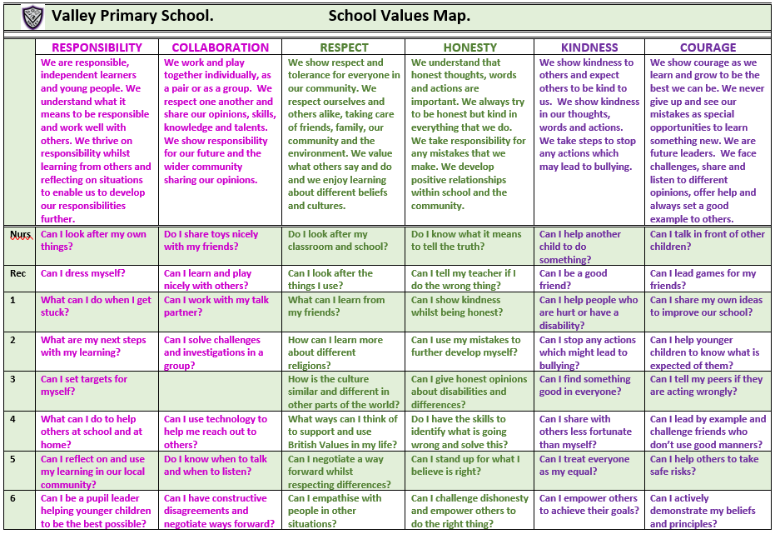
Valley Values
Notes:
David

Slide 7

Valley Life Skills
Valley Primary School. Life Skills Challenges.
 | MENTAL HEALTH MANAGEMENT SKILLS | PHYSICAL HEALTH MANAGEMENT SKILLS | TIME MANAGEMENT SKILLS | DECISION MAKING SKILLS | HOME MANAGEMENT SKILLS | INTERPERSONAL SKILLS
 | We have feelings and thoughts about ourselves and the world around us. These can affect how we cope with life’s challenges and stresses. | We promote growth in confidence and awareness of control. This supports communication and language using large and small movements and gestures to convey messages to others. | We show good time management. This process helps us organise and plan how to divide our time between specific activities. Good time management enables us to work smarter – not harder – so that we get more done in less time. | We promote effective decision making. This involves choosing between possible solutions to a problem. Decisions can be made through either an intuitive or reasoned process or a combination. | We promote good home management skills. This affects how we manage challenges and activities at home. | We think of the behaviours and tactics we use to interact with others effectively. This involves choosing good behaviour when interacting with others.
Nurs | Can I tell people if I am feeling sad, happy, angry, glad or excited? | Can I wash my hands and dry them? | Can I focus on one activity until it is finished? | Can I choose between two options? | Can I put my dirty washing in the washing basket? | Can I share when I am taking turns with my friends?
Rec | Can I say what I am good at? | Can I pick up my rubbish and put it in the bin? | Do I know who to ask for help if I am stuck on a task? | Do I know how to make a decision? | Can I tidy my room? | Can I be a good friend?
1 | Do I know who to go to if I need help? | Can I eat 5 portions of fruit and vegetables per day? | Can I say how I am organised? | Do I know who to go to in school or at home to help me with my decision? | Can I share my toys with a person at home? | Can I work as part of a team?
2 | Can I say what I am most proud of? | Do I know what a balanced diet is? | Can I be good with my time management? | Do I ask a friend if I am stuck? | Do I know how I can help my parents at home? | Do I know the behaviour I should show in class?
3 | Can I say what I enjoy most about being in the classroom? | Do I help myself to relax? | Do I know how to improve my time management? | Can I use my mistakes to further develop my decisions? | Can I recycle things which I have finished with at home? | Do I understand the kind gestures I can use to everyone?
4 | Can I say what I am good at and justify it? | Can I say why exercising is important? | Do I know the different types of equipment I can use to keep track of time? | Do I have the skills to identify what is going wrong and solve this? | Can I set home targets? | Do I understand why good manners are so important?
5 | Do I know why it is important to be a good role model and friend? | Can I have a balanced diet? | Can I give an example of when I show good time management? | Do I choose the easiest choice or the quickest choice? Why? | Do I know how I can be a good role model at home? | Can I help others to behave better?
6 | Can I be a positive role model and friend? | Do I know why it is imperative to wash and dry my hands? | Do I understand why good time management is important? | Can I describe a time when I made a great decision fast? | Can I justify which skills are important and why? | Can I challenge myself at school?
Notes:
David

Slide 8

We are powerful learners…
Resilient Robbie
Reflective Rick
Resourceful Rosie
Reciprocal Ruth
Notes:
EA

Slide 9
A Typical Day in Year 4 & Year 5
8.40 - Arrival and Activate
8.50 - Register
8.55 – Assembly/Multiplication Activities
9.25 – Reading
9.45 - English
10.45 - Playtime
10.55 – Maths
12.15 – ECaR (Every child a reader)
12.30 – Lunch
1.15 – Register and read aloud
1.25 – Afternoon foundation subject lessons - Geography, History, Science, PE, PSHE, Computing, Art, Music, French.
3.30 – Outside for home time
Notes:
SO’B

Slide 10
A Typical Day in Year 4 & Year 5
On a Friday, the children finish at 2pm.
Some children will attend enrichment clubs in school.
Those children going home are encouraged to access the brain booster and curious challenge each week.
These can be found on the school website under Children and then Feel-Good Friday or on the Year Group Page under Life Skills Activities.
Please feel free to send in pictures of your children completing these activities to the class email address or send any related notes or artistic creations to school on a Wednesday. We would love to see the fabulous things the children do and share in phase assembly.
Notes:
SO’B

Slide 11
English in Year 4
Each English lesson begins with the children having the opportunity to respond to any next steps and improve a sentence through upleveling work.
Power of Reading
We have six power of reading books we will study this year:
Iron Man
The Wild Robot
The Lion, the Unicorn and other Hairy Tales
Arthur and the Golden Rope
Bluest of Blues
Varjak Paw
Notes:
TM

Slide 12
English in Year 4
Key Skills - Writing
We teach our English through these texts and the key skills for year 4 are:
Expanded noun phrases
Writing in different tenses
Using speech punctuation
Apostrophes for plurals and possession
Subordinate clauses
Key Skills – Reading
These are taught daily through our Power of Reading sessions.
These cover how:
To discuss and compare books from a variety of genres.
To understand how language, text structure and presentation affect meaning.
To infer a character's thought and feelings.
Notes:
EA- Writing
T M- Reading

Slide 13
English in Year 5
Each English lesson begins with the children having the opportunity to respond to any next steps and improve a sentence through up-levelling work.
Power of Reading this year are:
Cosmic
Skellig
The Journey
Boy in the Girl’s Bathroom
Rooftoppers
Tom’s Midnight Garden
English Skills
Children read a section of the book and have time to discuss their understanding, answering questions based on prediction, vocabulary, inference, retrieval and summarising.
Notes:
AS

Slide 14
English in Year 5
The children will write for a range of purposes this year including:
Instructions
Newspaper reports
Formal and Informal Letters
Non-chronological reports
Persuasion
Diary entries
Adventure and Mystery narratives
Writing skills
Year 5 skills include:
Correctly punctuated multi-clause sentences​
Relative clauses with correct relative pronouns
Using varied, correctly punctuated sentence openers
Using correct punctuation for direct speech
Punctuation for parenthesis (, - - : )
Experimenting with a range of adverbs
Notes:
SO’B

Slide 15
Spellings
Children will bring home spelling lists that include words to learn for weekly Friday assessments and half termly Wizard words.
Weekly spellings
- Spellings linked to a spelling rule.
- Lists will include up to 10 words and the children will be assessed on 5 of them on a Friday through dictated sentences so that teachers can assess if the children are applying new spellings or need further practise.
- Children will not be given a score at the end of the test but will move up the zone board if they get them all correct.
Wizard words
-These are the common exception words for each year group.
-Divided into half terms.
- The words will be talked about and used in school across the half term and should be learnt at home across the half term.
- All words will be tested at the end of each half term.
Notes:
SO’B

Slide 16


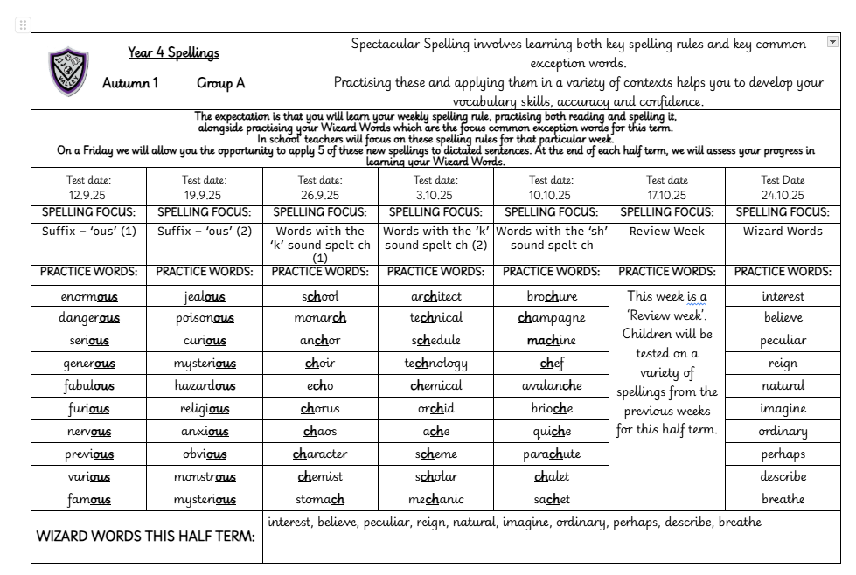
Spelling Sheet
Notes:
SO’B

Slide 17
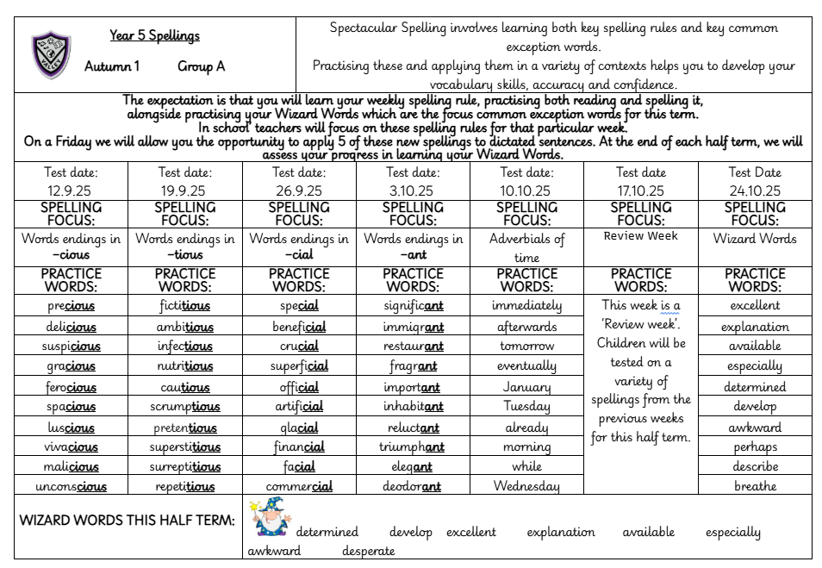
Notes:
SO’B

Slide 18
Maths
We follow the White Rose Maths scheme and use this to teach the main areas:
Place Value
Addition and Subtraction
Multiplication and Division
Fractions
Decimals
Measure - perimeter, area, money and time
Geometry – shape, position and direction
Notes:
David

Slide 19
Maths
Key Skills
All Maths lessons start with opportunities for retrieval practice
These sessions focus on the areas of place value, addition and subtraction, multiplication and division and shape.
Maths skills sessions are also planned into the day. These include:
Counting and recognising numbers
Mental addition and subtraction
Formal written addition and subtraction skills
Multiplication facts for all times tables
Multiplication and division formal written methods
Recognising shapes and angles
They are designed to enable children to practise skills from the previous and current year and to build children’s confidence in applying the skills taught in lessons.
Each week they have a KIRF session, which supplements the practice they are doing at home and enables them to develop the skill further.
Notes:
David

Slide 20
Science
Year 4
 | Autumn 1 | Autumn 2 | Spring 1 | Spring 2 | Summer 1 | Summer 2
Science | Living Things and their Habitats | Electricity | States of Matter | Animals, including humans (Digestion) |  | Sound
Children will take part in practical investigations to gain a deeper understanding of concepts.
Notes:
AS

Slide 21
Science in Year 5
 | Autumn 1 | Autumn 2 | Spring 1 | Spring 2 | Summer 1 | Summer 2
Science | Properties of Materials | Forces | Earth & Space | Living Things |  | Animals including Humans (how we grow)
Children will take part in practical investigations to gain a deeper understanding of concepts.
Notes:
AS

Slide 22
The majority of Foundation subjects (apart from MfL) are taught in Gems groups with mixed Year 4 and 5 classes
These are taught on a Tuesday, Wednesday and Thursday afternoons
Guitars and swimming are also taught in Gems Groups in rotation across the year.
Gem Groups
Notes:
David

Slide 23
Topic
At the beginning of each new unit the children will take part in an ENGAGE event to immerse them in their new learning and excite them.
 | Autumn 1 | Autumn 2 | Spring 1 | Spring 2 | Summer 1 | Summer 2
Topic | Viking Invaders | Ground breaking Greeks | Urban Influence | Keep the home fires burning |  | On top of the world
At the end of each unit the children will take part in an EXPRESS activity where they will be given the opportunity to share their learning in a variety of ways.
Notes:
Natasha?
EA & AS

Slide 24
PE – in PE children will study gymnastics, dance, cricket, tag rugby, athletics, hockey, swimming and outdoor and adventurous activities which includes team building exercises.
The children will also complete a unit on ball skills which will build on skills from previous years and also work on fundamental skills such as balancing and coordination.
The children have 2 PE lessons a week – During the year, one of these lessons will be swimming.
Please ensure that any earrings are covered or removed on PE days.
Please ensure that your child comes to school in their PE kit – plain black trainers, black bottoms (jogging bottoms or appropriate shorts depending on the weather), purple PE top and purple fleece.
Pumps will be kept in school in a drawstring bag to change into for indoor sessions. Please name all items.
Other Curriculum Opportunities
Notes:
Jon

Slide 25
RE: The children will learn about Christianity and Sikhism.
PSHE: We use the jigsaw scheme to help us teach the children about responsibility, hopes and dreams, making healthy choices, getting on and falling out and growing-up.
Other Curriculum Opportunities
Notes:
Jon

Slide 26
Computing – In computing, the children will have the opportunity to study coding, online safety, Google slides, databases, concept maps and 3D modelling.
Music – We use the Charanga scheme of work. The children will have the opportunity to study classic rock music, pop music and hip hop. Children will have the opportunity to play the guitar during their time in Year 5.
MFL – French: In French, the children will learn basic language skills.
The topics in Year 4 relate to weather, holidays and leisure and describing where you live and in Year 5 relate to Ourselves, School Life and Home and Family
We will also provide opportunities to develop eco-awareness and outdoor skills throughout the curriculum.
Other Curriculum Opportunities
Notes:
Jon

Slide 27
In year 4, the children must complete the Multiplication Tables Check.
The Multiplication Tables Check (MTC) is a key stage 2 assessment to be taken by pupils at the end of year 4 (in June).
The purpose of the MTC is to make sure the times tables knowledge is at the expected level.
The MTC is an online test where the pupils are asked 25 questions on times tables 2 to 12. For every question you have 6 seconds to answer and in between the questions there is a 3 second rest.
Questions about the 6, 7, 8, 9, and 12 times tables appear often. The questions are generated randomly based on the rules of the MTC.
A good way to prepare is to start early and build a regular routine practising the times tables. This can be done using times tables rock stars ‘Soundcheck’ game and other games.
This Year’s Assessments
Notes:
Jon

Slide 28
Reading– it is crucial your child reads most nights. This can just be a small amount but will really help them develop their skills and widen their vocabulary and understanding.
It is very helpful if you can ask them to discuss their reading or ask them specific questions about what they have read.
Stickers are given at the end of every double page completed in their reading diaries alongside a house point. This year, we are continuing to give extra house points for every multiple of 10 books read. E.g 10 books = 10 house points, 20 books = 20 house points, 30 books = 30 house points etc. This should be recorded on the inside covers of the reading diaries.
WE EXPECT EVERY CHILD TO READ AT LEAST 3 TIMES PER WEEK FOR A MINIMUM OF 10 MINUTES EACH TIME AND FOR THIS TO BE NOTED IN THEIR READING DIARIES BY AN ADULT.
English
Homework
Notes:
Jon

Slide 29
​
2) Spellings - it is vital your child practises these to help them develop their vocabulary skills, accuracy and confidence when writing/decoding. Each week, they will focus on a spelling rule and have a list of words which use that rule to help them practise. Children will be given dictated sentences to apply a selection of these on a Friday and will be rewarded for learning the key rule with house points and the chance to move up the zone board if they get them all correct. Alongside this, they will have Wizard Words which are common exception words they should practise throughout the term ready for their Wizard Word Activity to test these at the end of term.
WE EXPECT EVERY CHILD TO PRACTISE IN DIFFERENT WAYS AT LEAST 3 TIMES PER WEEK FOR A MINIMUM OF 5 MINUTES EACH TIME. ​
English
Homework
Notes:
Jon

Slide 30
3) Times Table Rock Stars– An optional activity will be set for the children to complete in order to practice their times tables. Children will be moved up the zone board for doing this and be celebrated in assembly on a Friday.
4) KIRFs – Key Instant Recall Facts.
Each half term, we choose a different focus and ask you to help us to encourage your child to learn their key instant recall facts. We will be testing the children every Friday through 5 questions to ascertain how the children are progressing with their learning. We use the 6 second rule set by the government for the Times Tables Test to define whether recall is instant, so please do encourage your child to answer quickly.
Again, we will be moving children up the zone board if they get all questions correct.
WE ASK EVERY CHILD TO SPEND 3 x 10 MINUTES EACH WEEK ON THEIR KIRF AT REGULAR PLUS COMPLETE ONE OF THE CHALLENGES FROM THE KIRF SHEET.
Maths
Homework
Notes:
David

Slide 31
Topic Home Learning – A choice of suggested cross curricular tasks will be sent home at the beginning of each topic. Please encourage your child to complete as many tasks as possible. We encourage all children to bring in their work for their class to celebrate on a Wednesday. Each piece of completed work will be rewarded with house points and may be shown in Phase assembly.
Class teachers will decide if a piece of work is worth a merit or a distinction. For a merit, 5 house points will be awarded and for a distinction 10 house points will be awarded.
Wider Curriculum Homework
Notes:
David

Slide 32
2) Life Skills Activities – A focus Life Skill will be set each half term and your child is encouraged to try and demonstrate the skill during the half term. We encourage children to bring in evidence of this for their class to celebrate and each half term, a child will be chosen as life skill champion and receive a gold star badge.
3) Curious Challenges and Brain Boosters – As part of our Feel-Good Friday, a suggested Curious Challenge and Brain Booster are set each week for your child to choose to complete at home. You can encourage your child to complete these tasks during our early Friday finish or during the weekend and
bring photographs or artistic creations/ notes from these into school on a Wednesday to show in Phase
Assembly.
Wider Curriculum Homework
Notes:
David

Slide 33
Please ensure that all items from home are named so they can be returned should your child misplace them.
Reading books should be in school every day. Books will be changed once an adult has signed the reading diary and the child has answered a question about their reading to demonstrate their understanding.
Please ensure your child has their water bottle in school every day with water in. They may bring in a separate drink for lunchtimes.
Should you have any queries or need to speak to your child’s teacher, please email using the class email address or ring the school office and request for a telephone call home. You can also contact the parent liaison lead should you prefer or have any whole school concerns or feedback. Add bullet points
Further Information
Notes:
David

Slide 34
Thank you for taking the time to come to our Curriculum Evening Presentation. We hope you found it useful.
Does anyone have any questions?

