Slide 1
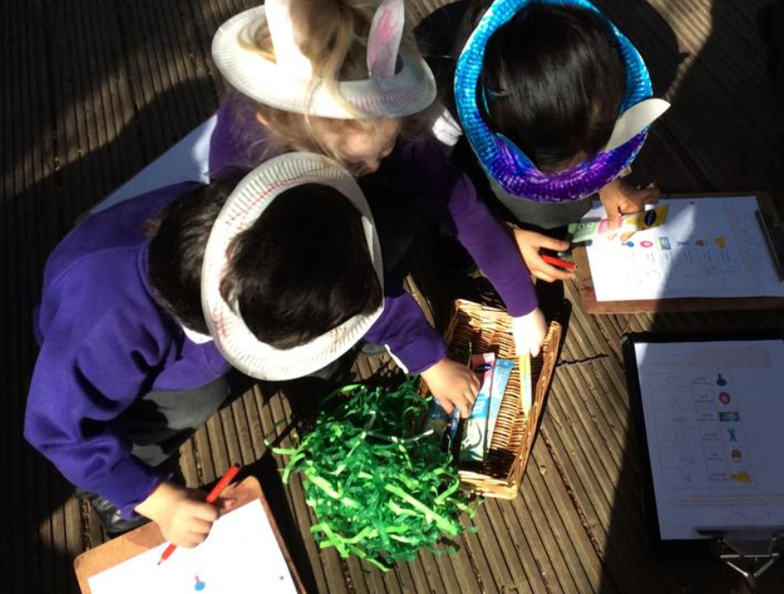

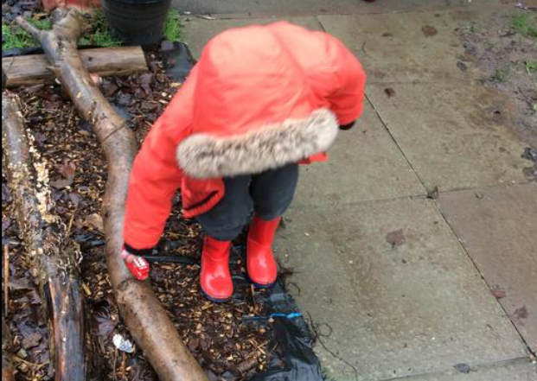
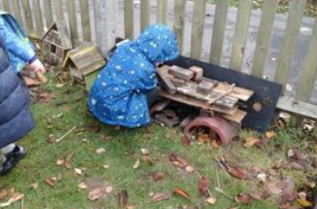
Reception
Welcome Meeting
Tuesday 3rd June 2025
6.00 P.M.

Slide 2

GROWING AND LEARNING TOGETHER TO BE THE BEST WE CAN BE!
We always…
ASPIRE for excellence
ENJOY learning
ACHIEVE success
CHALLENGE ourselves further.

Slide 3
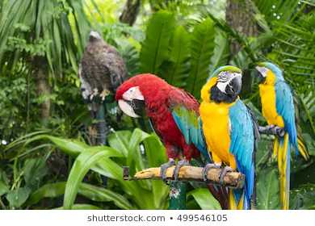
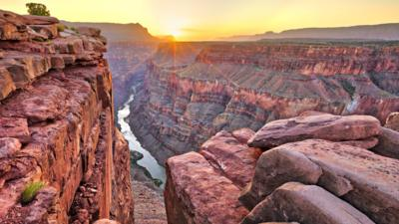
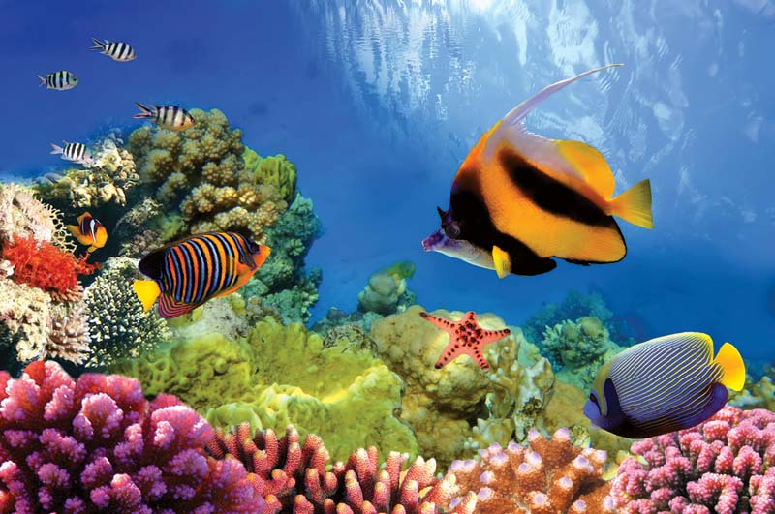
House Points…
Amazon Rainforest (Green)
Grand Canyon (Red)
Great Barrier Reef (Blue)
All our children try and earn house points.
House points are given for great work, living our values and being kind.
A House reward is given at the end of each half term for the winning house.

Slide 4

Valley Values

Slide 5
Admission Arrangements
Step 1. Today’s Welcome to Reception Meeting. Polite reminder that you were asked to bring your child’s birth certificate to the school office. If you have not yet done so, please present this ASAP to secure your place.
Step 2. A parent / teacher information sharing sheet was emailed to you. If you have not emailed it or brought it with you this evening, please bring it to the school office ASAP. There are spare copies to collect.
Step 3. You are invited to a Stay and Play session on Wednesday 2nd July.
Girls are invited 9am-10am
Boys are invited 10.30am – 11.30am.
Valley Nursery will be closed on the 2nd July so current Nursery children should only attend for their Stay and Play session.

Slide 6
Phased start in September
Monday 1st INSET day – School closed
Tuesday 2nd and Wednesday 3rd Girls – 9.00 – 11.00
Boys – 1.00 – 3.00
Thursday 4th All children - 8.30 - 11.45
Friday 5th 8.30 - 13.00 (including lunch)
Monday 8th - all in - normal hours - Explorers commence.

Slide 7
Times from Monday 8th September
From Monday 8th September: All children in for normal hours from this point onwards. Please note that school finishes at 1.50 p.m. on Fridays.
Monday – Thursday
Drop off 8.30a.m. Collection time 3.20p.m.
Before and after school childcare is available at a cost. Please contact the school office for more details.
*Please note that Collection time on Friday is always 1.50p.m.

Slide 8
The Reception Classes
We have three Reception classes:
Aston R
Grylls R
Peake R
However, the children and staff mix across all of the classrooms and the outdoor area.
Children will also be give Gem Groups (Emerald, Ruby, Diamond, Sapphire or Pearl)
for carpet sessions some afternoons.

Slide 9
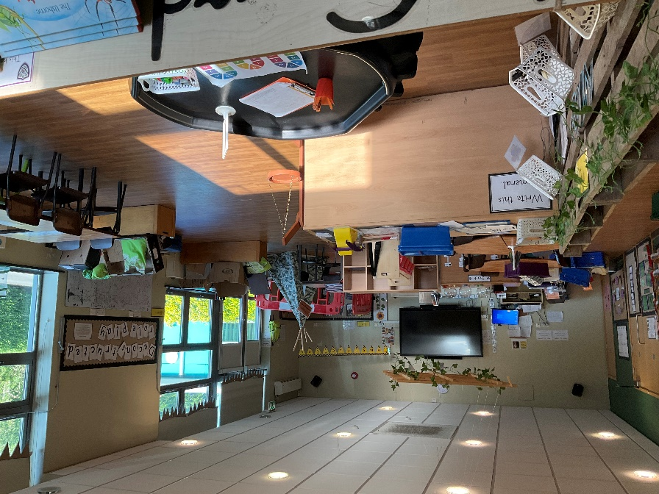
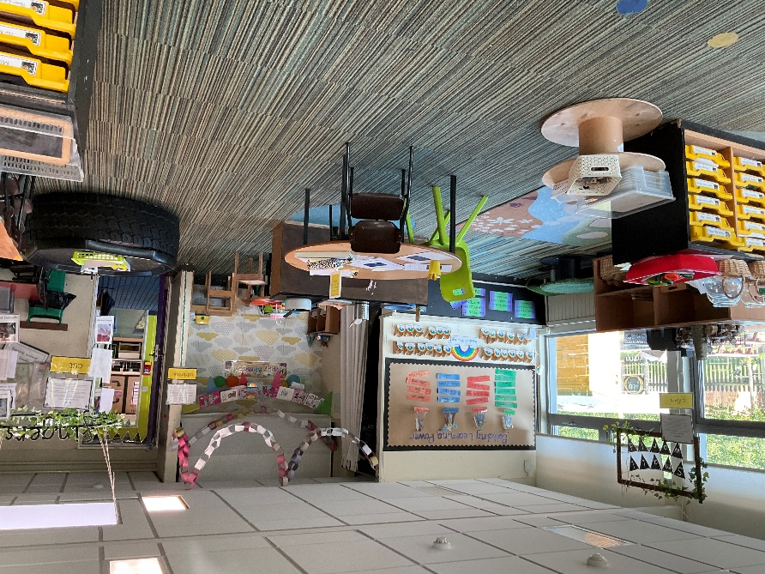
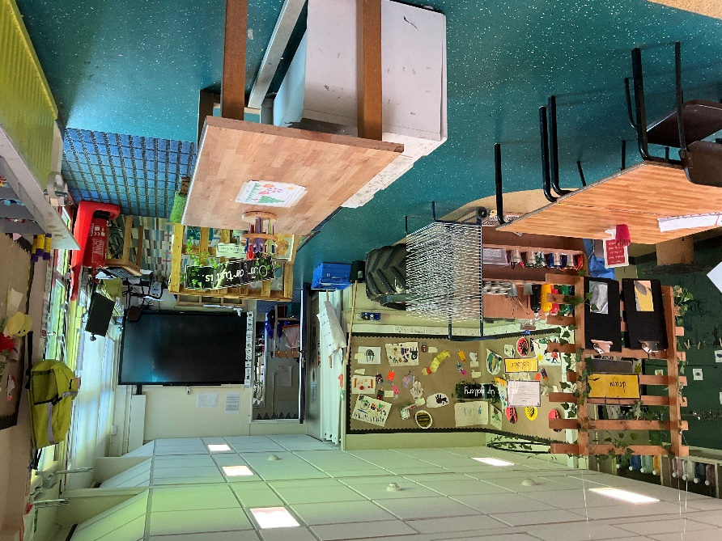
Our Classrooms

Slide 10
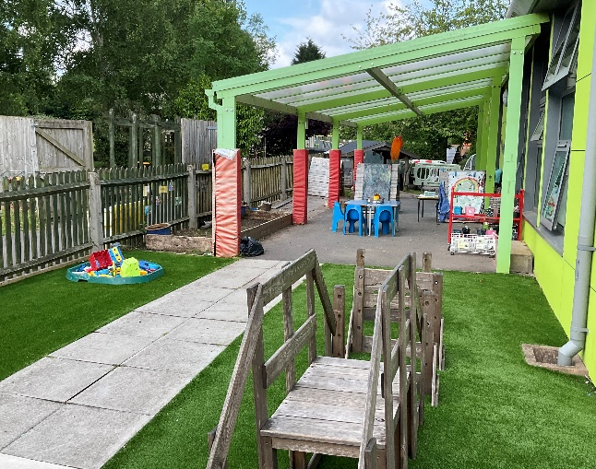
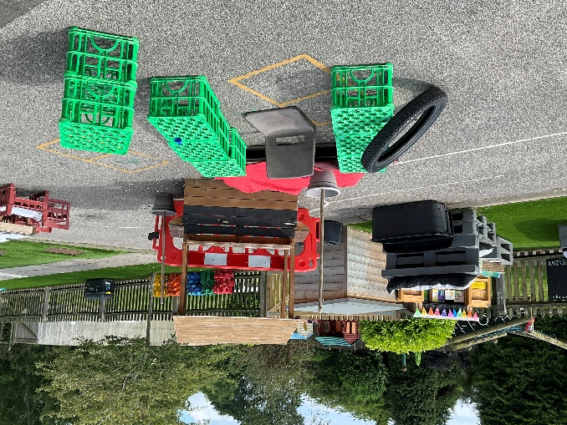
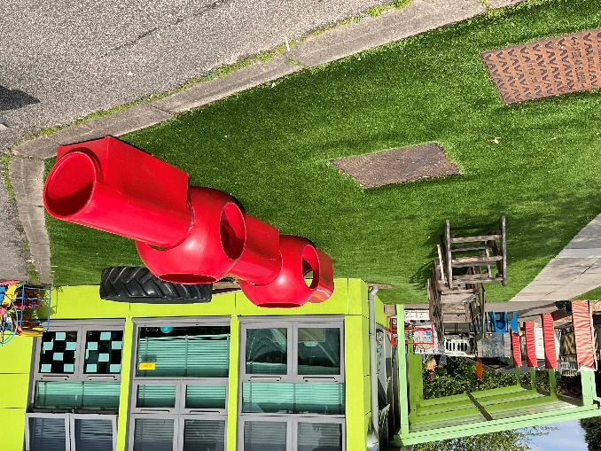
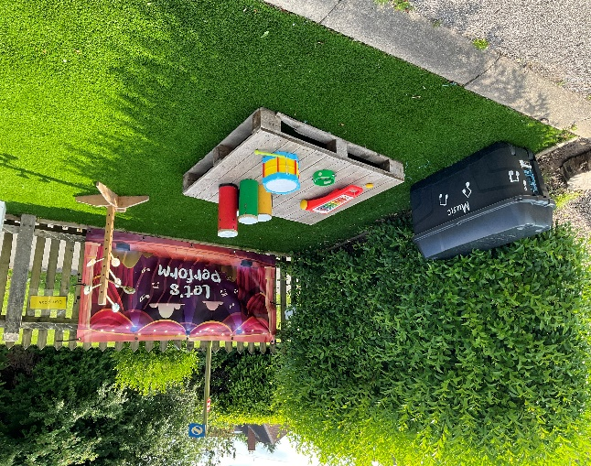
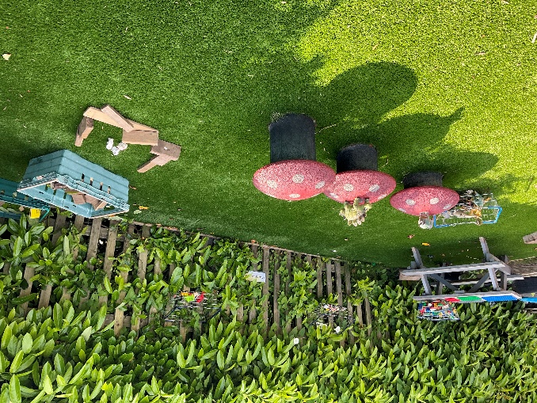
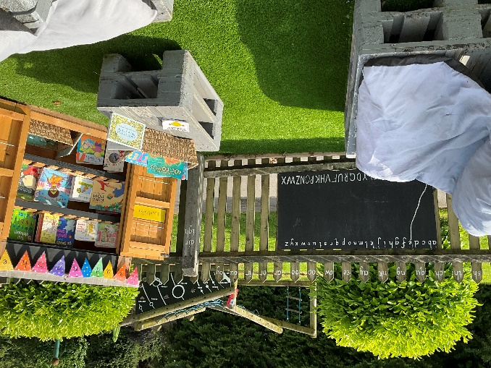
Outside Area
“The best classroom and cupboard is roofed only by the sky.” Margaret McMillan

Slide 11
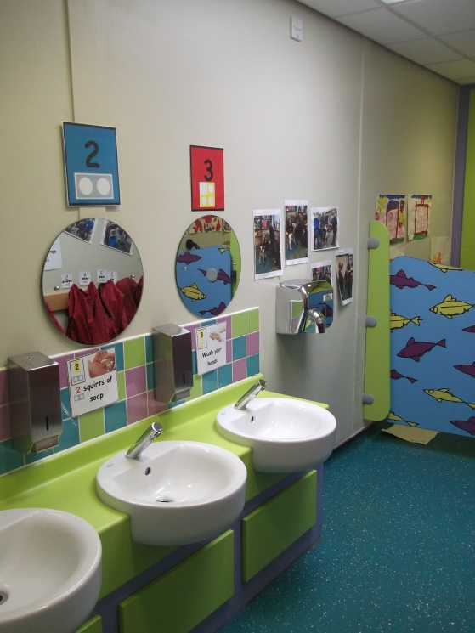
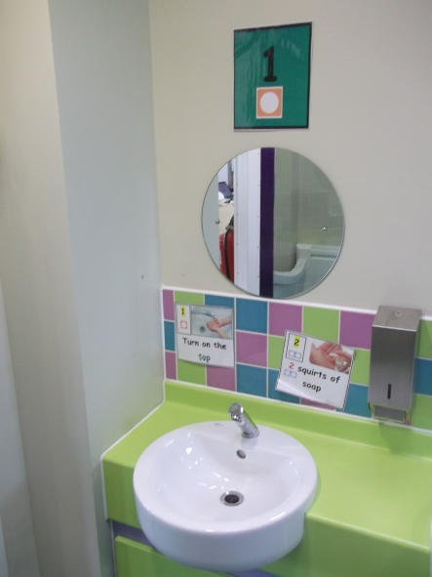
Toilets
Child friendly toilets
Support your child over the summer to become independent when going to the toilet
Accidents happen
Please provide spare clothes and underwear in a purple or black drawstring bag.

Slide 12
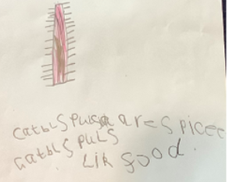
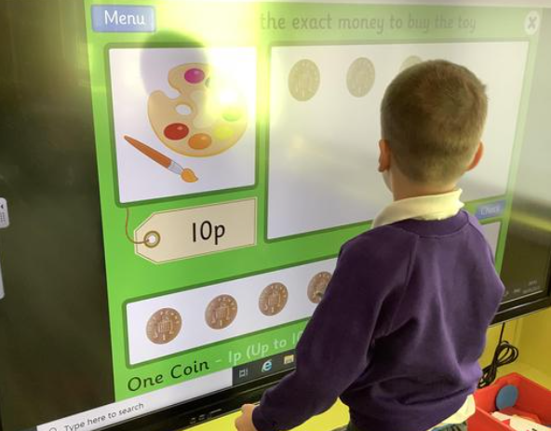
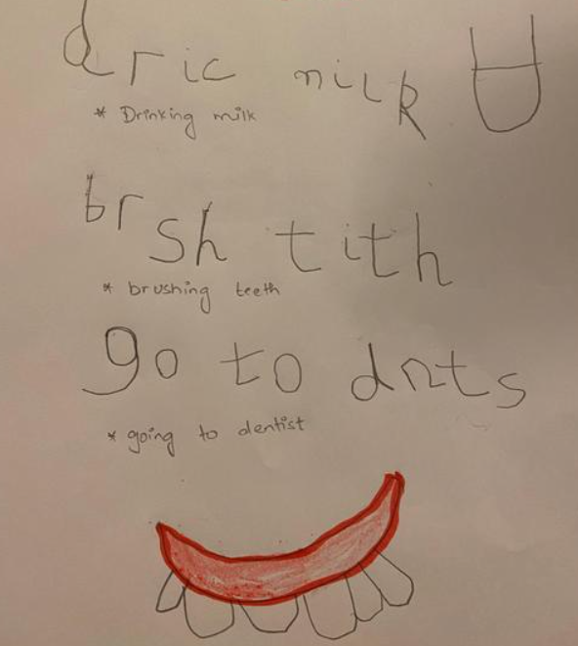
Early Years Curriculum
Prime Areas of Learning
Personal, Social and Emotional Development
Communication and Language Development
Physical Development
Specific Areas of Learning
Literacy
Mathematics
Understanding of the World
Expressive Arts and Design

Slide 13
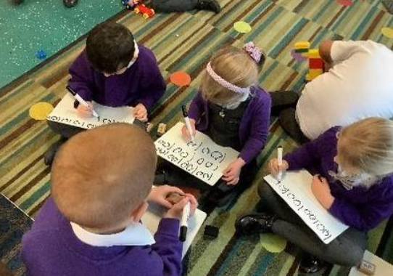
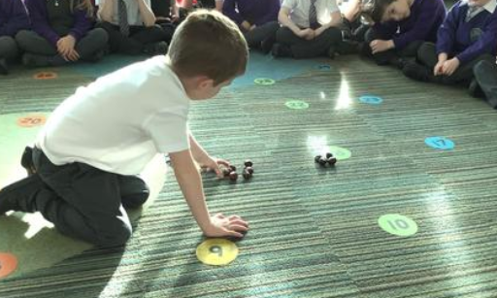
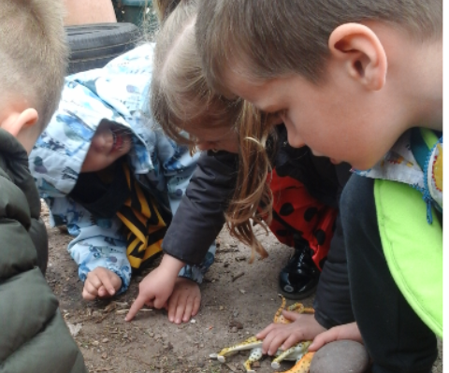
A Typical Day in Reception
Welcome and Registration
Carpet times to explore key aspects of the curriculum
Focus activities with a teacher
Learning through play (Free flow inside & outside)
Additional Rainbow Challenges to complete over the week
Milk & Fruit available
Story times
Once a week we go into the hall for PE
Look at the Year Group pages on the school website to see what this year’s Reception children have enjoyed.

Slide 14
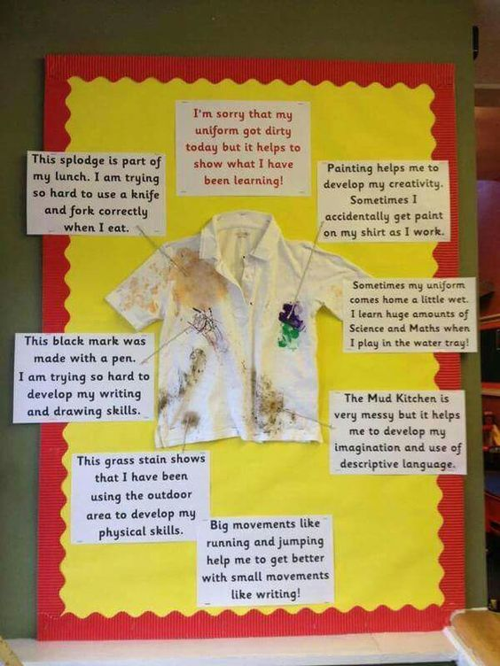
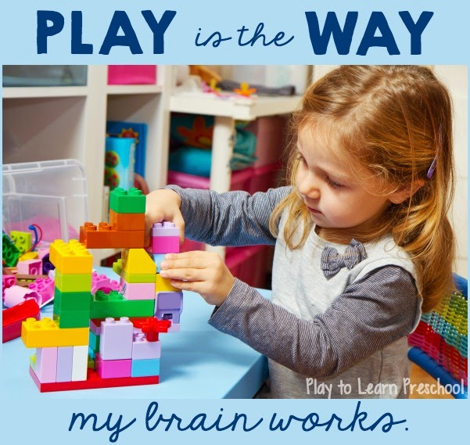
Learning can be messy but fun!

Slide 15
Uniform
Winter Uniform:
Grey skirt, pinafore dress or trousers.
Purple and grey striped school tie (elastic ones best for Reception usually).
White shirt/ blouse.
School logo V neck sweatshirt/ cardigan or plain purple V neck jumper/ cardigan.
Grey/ white socks or grey tights.
Black flat heeled shoes.
School logo or plain purple fleece (optional).
Purple, grey, black or white head scarf (optional).
Summer Uniform (Summer Term and Autumn First Half term only):
Dress with purple check or smart grey shorts with logo polo shirt/ short sleeved white shirt with purple and grey striped school tie.
School logo V neck sweatshirt/ cardigan or plain purple V neck jumper/ cardigan.
Grey/ white socks.
Black flat heeled shoes.
Purple summer sun hat or cap (optional).
Purple, grey, black or white head scarf (optional).
N.B. All items of clothing, including shoes, MUST be clearly labelled with your child’s name.
Only stud earrings are permitted.

Slide 16
P.E.
Children in Reception will have P.E. once a week and we ask that they come to school in their P.E. kits that day.
Receptions P.E. Day will be confirmed first week in September.
On P.E. Days children should wear:
Purple logo polo shirt or plain purple polo shirt.
Black tracksuit bottoms, black gym leggings, black skort or black shorts.
Grey/ white socks.
Plain black trainers.
School logo or plain purple fleece.
To be kept in school:
Valley logo P.E. drawstring bag or a plain purple or black drawstring bag.
Black pumps (without laces for the younger children)

Slide 17
What else do children need in Reception?
Change of clothes and underwear in a separate purple or black drawstring bag.
Purple school book bag.
Wellingtons.
A coat in school every day – we go outside every day.
Sensible shoes.
Water bottle.
PLEASE NAME EVERYTHING - Lost Property can only be returned if it is named.
Support with the cost of School Uniform:
Please contact our pastoral team who will be happy to help or signpost the appropriate bodies if you are struggling to afford uniform for your child.
Our pastoral team can be contacted via our parent liaison lead:
parentliaison@valleyprimary.org

Slide 18



Snack Time & Milk
Promoting Healthy Lifestyles
All children receive free fruit

Slide 19
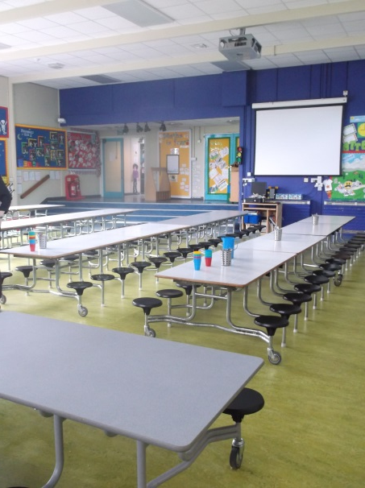
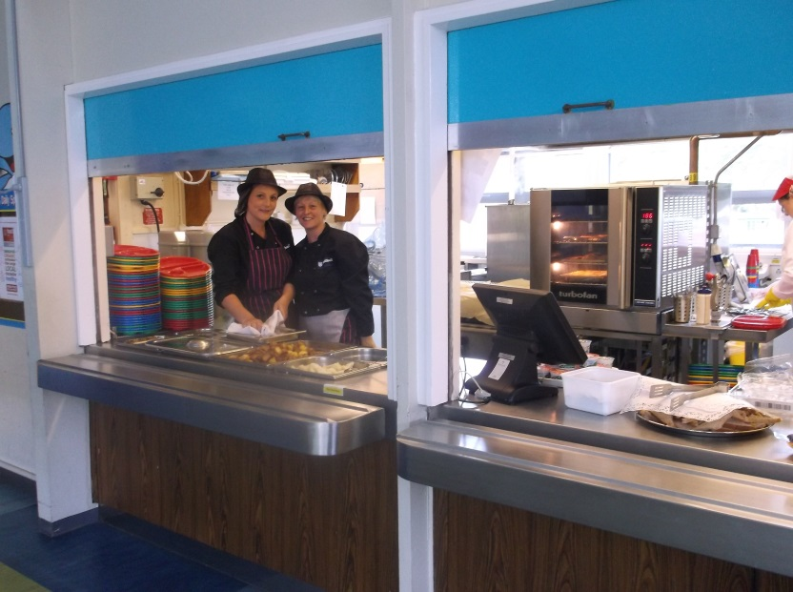
Lunchtime in Reception
All Key Stage 1 children receive a free school lunch but if you think you will be entitled to free school meals in the juniors please fill in the appropriate forms at the school office in September as this entitles your child to additional funding that we can use to help their learning.
Each class will have their own lunch time supervisor to support them in the hall and on the playground.
Lunches will need to be pre chosen and booked. The menu will be sent via parent pay and saved on our school website. This usually changes termly.
All Reception children play together outside.

Slide 20
Home to School Links
Parental support is one of the biggest positive influences on children’s education.
September Curriculum Evening
Parent consultation meetings
Talk to your child about their day – photographs are added to the year group pages each week to aid your discussions
Curriculum newsletters sent home half termly
Topic home learning tasks
Library books sent home weekly
Reading books will be given out when each individual child is ready and access to our e-library
Express days
Trips
We are always here to answer questions and offer support.

Slide 21

Good school attendance will help your child to:
Develop their knowledge of school routines and expectations meaning they will feel comfortable and secure in a new environment.
Develop social skills, friendship groups and positive relationships with staff and children, helping them to feel that they ‘belong’.
Take part in all aspects of the curriculum, building confidence and enjoyment of learning. There is a strong link between attendance and how well children do at school.
Develop their life skills, encouraging good habits for later life.

Slide 22

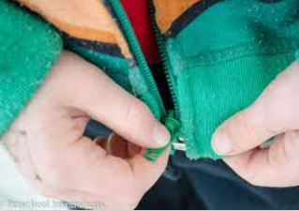

Getting Ready for September
Ways in which you can help prepare your child for Reception
Talk positively about starting Reception and walk past the school as often as you can.
Support your child’s self-help skills so they learn to do things for themselves. E.g. dressing and undressing independently including turning clothes the right way when they are inside out.
Talk through your child’s feelings and different emotions.
Establish a good sleep routine – share a bedtime story.
Show your child how to recognise and write their first name with a capital letter as the first letter only and lower case letters after that.
From day 1 in September encourage your child to be responsible for carrying their own book bag and water bottle into school.
Purchase Set 1 Read Write Inc flashcards to help your child to learn the sounds. There’s information on our website on the Year Group Pages under children.

Slide 23
Our Valley Vision
“Learning and growing together to be the best we can be”.
We always…
ASPIRE for excellence
ENJOY learning
ACHIEVE success
CHALLENGE ourselves further.
Thank you
We look forward to beginning and continuing your child’s learning journey together.
28th June 2025 PTFA summer fayre
at our Old Lode Lane site

