Slide 1










Special Educational Needs Provision
Click on the balloons for more information
Aims
ADPR
The Hub
Transition Support
Identifying special educational needs?
Staying informed
SEN Support
Inclusive education

Slide 2

SEN at Valley
EHCP | 18
SEN support | 106
Need
Communication and interaction | Speech language and communication need (SLCN) | 27
 | Autism Spectrum Disorder (ASD) | 13
Cognition and Learning | Moderate Learning Difficulty (MLD) | 23
 | Specific Learning Difficulty (SpLD) | 9
Social Emotional and Mental Health (SEMH) |  | 31
Sensory and Physical Impairment (SPI) |  | 3
National average
EHC Plans – 4.8%
SEN Support – 13.6%
Click → to return to menu

Slide 3
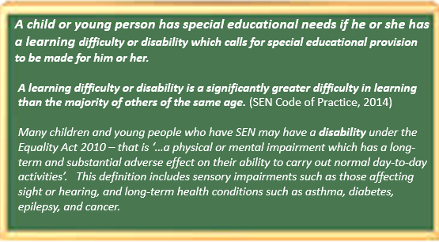


Our aims for children with special educational needs or disabilities
Objectives:
For staff seek to identify the needs of pupils with SEND as early as possible.
To closely monitor the progress of all pupils in order to aid the identification of pupils with SEND.
To make appropriate provision to overcome all barriers to learning and ensure pupils with SEND have full access to the National Curriculum.
To work with parents to gain a better understanding of their child and involve them in all stages of their child’s education.
To work in partnership with outside agencies when a pupils’ needs are unable to be met by the school alone.
To create a school environment where pupils can contribute to their own learning by offering all pupils the opportunity to have a voice.
To provide support and advice for all staff working with pupils with special educational needs.
At Valley Primary School, we maintain that every child is unique and special. We are committed to ensuring that every child is provided with the opportunities and support, within a rich and varied curriculum and safe, caring and stimulating environment, which enables each child’s chance to reach the highest possible standards.
We aim to:
Raise the aspirations of, and expectations for all pupils with SEND.
Focus on outcomes for children rather than just on hours of provision.
Support children to make progress in line with or exceeding their expectations.
Encourage children and young people to become more independent in their learning in order to prepare them for life after school.
Support children and young people to make a successful transition from primary school to secondary school and beyond.
Reduce barriers to learning
Support engagement in all activities
Support medical needs
Make reasonable adjustments
Secure specialist provision as needed
Work cooperatively with parents, young people and outside agencies
Click below to return to menu

Slide 4

Identifying Special Educational Needs
MONITORED GROUP
SEN SUPPORT
EHCP
SEND register begins
There are four broad areas of need recognised.
Cognition and Learning Needs
Speech, Language and Communication Needs
Social, Emotional and Mental Health Needs
Physical and Medical Needs
Children, or young people, who require teaching or support that is additional, or different, in order to make progress in line with their peers, are classified as having special educational needs. This may in some cases include a specifically diagnosed condition or disability. Identification may be via transition information from previous schools, via reports from external professionals, or through assessments carried out in school.
Our admission procedures ensure that we are able to identify and consider any specific needs for new children and then we plan the provision required to support those needs. This includes consideration of:
Physical accessibility and environmental resources
Accessibility of the curriculum, to include the use of assistive technology
Inclusion in extra-curricular activities
Short term needs/slow progress
Specific diagnosis and/or medium-level support needs/lack of progress despite intervention
Specific diagnosis and/or high-level support needed/ continued lack of progress despite intervention and outside agency involvement
Children and young people may move along the support pathway to best support their needs at that time
Cognition and Learning Needs cover a wide range of needs, including moderate learning difficulties (MLD), severe learning difficulties (SLD), global difficulties, through to profound and multiple learning difficulties (PMLD), where children are likely to have severe and complex learning difficulties as well as a some physical disability or sensory impairments.
This includes: dyslexia, dyspraxia, dyscalculia, visual stress.
Speech, Language and Communication Needs present a difficulty in communicating with others. This may be due to difficulty saying what they want to, understanding what is being said, or not understanding the rules of communication.
Includes: Autism Spectrum Needs, ADHD, some physical disabilities, attachment needs.
Children who speak English as an additional language may also benefit from communication support.
Behaviour is seen as an indicator of a possible underlying need. As a school, we will recognise that behaviour is always a communication.
We are committed to identifying any behaviour that stems from an underlying need, and will work with each child and their family to support their individual needs.
Social, Emotional and Mental Health difficulties can manifest in many ways. These may include becoming withdrawn or isolated, as well as displaying challenging, disruptive or disturbing behaviour. These behaviours may reflect underlying mental health difficulties such as anxiety or depression, self-harming, substance misuse, eating disorders or physical symptoms that are medically unexplained. Other children and young people may have disorders such as attention deficit disorder, attention deficit hyperactive disorder or attachment disorder.
Sensory and/or Physical needs include disabilities that prevent or hinder them from making use of the educational facilities generally provided. These difficulties can be age related and may fluctuate over time. This includes vision impairment (VI), hearing impairment (HI) or a multi-sensory impairment (MSI). Children and young people with an MSI have a combination of vision and hearing difficulties. Some children and young people with a physical disability (PD) require additional ongoing support and equipment to access all the opportunities available to their peers.
Click below to return to menu

Slide 5
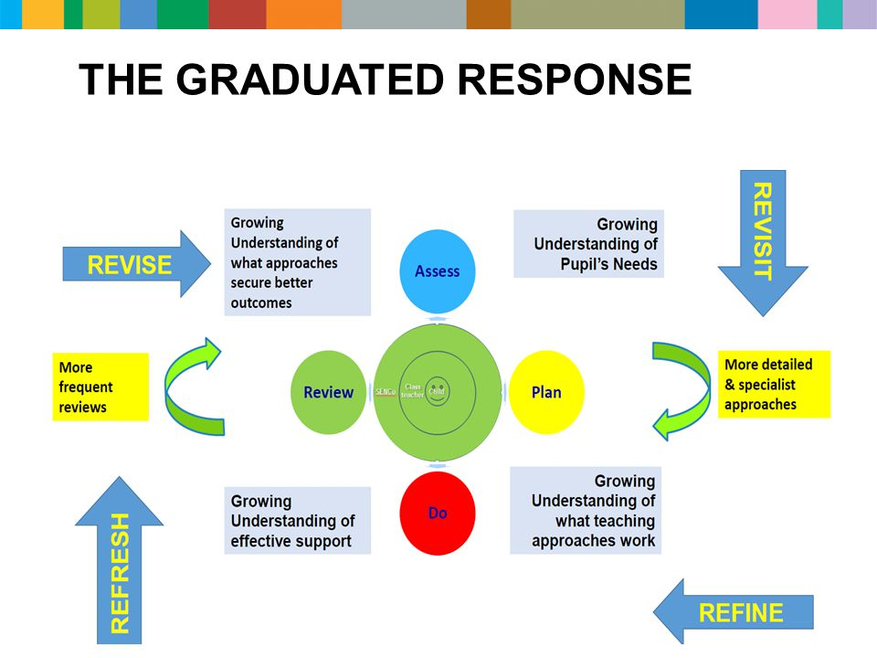
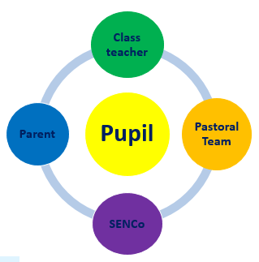

Support
Valley has a strong ethos of inclusion. We are committed to ensuring that every child has the opportunity to achieve their best, become confident individuals with fulfilling lives and make a successful transition into adulthood, whether into employment, further or higher education or training.
The Graduated Response
Quality First Teaching (QFT) is a measure of effective practice. Our class teachers provide an educational experience that allows for all children, including those with SEND, to make expected progress or better. Teachers assess the needs of all pupils and plan how they will meet their needs in the classroom to allow pupils to support them to make progress. Additional intervention and support cannot compensate for a lack of good quality teaching. Quality first teaching is part of the graduated response cycle of assess, plan, do and review.
There are three broad tiers of support above quality first teaching. This is not a linear model; some pupils with SEND will receive a personalised programme of support that may encompass one or more tiers.
Support is reviewed at least three times per year; in some cases more frequently. Provision within an Education, Health and Care Plan is discussed and amended as necessary in the Annual Review.
Tier 1 Tier 2 Tier 3
Support from class teacher Support from the SEND team Support from specialist practitioners
All pupils with SEND Some pupils with SEND Some pupils with SEND
Assess Plan Do Review
Identification of SEND:
Transition information
Internal assessments
Parental referral
External assessments
Planning support:
Discussions with parents
Discussions with pupil
Discussions with teachers
Advice from specialists
Ensuring support:
Key information for teachers
Reasonable adjustments
Specialist programmes
Additional adult support
Evaluation of support:
Subject assessment data
Specialist assessment data
Review of personal targets
Discussions with teachers, pupils and parents
School based support
External support
All students with SEND
Personalised SEN/EHCP support plan
Effectively planned lessons
Reasonable adjustments in lessons to
reduce barriers to learning
Some students with SEND
Specialist equipment or additional adult support
Small group or individual specialist interventions
Additional sessions in core subjects like English and Maths
Solihull/Birmingham Local Authority SEND Team including Educational Psychology, Schools Mental Health Support Team
Professionals: Occupational Therapy, Physiotherapy, Hearing Impairment Team, Visual Impairment Team, Paediatrician, Speech and Language Therapy
Connected Care – Solar, Ordinary Magic, Kooth
Information, Advice and Support Agency
Health care (to include school nurse, hospital services)
Counselling services – CAMHS, Solar
Click below to return to menu

Slide 6



Inclusive Education
We welcome pupils of all abilities and backgrounds into our caring and challenging learning environment and through our highly skilled and compassionate team of staff, seek to create an exceptional learning community where everyone can excel.
The Curriculum
The Building
All SEND children have their own learning resource pack to encourage them to be independent learners
Quiet working spaces are available for pupils with specific needs
Pupils with SEND have the same curriculum choices as all pupils unless it is inappropriate for them to do so
Strategies for class teachers to use are detailed in a child’s SEN support plan/EHCP
Adapted approaches and resources are available to suit the individual needs of all pupils
Alternative curriculum packages are accessed for individual pupils with specific needs
Teachers use accessibility tools to make lessons inclusive
Spacious site with wide corridors, main doors and classrooms
Disabled parking space
Assistive technology (laptop computers, Chromebooks, iPads, immersive reader)
Managed transitions for pupils if needed
A copy of the accessibility plan is available on the main school website
Trips and Visits
Click below to return to menu
Activities are open to all pupils. Discussions with parents and providers take place as needed, and full risk assessments are carried out. Reasonable adjustments and additional staffing are utilised in line with specific pupil needs.

Slide 7
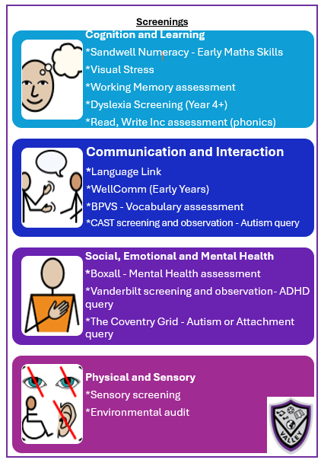
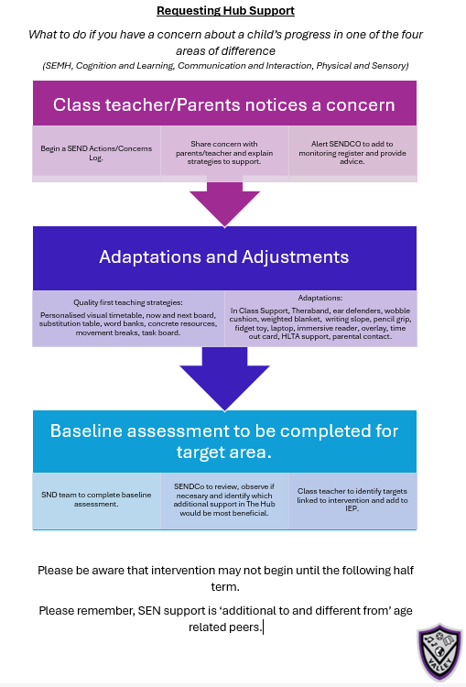
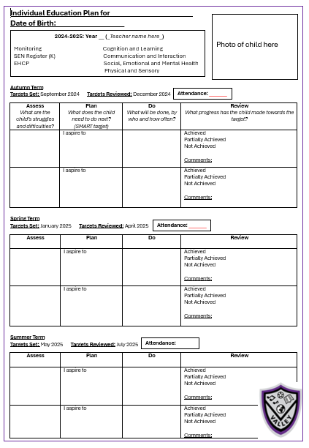
SEN Support
Click → to return to menu

Slide 8



Flexible intervention provision
At Valley, we have a growing SEN population meaning we have to regularly reflect on how we provide the best opportunities for children with a wide range of individual needs.
We recognise that for many reasons for some children a mainstream classroom is a barrier to children’s progress and wellbeing.
Due to this we have a created bespoke internal provision that better meet some children’s individual needs whilst ensuring children remain part of our ‘Valley family’.
The Hub is part of our whole school SEND approach and commitment to providing bespoke provision for children who have specific additional needs and/or barriers to learning and emotional well-being.
External Expertise
The Hub
Quality First Teaching
Adapt and Adjust

Slide 9
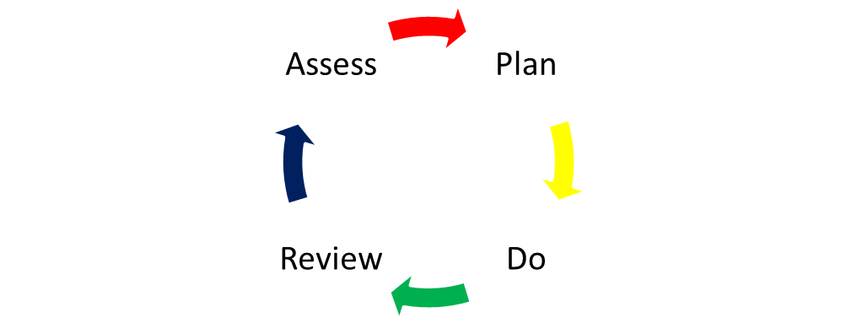
Interventions
We aim to deliver quality intervention in a learning environment equipped to support specific learning needs, implemented through by our highly skilled and compassionate team of staff.
Cognition and Learning | Speech, Language and Communication Need | Social, Emotional and Mental Health | Physical/Sensory
Attention Autism | Makaton Signalong | Zones of Regulation | Touch Typing
Read, Write, Inc Phonics | Time to Talk | Lego Therapy | Sensory Circuits
NIPA NAPA | Speech Therapy target work | ELSA | BEAM
Number Stacks | Super Skills | Relationship Based Play | OT target work
Colourful Semantics | Language Link | Mindfulness | Physiotherapy target work
Precision Teaching | WellComm | Karen Triesman CBT | VI/HI target work
SOS Spelling
Memory Magic
Click below to return to menu

Slide 10
Staying Informed
We are proud of the strong partnerships we have created with parents, pupils and the community and place a high value on the comments and feedback that they provide in helping us to improve the school even further.
We offer an open door policy and encourage parents to speak to a member of staff straight away if they have any concerns or questions about their child and/or their child’s education.
Pupils are assessed in every lesson against the learning objective and their personal targets. Each term, assessment data is formally recorded and tracked, so that pupil progress can be closely monitored. Reports on pupil progress are shared each term either at parents evening or in an end of year detailed report. The SENDCO is also available to speak to parents at parents evening for an additional 10 minute appointment.
Other sources of information (available via our website, or through the link provided):
Accessibility plan – this outlines our school's ongoing commitment to improve the physical environment of the school so that pupils with special educational needs or disabilities are able to full access the educational curriculum, school facilities and our wider curriculum provision
SEN Policy – this provides further information about our aims for supporting pupils with special educational needs and disabilities.
SEND guide for parents - this is a government document outlining information for parents around special educational needs and disabilities.
https://www.gov.uk/government/publications/send-guide-for-parents-and-carers
SEND Code of Practice: 0-25 years this is the formal document that provides all educational providers with guidance on statutory provision.
https://www.gov.uk/government/publications/send-code-of-practice-0-to-25
The school regularly emails, messages via ParentPay or contacts parents by phone to discuss any concerns or progress. Praise, rewards and behavioural concerns are logged and can be viewed by parents on request.
SEN Review meetings
All children on our SEND register will have either a SEN support plan or an EHCP termly target plan dependent on if they are on SEN Support or have an EHCP. These documents are reviewed three times a year, in partnership with the child and their parents by the class teacher and/or SENCo.
Annual Review
All children with an EHCP will have an annual review meeting once year. This meeting is arranged by the SENCO, who will invite the parents, child and other professionals who are supporting the child. The annual review meeting is an opportunity to share progress and areas for development whilst updating the EHCP plan.
Pupil Views
Pupil views are gained at each review point. For children who are unable to share their views with us, we will use photographs and observations to inform us on what things they like to do in school. Pupil views about what is important to them are recorded on their SEN Support plan or EHCP.
Click below to return to menu
If you wish to meet to discuss your child’s progress further, then you can email, call or arrange an appointment to meet with:
Class Teacher
The SENDCO
Member of the Pastoral Team

Slide 11

Transition Support
From nursery/playgroup – starting school
Reception teachers will visit nurseries/playgroups and/or attend home visits/meet families virtually prior to them starting school
In the Summer term, prior to the children starting reception, parents and their child are invited to attend settling sessions to meet the teacher and familiarise themselves with the setting.
At the beginning of the Autumn term, children are offered additional settling sessions prior to starting fulltime in the second week of term. Children with special educational needs may have a slower transition into fulltime school if deemed appropriate through discussions with parents, class teacher and SENDCo.
Key paperwork regarding pupils’ special educational needs, as well as current Education Health and Care Plans will also be transferred (as agreed through transfer review) and shared with the class teacher and assigned adult supporting the child.
Moving up to their new class
Extra class visits will be planned to allow children to get to know their new class and classroom environment.
A transition booklet will be created and shared with the child in school, with a copy also being sent home.
All children attend a morning transition session in their new class during the end of the summer term.
Class teachers and one to one adults provide detailed information which is shared with the new class teacher and LSA.
Parents are given an opportunity to meet with their child’s new class teacher prior to them starting in September.
Moving to secondary school/new school
Class teachers will discuss and share information with a child’s new school.
The SENCO will hold additional meetings with secondary schools to share information regarding a child’s SEN to ensure key information is shared prior to them starting.
All SEN paperwork is passed on to a child’s new school in a timely manner.
The SENDCO will also attend a meeting to share information with their child’s new SENDCo.
From Other Schools
For pupils who join the school at other points, parents will be invited to meet with the Assistant Head and Pastoral Lead as part of the induction process to discuss their child’s needs
Tours of the school are arranged as part of this process.
Additional information will be sought from the child’s previous school to ensure that the right support and resources are provided as soon as they start our school.
Click below to return to menu

