Slide 1

Sleep Hygiene
6th December 2023

Slide 2

What is sleep?
An extended bout of rest where we are unconscious (unaware of what’s going on around us)
Our brain, nerves and muscles go into “rest and recover”
Sleep is an active period in which a lot of important processing, restoration and strengthening occurs

Slide 3
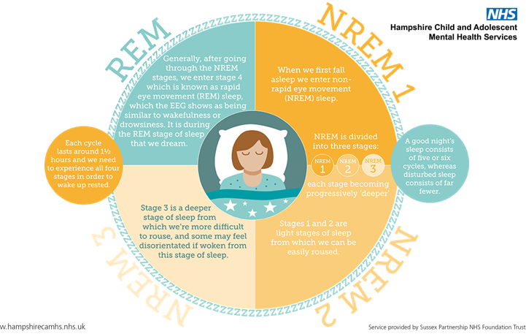

Slide 4
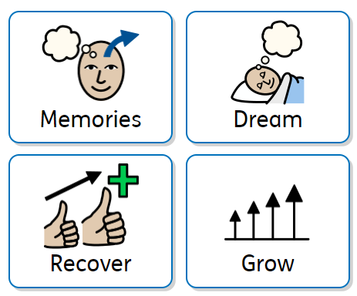
Why do we sleep?

Slide 5
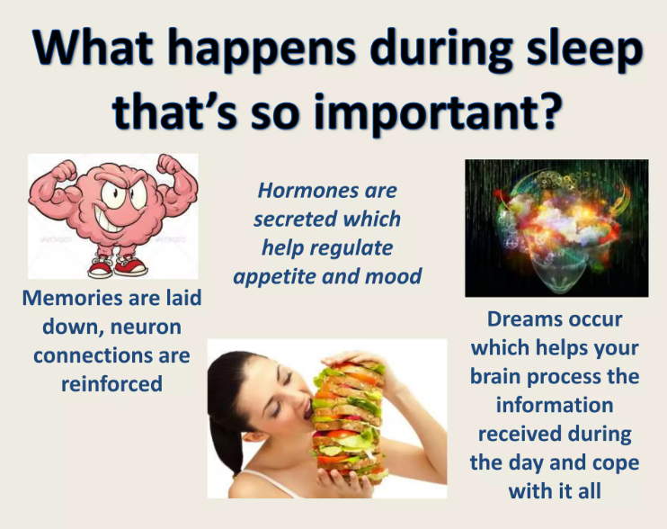

Slide 6
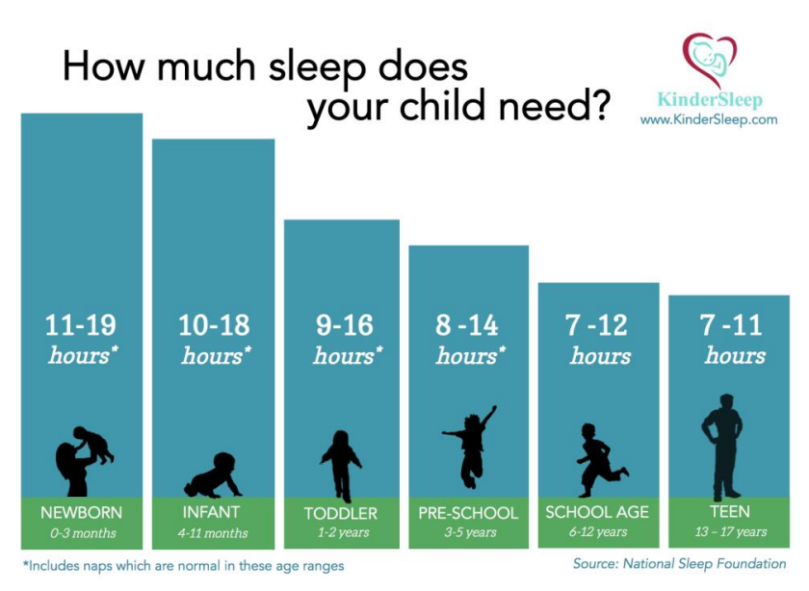
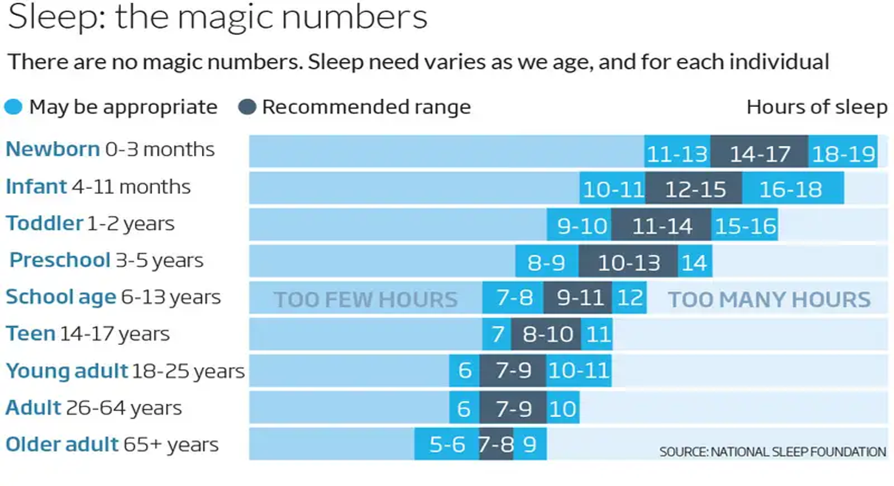
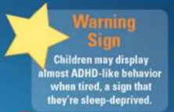
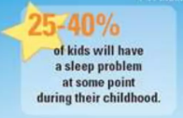
7 hours
(for example… a 7pm bedtime could mean a 2am wake up!)

Slide 7
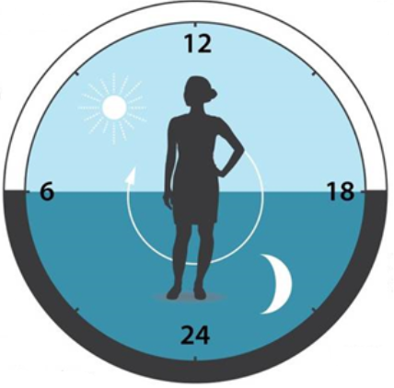
Circadian rhythm..?
Melatonin is a hormone that occurs naturally in our bodies during our circadian rhythm
Light in the morning signals to our brains to stop producing this hormone meaning we feel less sleepy
It’s produced at night time to help us go to sleep
In adolescence, this rhythm naturally shifts to later on at night
Internal body clock
Notes:
We find it hard to fall asleep earlier and are more sleepy in the morning. Teens – harder to get up in the morning as their rhythm is still in a dip meaning they feel tired. This can be made worse by the early start of the school day, increasing feelings of tiredness if they haven’t had enough sleep. Teens get a bad rep but it’s actually their rhythms!

Slide 8
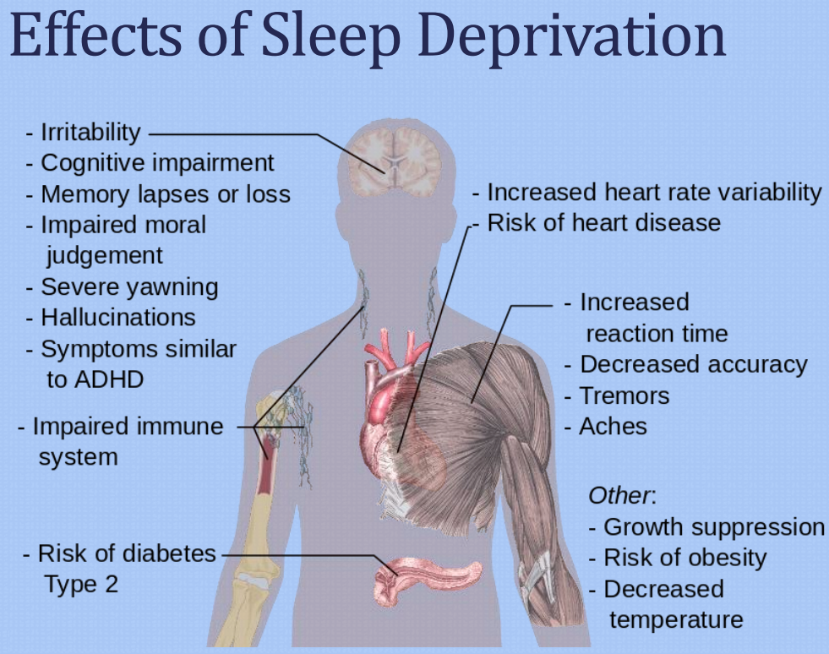
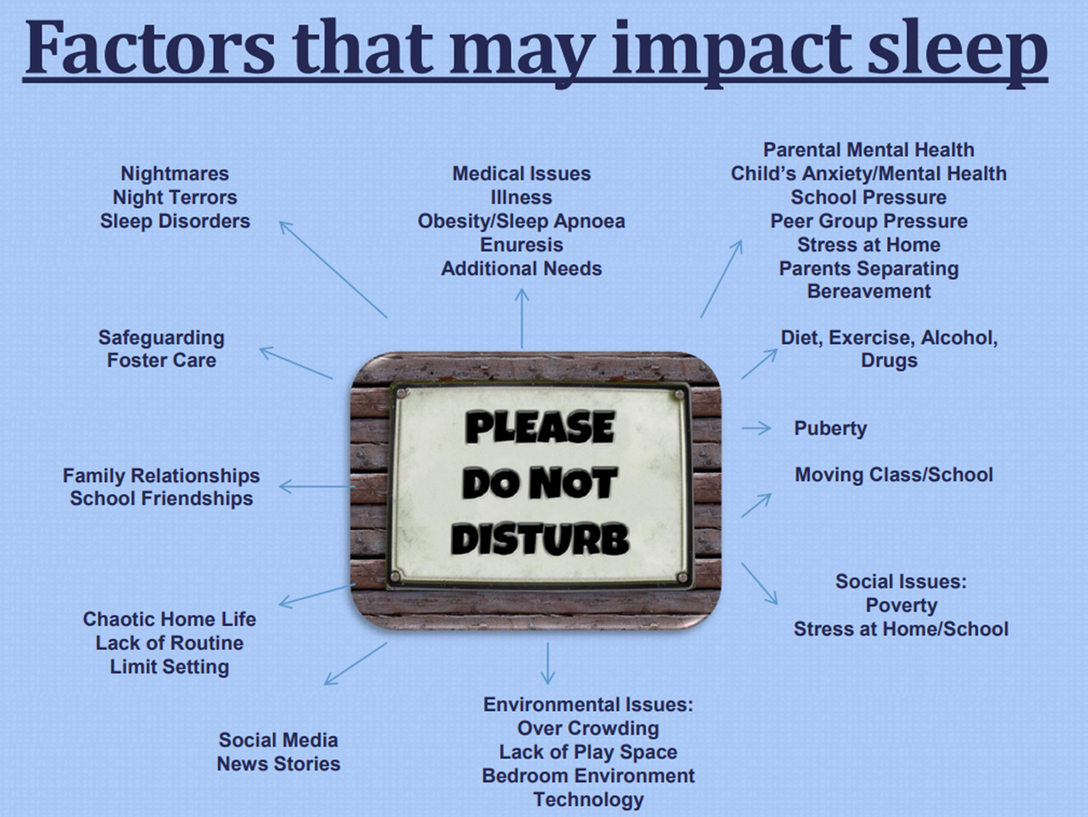


Slide 9
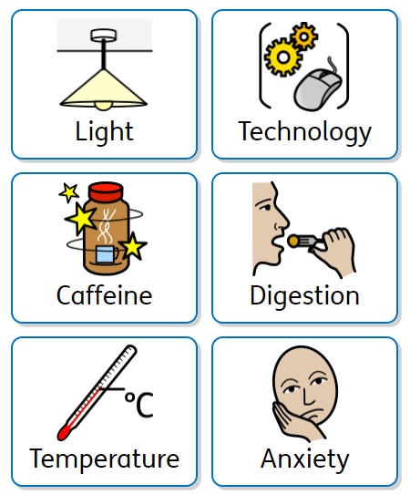
Barriers…

Slide 10
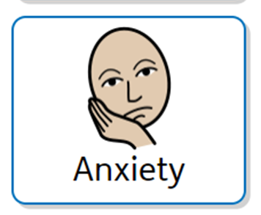
Can result in bedtime battles, difficulties falling asleep, late sleep phase, night wakings
Think about what may be the cause
Talk about worries in the day (set a time limit on this)
Avoid scary books or TV programmes
Winding down bedtime routine
Relaxation techniques
Security object
Night Light
Don’t look for monsters!

Slide 11

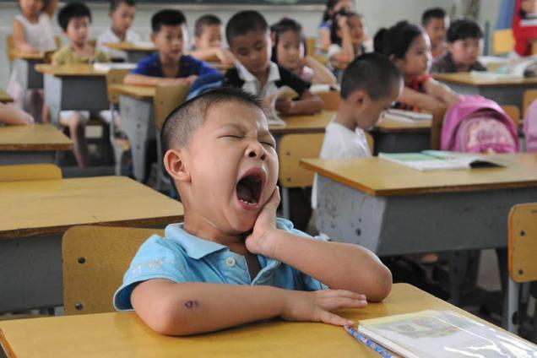
What does this look like in school?
Concentration difficulties
Memory impairment
More ‘sick days’ from school because of tiredness
Risk-taking behaviour
Lack of enthusiasm, moodiness or aggression
‘Drifting off’ in class
Reduced academic performance
Low resilience – difficulty ‘bouncing back’ from challenges

Slide 12

Communication!
Young people want to get a good sleep
Coach, not manager
I statements: “I want to help you because I can see how hard it’s making things for you”
Support them to identify sleeping issues and the impact it is having
Help weigh up pros and cons of changing sleep routine
Team morale
Praise
Model good sleep habits

Slide 13
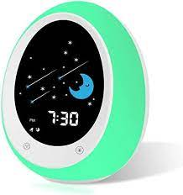
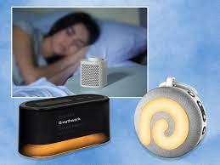


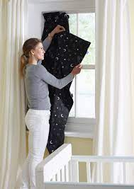
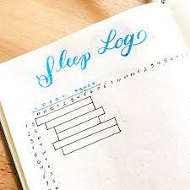
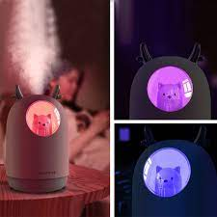
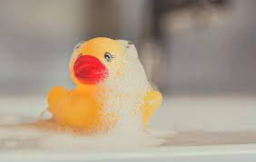
Tools to help…

Slide 14


1 hour before bed
Banana
Warm milk
Yoghurt (low sugar)
Almonds
Salmon
Broccoli
Oats

Slide 15
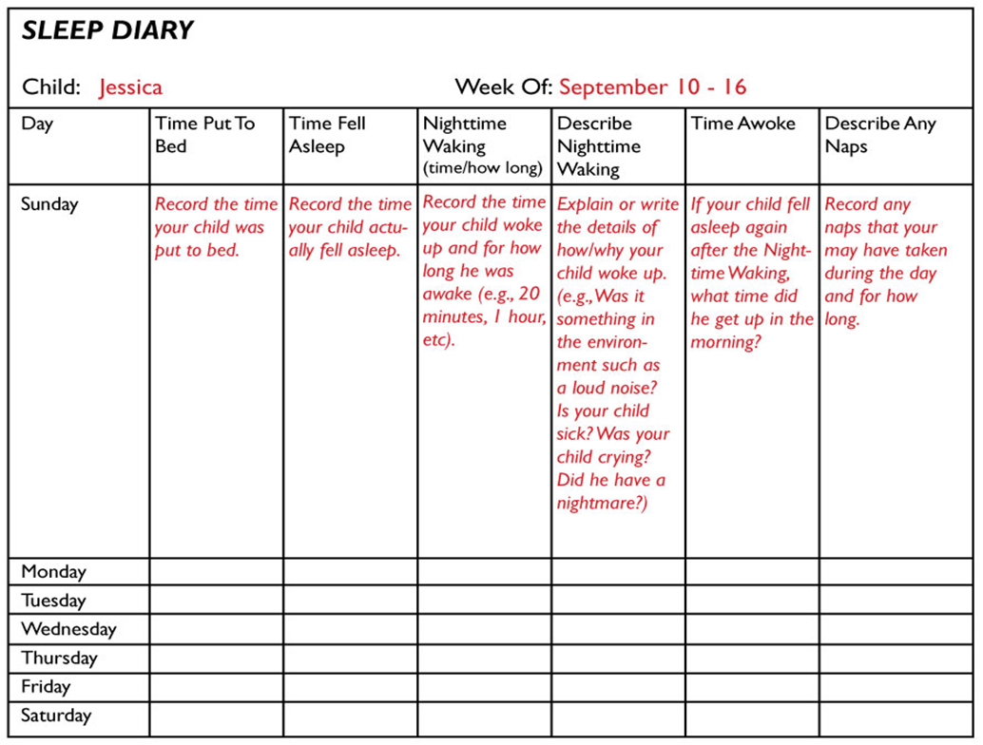

Slide 16
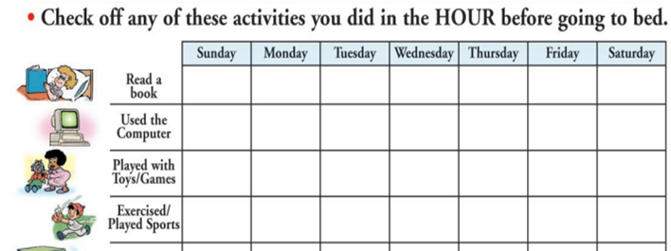
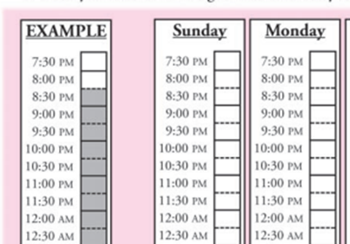
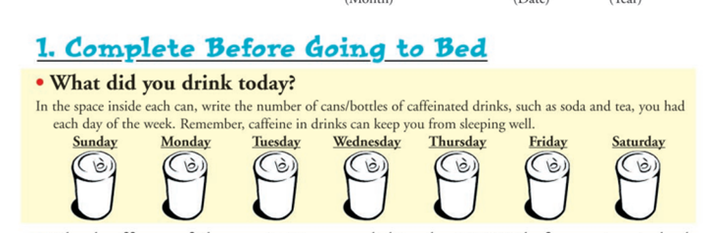

Slide 17
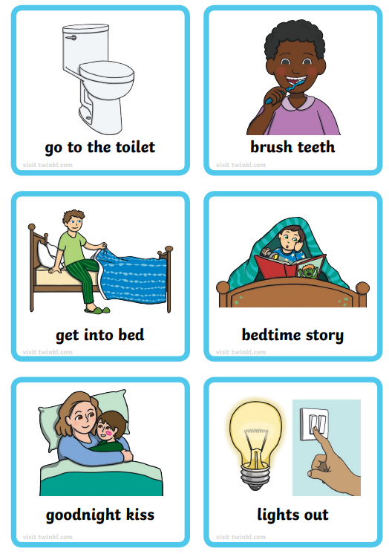
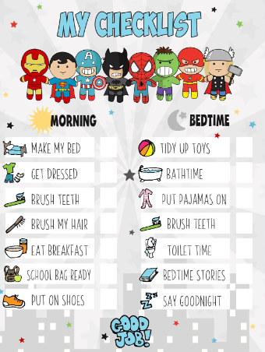
Visual prompts

Slide 18
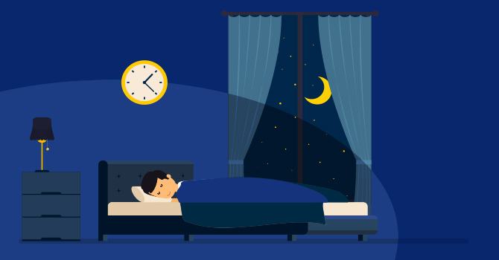
Have a consistent routine
Aim 10.5 hours sleep – 8.30pm - 7.00am
7.45 start bedtime routine.
Prepare bedroom so it is dimly lit
Run bath, have a 5 min warm bath, quiet and relaxing, no games
Go straight to the bedroom from the bathroom
Slight drop in body temperature will trigger sleep hormones
Into pjs, story and prepare to leave
8.15 kiss and cuddle and leave
8.30 child should sleep

Slide 19
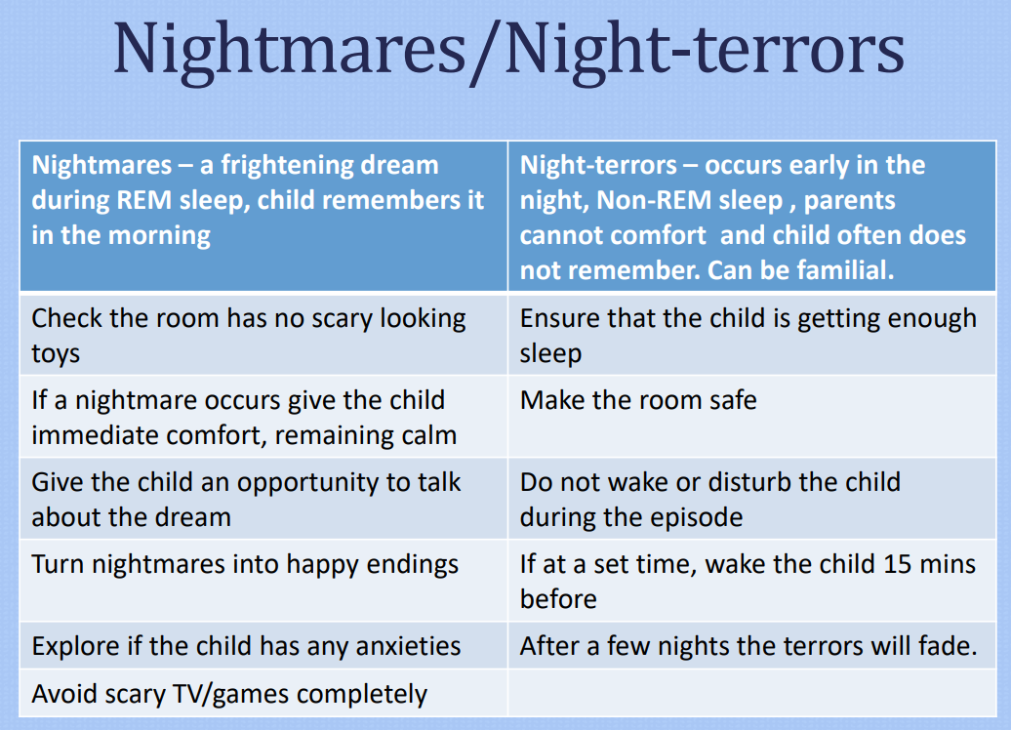

Slide 20
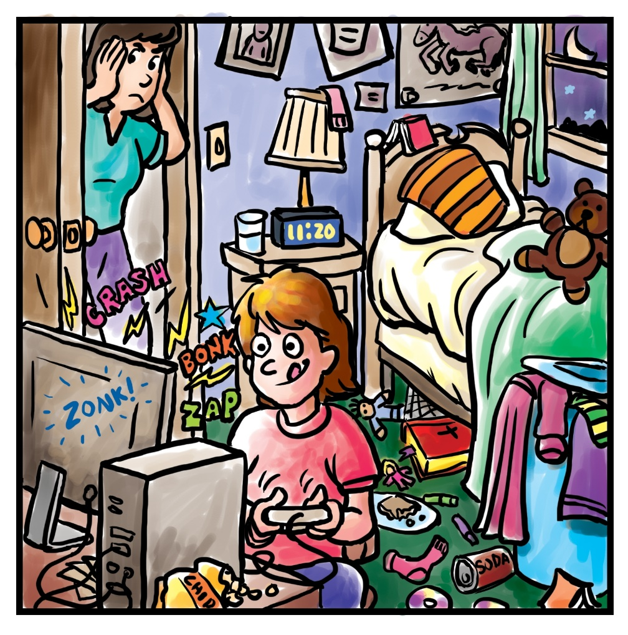
Sleep Environment
Getting to sleep
Comfortable Temperature
Comfortable space to rest horizontally
Low noise level
Low light or darkness
No blue light
Lack of distractions
Clothing
Notes:
There are no TVs or computer screens in the room. Good for you! With the TV and computer in another room, kids are less likely to stay up late staring at screens.
We turn off all screens at least 30 minutes before bedtime. Yeah! You prioritize your sleep! Any screen activity—video games, computers, or cell phones—before bed can rev you up and make it hard to fall asleep.
The room is dark. Your body naturally senses light and wakes up. So the darker you can make the sleeping area, the better the sleep. Of course, if your child prefers to have some light, like a nightlight, that's okay. Just make sure the light is not too bright.
The room is a comfy temperature for sleep. Being too hot or cold can keep your child from sleeping. Cold feet make it particularly hard to fall asleep. Got cold feet? Sleep with socks on. Too hot? Try putting a fan in the room.
You save wild coloors—like neon pink or fluorescent green—for clothes and accessories, not walls or curtains. Maybe your child’s favorite colors are bold and bright. But for good sleep, stick with wall and curtain colors that are calming like soft grey, cool white, pale beige, calm blue, or any soft tone in a color that they like.
The room is tidy and clean. Believe it or not, clutter and dirt can interrupt sleep. Go ahead and pile stuffed animals on the bed during the day, but at night, make space to stretch out and snooze. Make picking up dirty clothes and putting the toys away part of a bedtime routine. Not only will you sleep better, but you don’t have to worry about tripping over things!

Slide 21



Rapid Return
For children who are having difficulty staying in their bed once you say goodnight.
Sleep training,
Shaping behaviour Setting boundaries
Notes:
Each night, your child gets an actual card or pass (like a school hall pass) granting permission to leave their room briefly, just once (for example, for water, the bathroom or a hug). Research shows that most kids will stay in bed and not even use the card, secure in the knowledge that they could if they wanted to.
Start by delaying bedtime by 30 to 60 minutes so your kiddo is sleepier than usual and falls asleep easily (and solo), without fighting or pleading. Do this for a few nights, until they’ve mastered falling asleep faster on their own. Then gradually reel bedtime back by 15 minutes every few days until you reach your target (this should be between 7:30 and 8:30 p.m. for most children).
You can combine bedtime fading with “excuse me” drills, in which you give a series of excuses to briefly leave the room and then return to check on the child (and praise them for staying in bed). If your child is anxious about falling asleep alone, this helps desensitize them to your absence. The idea is that you begin with very frequent checks—perhaps every few minutes on the first night—but extend the time a bit each night until the child is calm enough to fall asleep independently. Boring excuses, like going downstairs to take out the trash or load the dishwasher, work best.

Slide 22

The Rabbit Who Wants To Fall Asleep
https://www.youtube.com/watch?v=sh7rpq3FWuo (picture book)
https://www.youtube.com/watch?v=H93HXdtLh1Y (audio book)

Slide 23
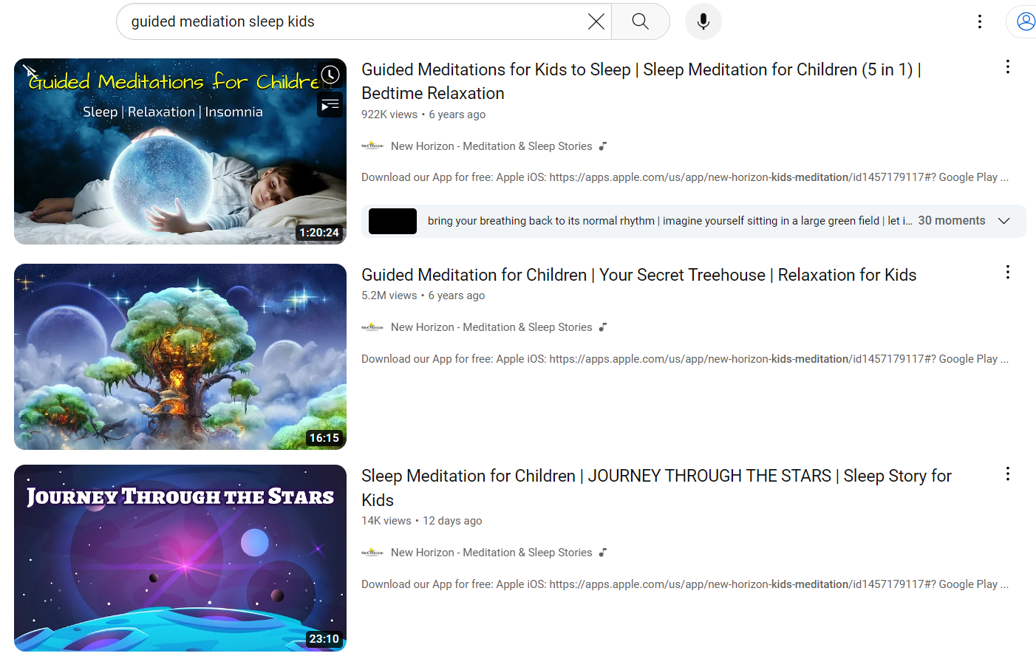

Slide 24

Help!
GP
School Nurse
Paediatrician

Slide 25
Useful Links…
https://www.mentalhealth.org.uk/sites/default/files/2022-06/Sleep-Guide-for-Parents-and-Caregivers.pdf
https://www.nhs.uk/conditions/baby/health/sleep-and-young-children/
https://parents.actionforchildren.org.uk/sleep/
https://thesleepcharity.org.uk/information-support/children/
https://www.sleepfoundation.org/children-and-sleep/sleep-strategies-kids

