Slide 1

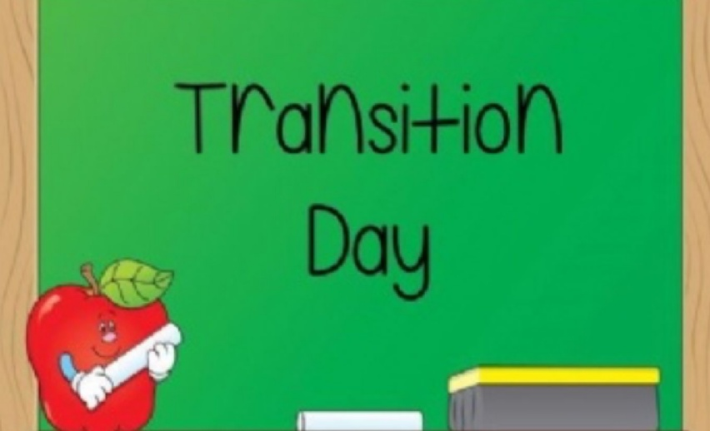


Supporting children with transition
Friday 9th June 2023

Slide 2
Welcome!
Aims of today’s session:
Understanding of why transition is difficult for some pupils.
Additional support available in school.
Strategies to support at home.
Questions are welcomed!

Slide 3
Our aims in school:
For all the children at Valley to experience a smooth transition from their current class to their next.
For the children to enjoy the new challenges and approaches of learning in their new year group/phase.
Parents to feel involved and informed about the transition process.

Slide 4
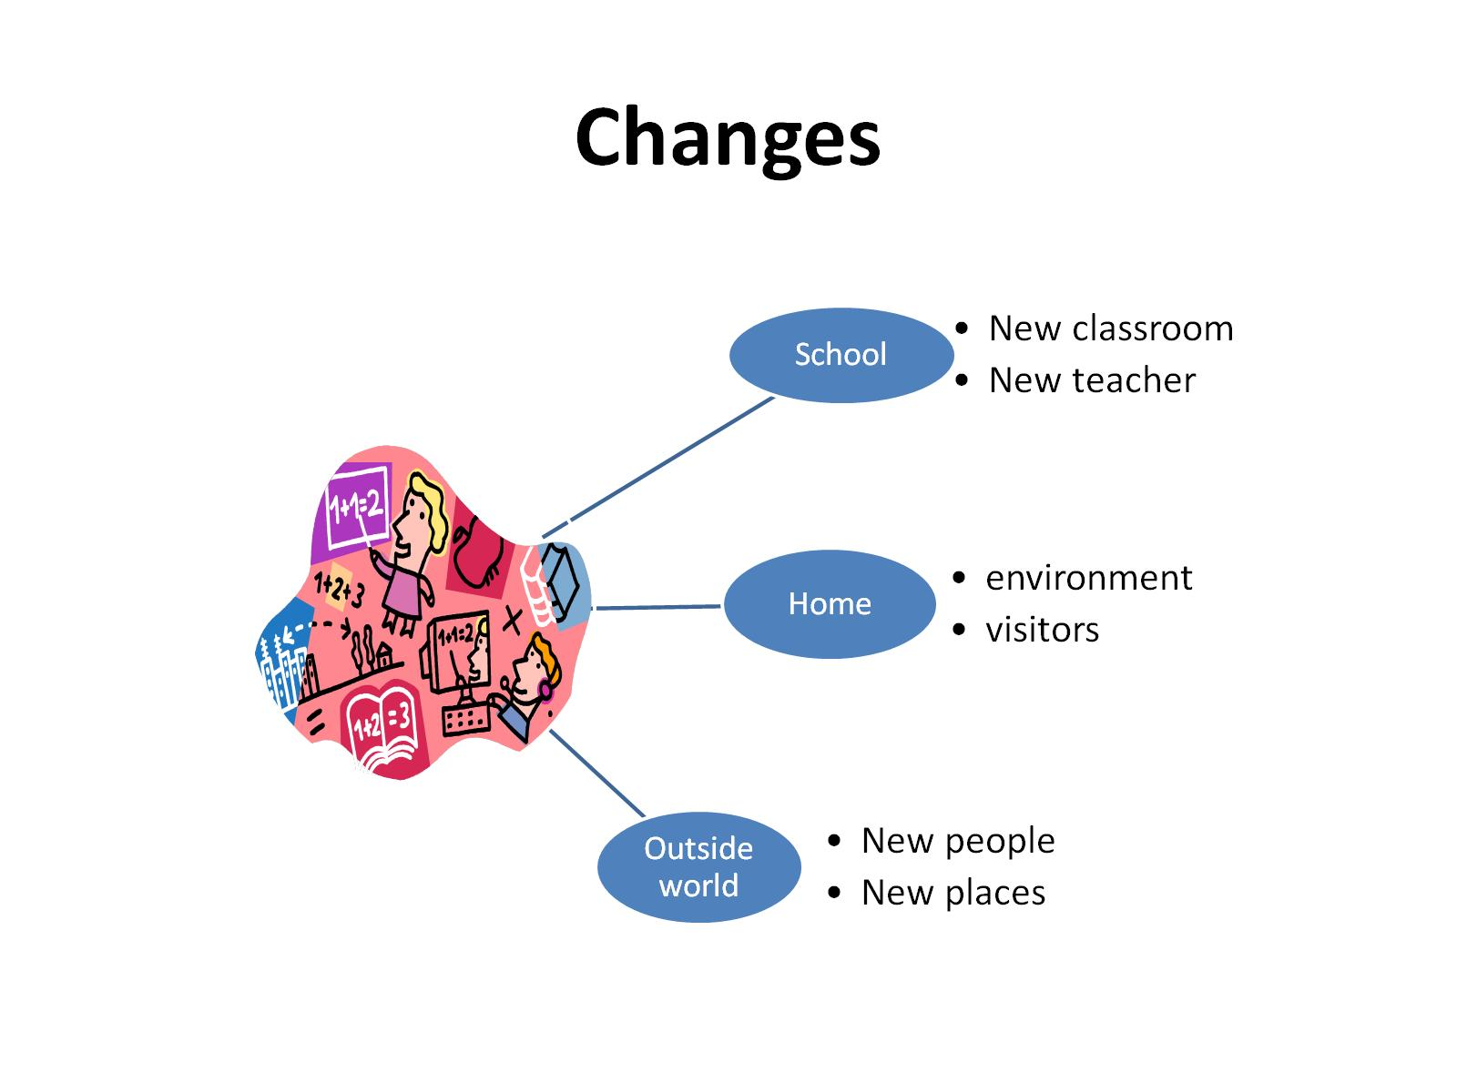
Changes
Notes:
Changes can’t be avoided.
They are part of everyday life and we teach the children that changing things is a way of moving forward (that they are positive).
However, we are aware that many children, as we do, can find some changes difficult and this can lead to anxiety.
It is important that we remain positive about changes that are afoot.

Slide 5
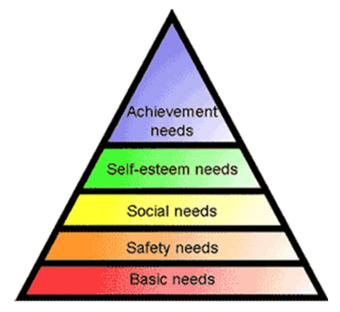
Why do we prepare for transition?
Anxiety
Behaviours
Successful
outcomes

Slide 6
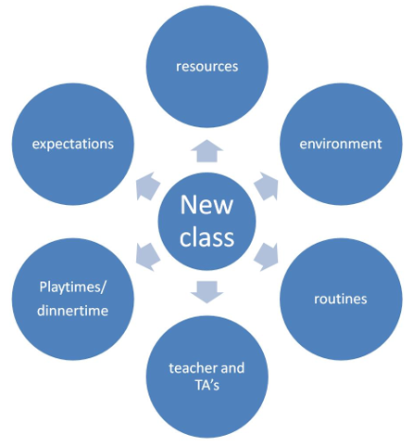
What causes the anxiety?
‘Fear of what I don’t know’
‘I might not know what to do’
‘They don’t know me’
‘What if I get it wrong?’
‘I don’t know what will happen next’
‘I don’t like the noise’
‘I can’t do the work’
Notes:
With any changes we find it is the unknown that generates the fear. What if… they don’t know me… I do the wrong thing…they don’t have toilets close… I can’t eat my snack at break.

Slide 7
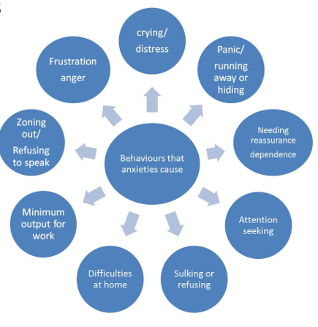
What behaviours can be demonstrated?
‘Sometimes I get so frustrated that I kick out’
‘If I am worried about it I just run away or I can’t move’
‘I get into arguments because I just want it to be like this’
‘Sometimes I cry because I feel scared’
Notes:
However, this can be difficult to detect in school. For some children, it may be obvious but for others they may display their anxieties away from staff and peers. We try to detect need where we can but this is where we need your help. We rely on parents letting us know when there are anxieties. Please speak to teachers and keep the lines of communication open.

Slide 8
All | Specific
New teachers | Level of support received
Worried about making friends | Additional support needed
New subjects | Will my teacher understand my needs?
Will the work be harder? | Moving around the school
Homework | Resources to support me in class
Changes in routine/timetable | New classmates
 | Not wanting to be seen as ‘different’

Slide 9
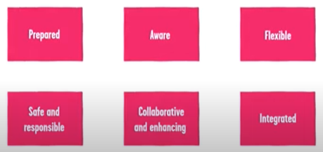
6 key principles to aid successful transition:

Slide 10
Different aspects of transition…
Teachers talking to each other
Meeting office staff and lunch staff
Taking photos of different areas
Parent and pupil voice
Only one piece of the jigsaw!
Visits to playground
Teacher/TA
Notes:
Although the focus is often on who will be my teacher/who will be the TA. It is important to note that this is only ‘one piece of the jigsaw’. There is so much else going on in the background.
It is important that these are not focused on as we are unable to provide information about these changes due to knowing our staffing structure.

Slide 11
EYFS…
Communication and Language
Physical development
Literacy and Maths
Understanding the world
Personal, social and emotional development
Expressive arts and design

Slide 12
NC
English
Maths
Music
PE
Science
Computing
History
PSHE
Geography
DT
Art
RE

Slide 13
How will I know if my child is struggling with transition?
Anxious
Unhappy
Withdrawn
Unsociable
Emotional
Wetting/Soiling
Falling out with friends
Risk-taking
Obsessive
Judgemental about themselves
Having issues with sleep/eat
…more than usual or a combination of these.

Slide 14

What is Anxiety?
An alarm system which has kept humans safe for MILLIONS of years!
It is a completely normal and healthy reaction, to many situations, that we can’t and don’t want to get rid of.
It’s designed to feel unpleasant so that we react.
At mild to moderate levels, it can improve our performance.
Becomes unhelpful when it interferes with everyday life.

Slide 15
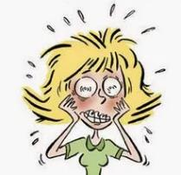


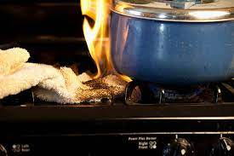

How anxiety works
Life threatening danger
Non threatening event
Notes:
Carly
Smoke alarm is good example of explaining how anxiety works to keep us safe.
A smoke alarm alerts us of real danger when there is a risk of fire.
It detects smoke in the air and sounds an alarm.
Like a smoke alarm, our bodies detect the threat of danger too, which triggers an anxious response.
However, we all have smoke alarms in our house
I’m sure you have experienced them going off when there is no threat of fire e.g. Burnt toast.
Anxiety works in a similar way.
Our detector can also go off when there is no immediate danger but instead uncertainty or worry.
Whether there is a fire or not, a smoke alarm going off is alarming and can leave us feeling frazzled.
This is the same for anxiety.
********************************************************************************************************
SPARE info:
Anxiety is essential to human life, it is built into us to give us the best chance for survival. We all have this response built into us and it is the same for all ages. However over the years the threat to human life has reduced but our minds continue to stay alert. Like a smoke alarm in the house going off when you have burnt the toast, it is just doing it’s job.
Much like the smoke alarm, anxiety and fear doesn’t just occur in situations where we are in immediate danger – many people experience fear and anxiety in, face value, non-threatening to life situations like speaking in front of a class, meeting someone new, going to a crowded place.

Slide 16
What anxiety in children can look like:
Fight: becoming mad/ angry.
We might shout or become physical towards someone such as hitting, kicking, pushing
Flight: wanting to escape, running or backing away from danger
Freeze/Flop: Shutting down, mind goes blank, ‘I don’t know’, staying still and not moving.
Flock: Gather in a group, ask for reassurance.
Notes:
This is the behaviour we see Reactions to threat is driven by the reptilian part of our brain which hasn’t changed in 100’s of million of years. SO the threats are different but the reaction isn’t. It cuts of our thinking part of the brain, which hadn’t developed then, and other functions like digestion, in order to fight,flight, freeze flock.

Slide 17



Seeking reassurance
Anger
Over planning
Avoidance
Sleep issues
Trying to control
Inability to think
Notes:
So this is the behaviour we see, what are the feelings that we don’t see?

Slide 18



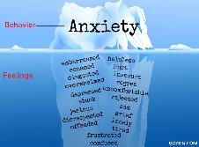













How anxiety is experienced- Symptoms
Unhelpful Thoughts
Physical symptoms
Feelings or Emotions
Behaviour (actions)
Notes:
Karen
Worry and anxiety can be experienced in a number of different ways and they are often linked.
Thoughts - Overestimating perceived danger and underestimating own ability to cope. Worrying about school, or health, relationships. Perceiving our thoughts as facts rather than ideas.
Physical symptoms – associated with adrenalin – preparing the body for action
Behaviour (actions) – Hypervigilance, Avoiding worrying or stressful situations. Controlling behaviours, Very good behaviour – very quiet (link to FFFF)
Feelings or emotions
All linked and effect each other. Eg, when we are thinking about a school test, or difficult meeting we have to attend we will feel sick in our stomach because our brain is sending neuro transmitters – or chemical messengers to our body to prepare it to take action. Some of these messengers get into out digestive system and make us feel sick. We think about avoiding the meeting or test, then we feel bad about ourselves, perhaps overwhelmed.
Improving one will have a positive effect on at least one other. We can reduce our difficult feelings about ourselves by thinking that it is normal to feel worried about a test or meeting, we can calm our bodies down by breathing more slowly, and we can take action to prepare ourselves for the meeting. Anyone of these things will have a positive impact on the others.
Because we are all individuals people will experience anxiety differently so it’s good to try out a few ideas from each section.
Question – what do you do already to help your child manage their anxiety?

Slide 19
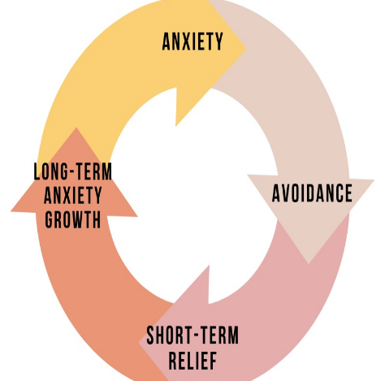
Anxiety Maintenance Cycle.
Seek reassurance or avoid situations is a natural response
It gives only short term relief and soon anxiety returns.
We can get stuck in a cycle of anxiety.
By not exposing ourselves to the situation we are not testing out how we might cope, which will often be better than we predicted.
Notes:
Karen
Eg,
1, If your child is anxious that something will happen to you or other parent carer figures upon separation, you might arrange to work from home or keep your child off school (avoidance) or text when you get to work. (reassurance) However this relief is short term and your child becomes reliant on texting everyday when getting to work. – which could be problematic.
Avoidance is a classic flight response.
Helping your child avoid anxiety or giving reassurance is not always bad, but it can help maintain the cycle of anxiety. Sometimes we can even predict anxiety and not plan or book things in or meticulous plan and practice activities to reduce uncertainty. We need to learn to tolerate it.
Neuro diverse children may experience anxiety in different ways – eg social anxiety and can find uncertainty particularly difficult.

Slide 20
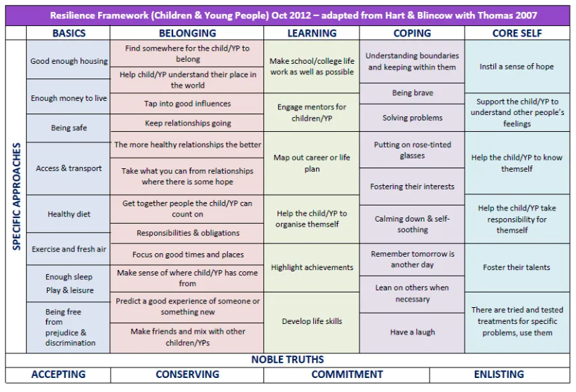
Boing Boing
Resilience Framework

Slide 21
Things we can do to support your child
Transition day (Valley – 29th June; Lode Heath/Arden – 29th June; Lyndon – 5th July; Langley – 6th July)
Additional visits to new classroom/new teacher
After school visits to new site
Transition booklets
Timetables for September to be sent over the summer holidays
Photo books/Social stories
Robust handover sessions between current teacher and new teacher
Additional pastoral team check-ins on the transition day, as well as on the first day back in September
Shorter sessions for EYFS if required

Slide 22
Intake Foundation Stage
Visits to Nursery settings
Individual transition meetings
Visits to school setting
Class photo book
Foundation Stage Year 1
Visits to new class
Visits to playground and other areas
Mixing with current Year 1’s
Year 2 Year 3
Additional visits to junior site
Opportunities for teachers to observe each other
After school visits
Assemblies/playtimes/parents
Class photo book
Year 6 Year 7
Visits to Secondary schools
Additional visits
Transition sessions/study skills
Photos and maps from school
Individual transition meetings
Notes:
Once your child finds out their new class teacher, lots of other things happen alongside the main transition day

Slide 23
Teacher to teacher Handover
Data and teacher assessment
Profiles of children (pupil passports)
Reports and individual needs based plans
Routines and resources that work
Behaviour management and routines
Specific Class Needs Analysis – pupil groupings, phonics/spelling need
Notes:
There is a lot going on behind the scenes and one of these is the in depth teacher to teacher handover. It starts from the summer term and is still apparent sometimes up until Christmas of the next academic year.
Of course there are individuals to talk about but also; teaching styles, behaviour management systems and routines

Slide 24
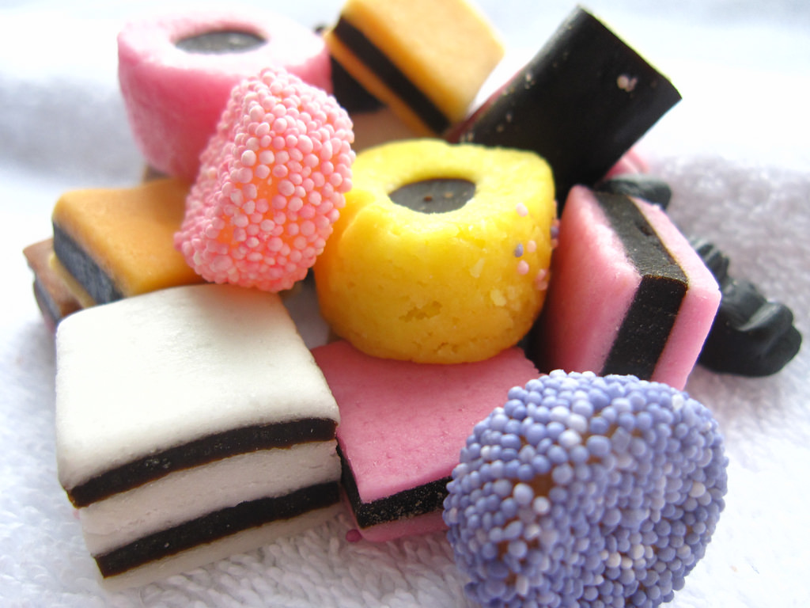
MIXING CLASSES – why?
Purpose – ensuring a balance of abilities and a good social mix
Opportunities for parents to fill out an ‘Anything else you want us to know?’ form
Opportunities for teachers to observe and try out different groupings to ensure pupils gel as a class
Develop social skills with unfamiliar peers

Slide 25
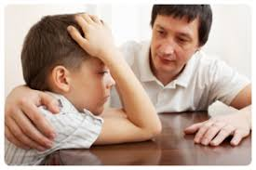

Active Listening Strategy
1. Listen with full attention
2. Repeat back what you’ve heard.
3. Name the feeling – matching it’s intensity
4. Give wishes in fantasy
Try to avoid
Dismissing feelings
Rushing to reassure
Asking questions and giving advice
This helps your child learn to tolerate anxiety and other difficult feelings .
Notes:
Karen 5mins
Our aim is to help our child feel better and also help them to learn how tolerate feelings and come up with solutions.
Look for what I’m not doing as well as what I am doing
Child – I’m not going on the school trip tomorrow
Parent – You’re not going on the school trip?
Child – No
Parent - oh
Child –Yes because what if no-one picks me to sit with on the bus and I end up having to sit next to Mrs Laver and then everyone will know that I have no friends.
Unhelpful –
Parent- That’s not true, you do have friends – and you like Mrs Laver.
Child – saying nothing or turning away.
Totally understandable responses from the parent – How is the child feeling?
Parent – well maybe I can drive you there
How is the child feeling?
Rather than jumping in to deny or reassure (you do have friends, and you like Mrs Laver or rescuing) let’s try repeating back and guessing the feeling.
Parent - so you’ve been thinking what if no-one picks me to sit with on the bus and I end up having to sit next to Mrs Laver and every will know that I have no friends. It sounds like you’re really anxious about this trip.
Child - well yes.
Parent – That’s really hard,
Child - Yes and I had been looking forward to it.
Parent – Hmmmm
Child – hmm
You might listen a bit more just show you are listening with a Hmm or a nod. I’m going to have a go at wishes in fantasy.
Parent - I wonder if you had a magic wand what you would do –
Child – hmm
Parent -Maybe make a wonderful friend to sit with? or make Mrs Laver have all the best snacks so everyone was jealous
Child hmm – well I do quite like Mrs Laver – and if Reece goes, he might sit with me.
Name it to tame it
Modelling – Carly and Karen.
Wishes in fantasy – can acknowledge feelings whilst being a distraction technique once feelings are tamed.
Discussion points
How to start a conversation
Pick your moment

Slide 26

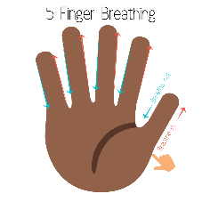


Calming our bodies using our breath.
Training your brain and body
Mindful breathing techniques
Examples for anxious moments
Notes:
Karen up to 5mins
2.05pm
Why it’s helpful – message it sends to our bodies
Breathing techniques that give our minds something to do too – so stop us from thinking.
Lots of clips on You tube, so good opportunity for your child to have a look

Slide 27

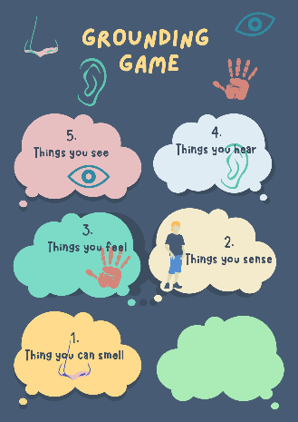



Using our senses for soothing and grounding
Notes:
We use senses to ground us as they are the way our body receives information.
Movement and immersion can also be very soothing.
How do the children you know – like to sooth themselves.

Slide 28

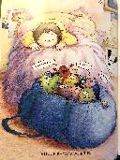
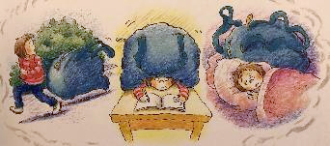
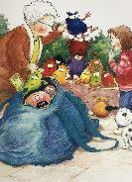
Helpful and unhelpful thoughts
A worry is a thought.
Some worries can be helpful and motivate us to take action
But some can be unhelpful,
especially if they are about things that are out of our control or unlikely to happen.
They get bigger over time without us even noticing. And we get used to them
Sometimes they become beliefs and we get attached to them
Worries can take over and step 1 is to notice them.
Notes:
Helpful
Likely to happen/real event worry
In response to a trigger
Feel in control/can problem solve
Does not take up much of your time
Eg, I haven’t done my homework I’m going to get into trouble.- Quite specific
Unhelpful worries
Unlikely to happen or about future hypothetical events
More habitual
Worry feels out of your control
Spend a lot of time worrying
Eg, No one at school likes me, I have no friends. – very generalised
However, letting go of worries is a tricky skill. There are ways to support this…
Bag full of worries is available to watch on you tube

Slide 29
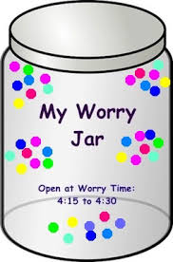

Worry Time
Plan when to have worry time
Worry time – Go through the worries one by one.
Write down worries and put the in the worry jar (let go)
Do something else (distract)
Notes:
Carly 8mins
“Worry Time”. This is a technique for you to help your child to contain their worries. It’s a time in the day when they allow themselves to worry and it might also be a time when you can work through them with them.
You could start by making a worry jar or box.
This means that when it is ‘Worry Time’ you have had the opportunity to prepare your responses to the worries.
Plan when in the day you want to have worry time and for how long-Experiment with when no more that 30mins.
Outside of worry time – Encourage your child to draw or write (or leave a voice note) their worries as they feel them and put them in the jar.
Do something else – once they have written down their worry support them to distract themselves with another activity.
During worry time – discuss your worry – name your child’s feelings – avoid dismissing feelings or reassuring – try out some strategies.
For hypothetical worries, let the worry go, use a distracting activity.
You could let a worry go by:
-Writing the worry down and throwing it away
-Imagining the worry being tied to a balloon and floating away
-Watching the worry pass by and leave your mind.
“Letting go of worries” - By acknowledging and defining your worries you are no longer simply ‘ignoring’ them. However, once you have solved whether or not you have any control over your worry, it is important to let go of the worry and redirect your attention.
Letting worries go – would anyone like to share ideas they use with their children to help let worries go?

Slide 30
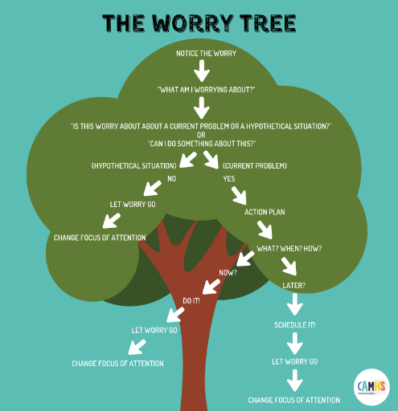
The Worry Tree
The Worry Tree aims to validate how the young person is feeling and to support them in managing their worries by:
1, Identifying whether a worry about
Practical worry e.g. about a current problem
or a hypothetical worries e.g. about something that might happen.
2 Working out what to do with those worries
Letting go of hypothetical worries
Problem solving practical worries
Notes:
Talk through worry tree
“Letting go of worries” - By acknowledging and defining your worries you are no longer simply ‘ignoring’ them. However, once you have solved whether or not you have any control over your worry, it is important to let go of the worry and redirect your attention.
Letting worries go – would anyone like to share ideas they use with their children to help let worries go?
You could let a worry go by:
Writing the worry down and throwing it away
Imagining the worry being tied to a balloon and floating away
Watching the worry pass by and leave your mind.
However, letting go of worries is a tricky skill. There are ways to support this…

Slide 31

The problem solving octopus
4, Make a plan including
Choose a possible solution
When you will do it
How you will do it
Who will might you do it with
What will help to overcome difficulties
1, Write down the problem in one or two sentences
2, On each tentacles write a possible solution, starting with your child’s ideas.
3, Discuss each possible solution, weighing up the pros and cons before choosing one to try
5, Make a time to review how it went, together and decide what’s next.
No matter what it is!!
Notes:
2,30pm Karen 5min
Example : Going into school
What’s the problem – going to a new class/ school. New teachers - they won’t know me and they might be strict and scary
What does that feel like- Scary, sad - I don’t want to go.
Ideas:
Child first
1, Child; Stay at home
2, Child: Do home schooling
3, Parent: Ask people who know the school, or teacher what it’s like?
4, Parent: Arrange a visit the school or classroom.
5, Child : Go with and visit with my friend.
6, Child : Try a different school
6, Parent : Make a sort of all about me book, so the teachers can know you better
7, ?
8, ?
Parent: ok now let’s have a look at all theses ideas and think about what’s good and not so good about them.
1, Staying at home – yes that would be less scary, anything that’s not so good?
Child – I might get lonely and I wouldn’t learn.
Hmm Yes, I don’t think that’s ok, I think we should cross that one out - is that ok?
Child – yes
Parent – what about number 2 – Be home schooled. What are the good and not so good things about this one.
Child – I supose I still might miss my friends.
Parent – And I think I would struggle to be your teacher – we might get very grumpy with each other, and I would need to give up my job.
Child hmmm – better cross that one out then.
Parent – if I had a magic wand and I could give up my job and come and teach you and all your friends
Child – No that would be weird No no cross that one out.
And so on.

Slide 32

Special time –for when you child creates worries because they love worry time!
Join your child in their play or activity.
For 10 minutes a day
Improves the parent and child relationship
Improves trust and communication
Enhances your child’s play or interests.
Improves concentration.
Improves self esteem
Improves problem solving skills.
Benefits
Notes:
Carly if time 2mins
Do we need to put in something about attention, routines, sleep, Boundaries?
When there is no request or obvious need for any of the strategies that we have mentioned.
We can make sure the special time is kept any children or young people build their emotional understanding and communication skills.
There is a hand out for this.
Recommend 10 minutes every day with your child so that it is predictable.
Let your child choose the activity.
Play alongside them but don’t take over.
KEEP to 10 minutes.
Explain that you have something to do in ten minutes (eg cook dinner)
Timmer if struggles with boundaries.
Get up and say that you need to stop but encourage them to carry on if they are enjoying themselves.
No board games as these can get emotional and competitive.
Using play with autistic children to explore how to cope with uncertain situations

Slide 33





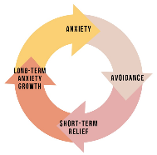

Choose one thing
Notice and contain unhelpful thoughts
Sooth our bodies
Actively listen
And try it for at least week
Make a plan
Avoid avoiding
Notes:
Karen 2mins
Remember changing any one of these will impact on the others

Slide 34
What’s staying the same?

Slide 35
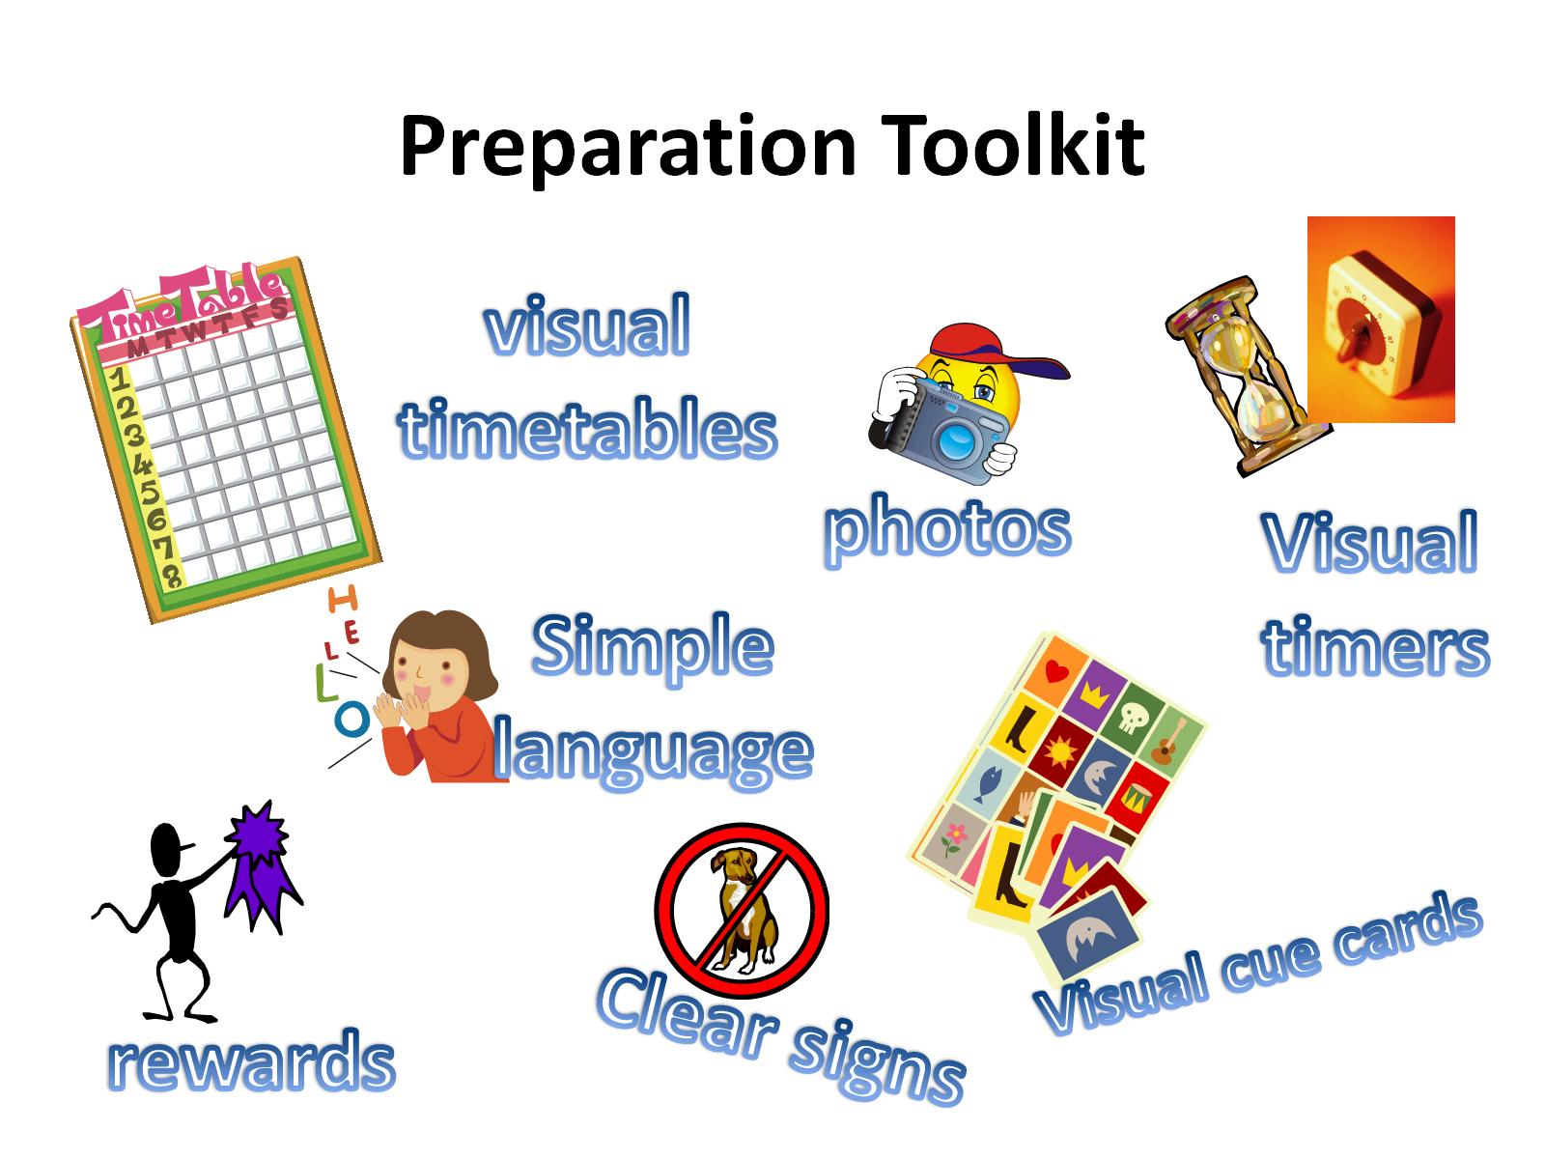
Preparation Toolkit

