Slide 1
Parent Workshop: Homework
Friday 26th October 2023

Slide 2


Slide 3
Why do school’s set homework?
Create a culture of learning that isn’t limited to school.
Embed new learning.
Practise new skills.
Discover more about the world around them with their family.
‘Student becomes the teacher’ model.
Research shows that pupils who engage in home learning with their family are more successful academically and more resilient as young people.

Slide 4

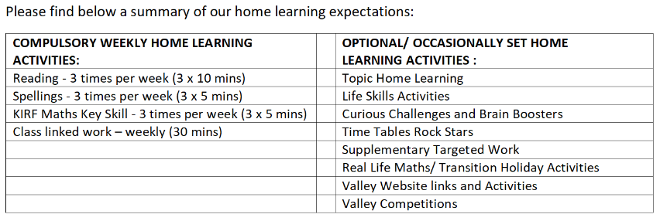
Valley homework expectation
Class linked work:
Y1 – Phonics
Y2-Y6 – Maths Homework

Slide 5
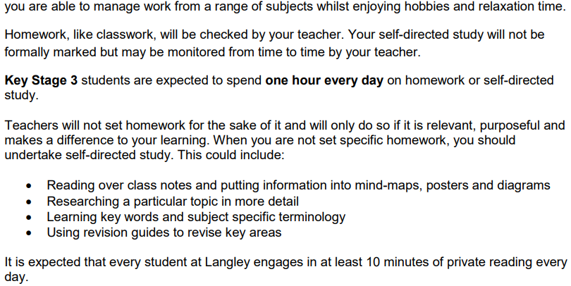
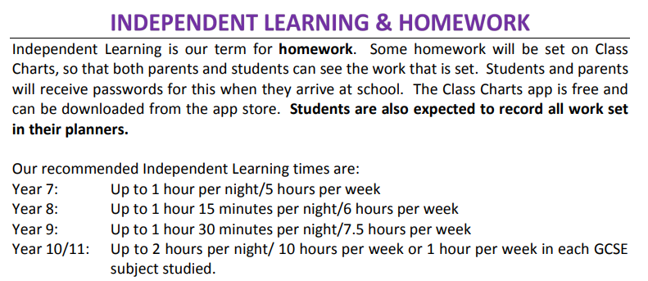



Secondary neighbours…

Slide 6



What are some of the challenges you face as parents?

Slide 7
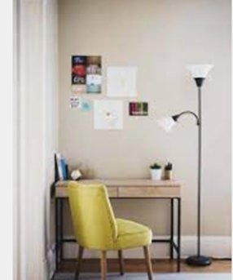
Setting the scene…
Distraction free environment
Snack and glass of water
All equipment ready
Clutter free surface
Good lighting
Timer
Calm music

Slide 8
Timing is everything….
Family calendar
Club nights
Finding hot spots for your child
Little and often vs. Blocked time

Slide 9
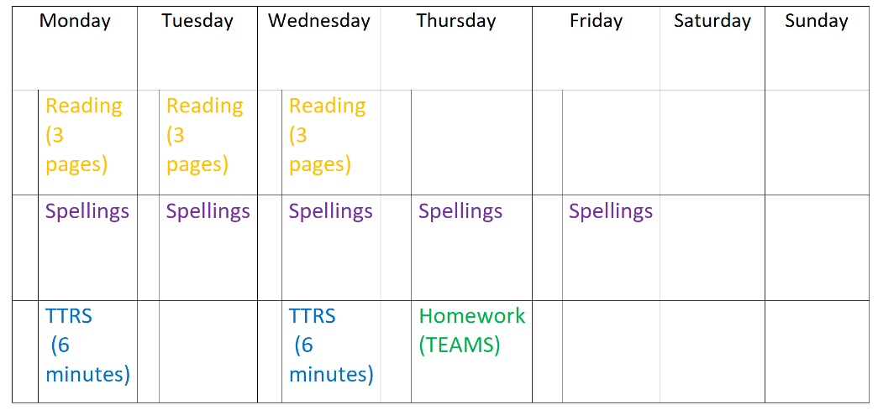
Maths (5 minutes)
Maths (5 minutes)
Maths (5 minutes)

Slide 10


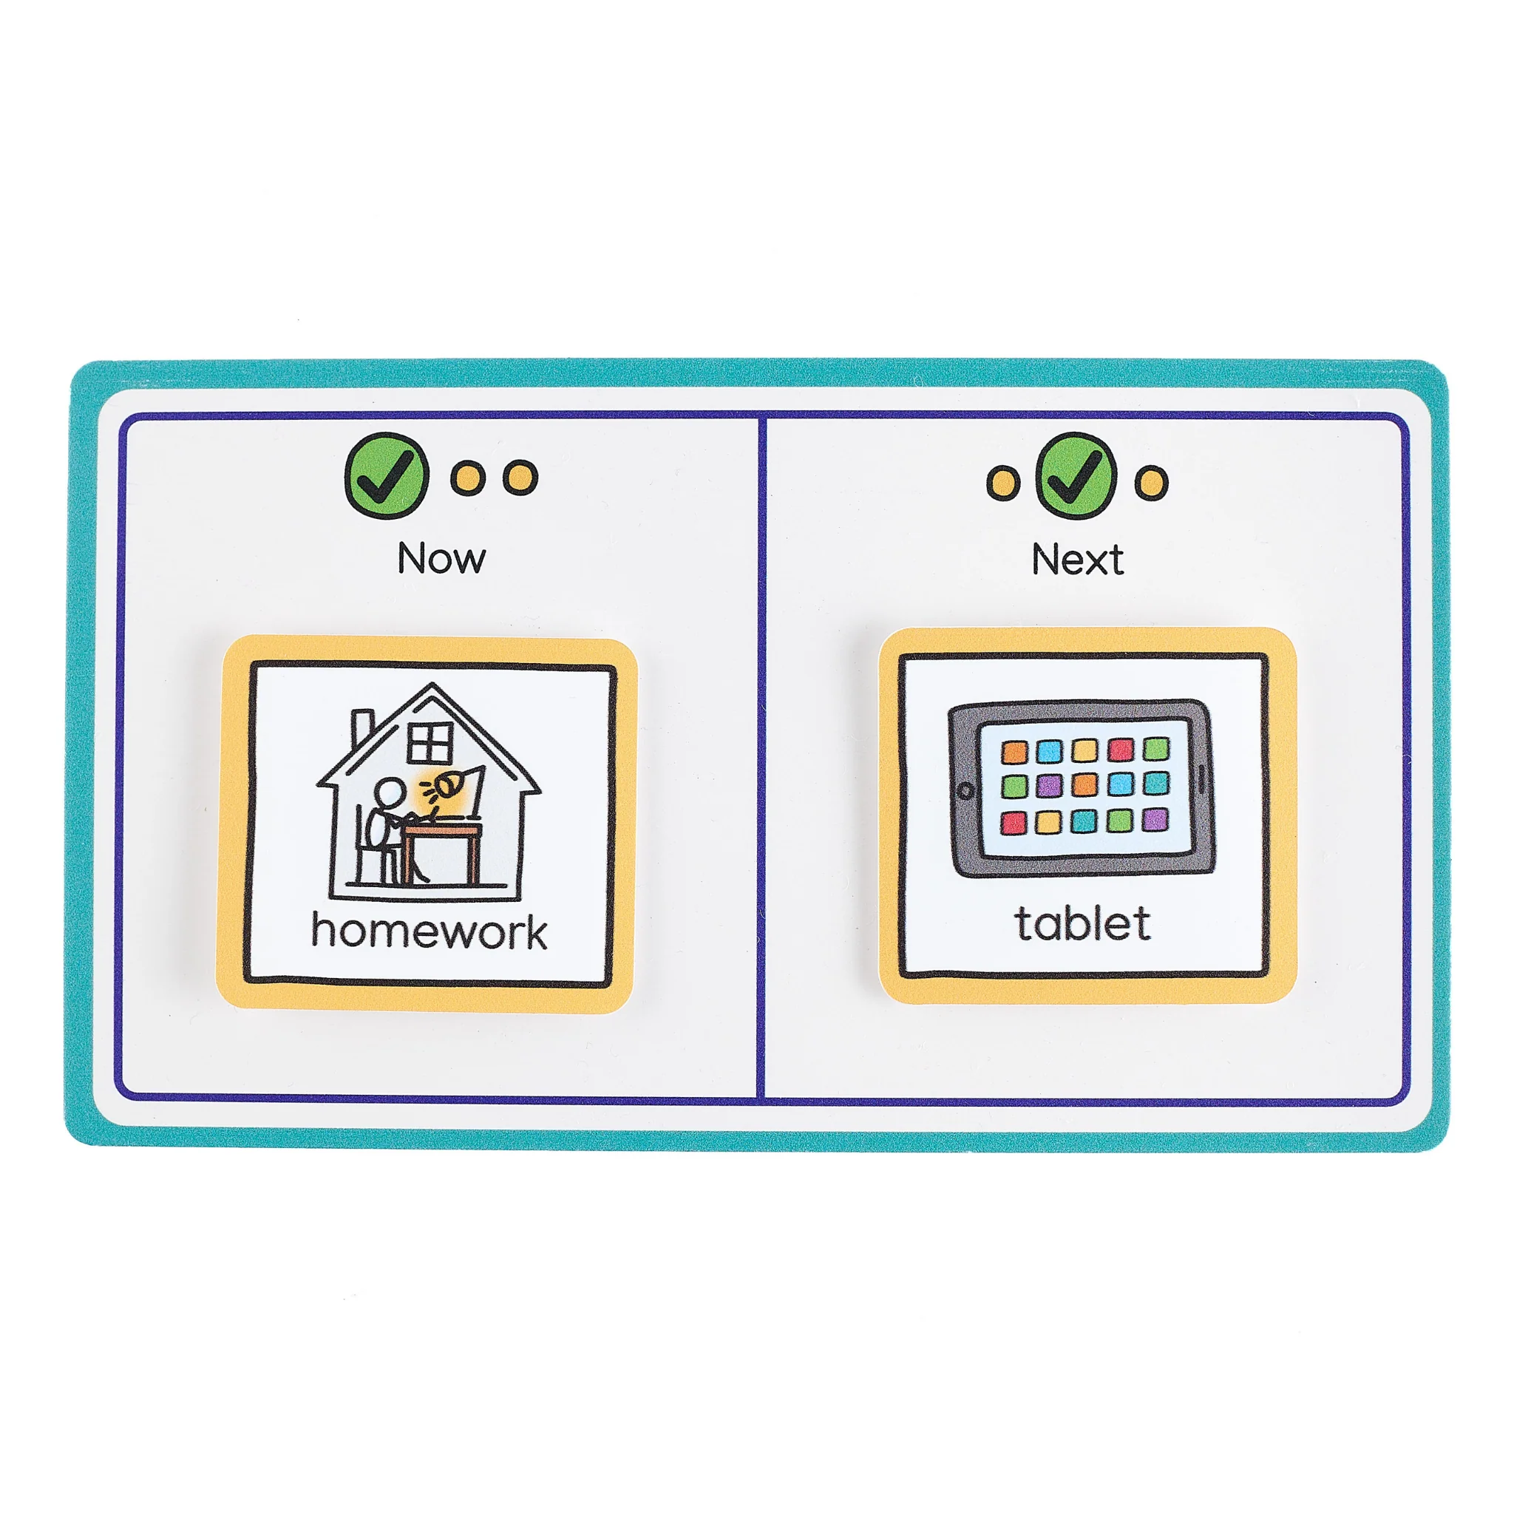
Visual Aids

Slide 11


Slide 12
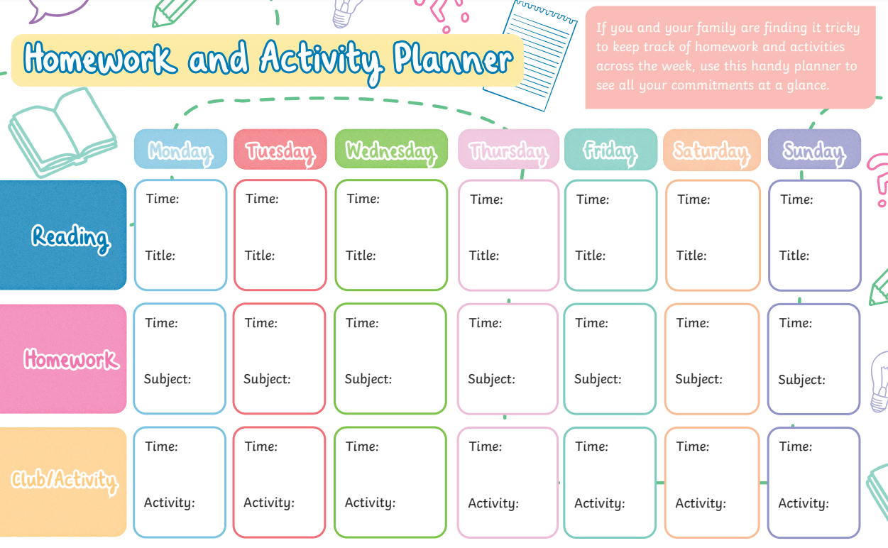

Slide 13
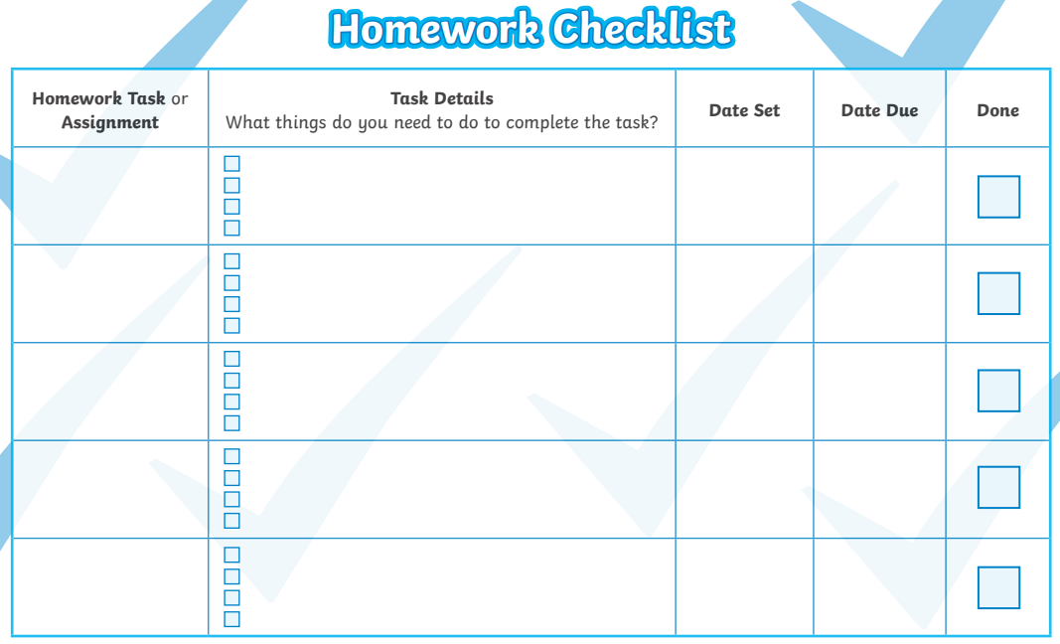

Slide 14
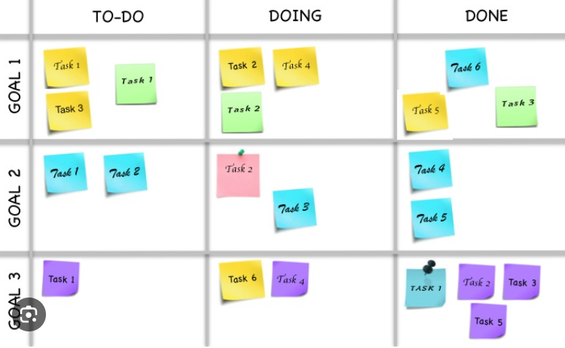

Slide 15
Your role…
Monitor, organise, motivate
Praise effort rather than accuracy
‘Think aloud’ – I wonder if…
Stick to timers, even if task isn’t complete
Become the ‘project manager’!

Slide 16





When is best?
Straight after school isn’t the only option…!
With breakfast
In the car
In bed, before bedtime
Whilst waiting for food
Mid-weekend

Slide 17
School is school…Home is home!
Homework club/After school club
Less formalised environment
Different ways of recording
Social stories

Slide 18
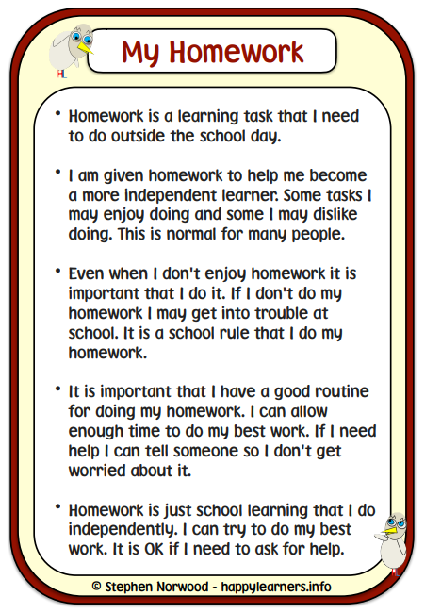
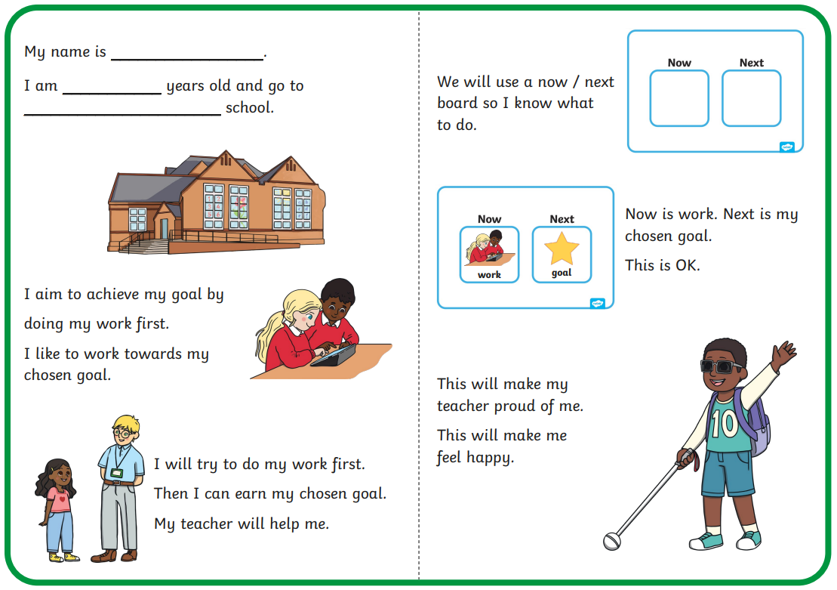

Slide 19

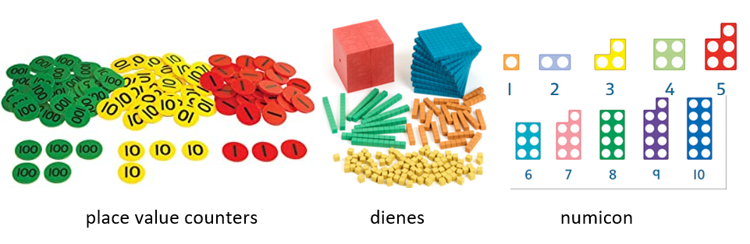



Equipment…

Slide 20

Help!
Don’t fake it!
Ask Professor Google
Create a Homework Hotline
Class email address
Set a good example

Slide 21
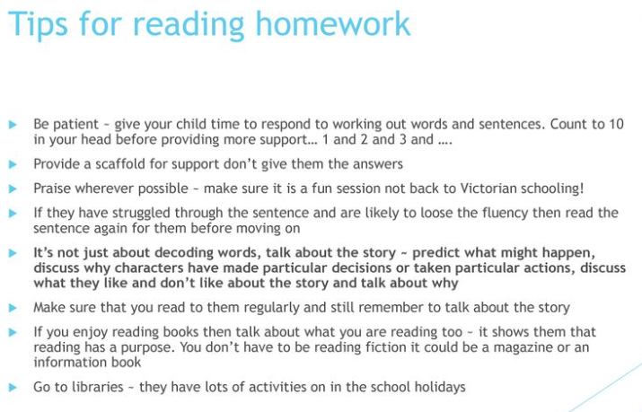

Slide 22


Slide 23
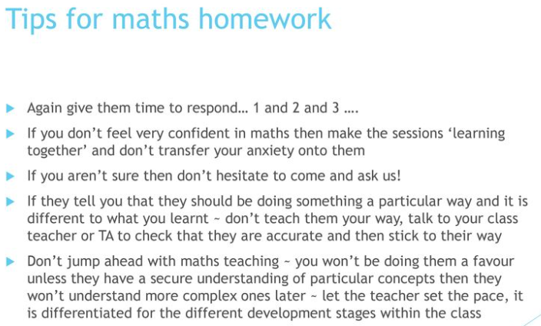

Slide 24
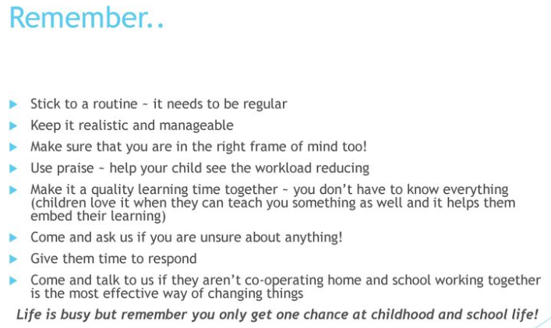

Slide 25

Top Tips
Be positive about homework
Help your child with time management
When your child asks for help, provide guidance not answers

Slide 26
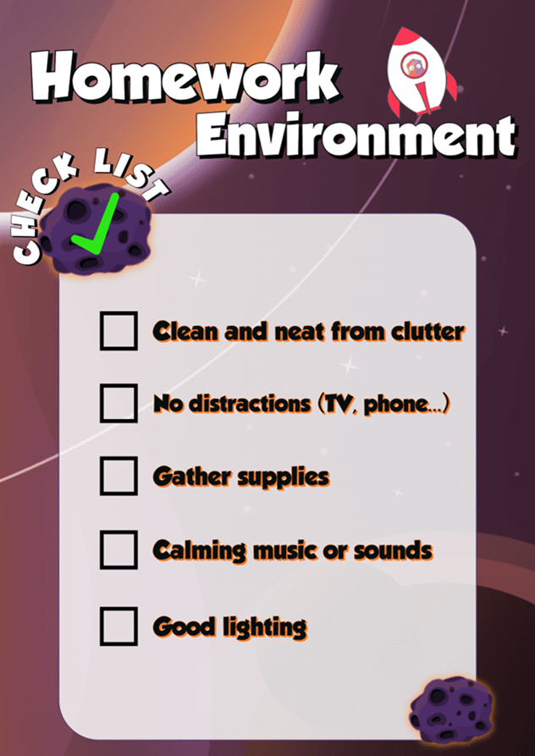

Slide 27

"Many parents are under the impression that they shouldn't have anything to do with their children's homework. This comes from schools emphasizing that homework is a child's responsibility, not the parent's while it is absolutely true that parents should not do their children's homework, there is a role for parents - one that's perhaps best described as "homework project manager." Parents can be monitoring, organising, motivating, and praising the homework effort as it gets done. and yes, that means sitting with your child to help them stay focused and on task. Your presence sends The message that homework is important business, not be taken lightly....."

