Slide 1


Year 1
Curriculum Evening

Slide 2
Year 1 Team
Mrs Gorman
Mrs Byron
Miss Goymer

Slide 3

VALLEY'S VISION
GROWING AND LEARNING TOGETHER TO BE THE BEST WE CAN BE!
We always…
ASPIRE for excellence
ENJOY learning
ACHIEVE success
CHALLENGE ourselves further.

Slide 4
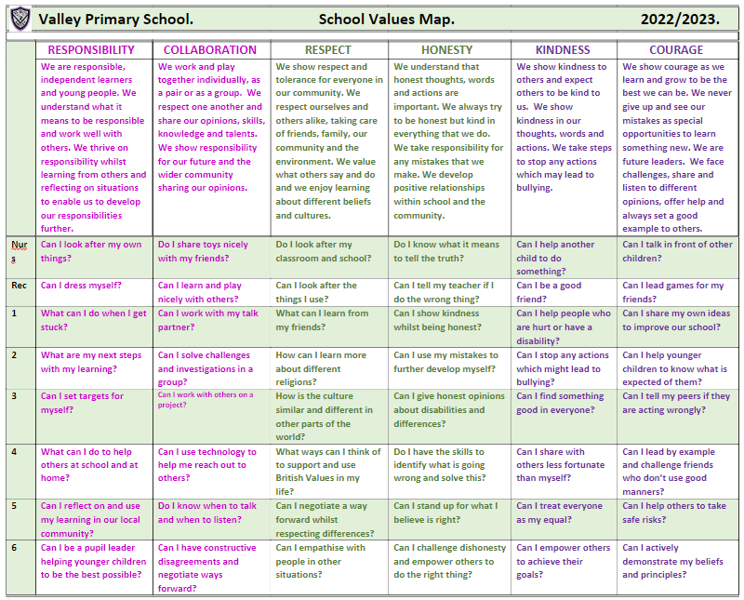
Valley Values
Notes:
David

Slide 5


Slide 6
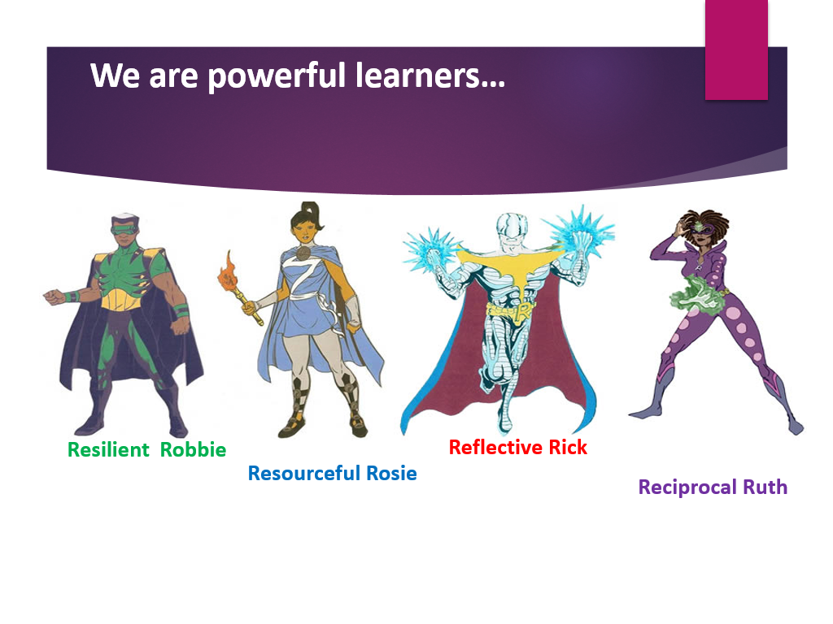

Slide 7
A Typical Day
8.30 – 8.45 – Challenge of the Day
8.45 – 9.00 – Register and Activate
9.00 – 9.20 – Assembly/PSHE
9.20 – 9.45 – Phonics
9.45 – 11.00 – English, including Reading Skills
11.00 – 11.15 – Play & Snack
11.15 – 12.30 – Maths, including key skills
12.30 – 1.30 – Lunch, including 15 minutes reading
1.30 – 1.35 – Register and Activate
1.35 – 3.05 – Foundation Subject lessons
Science, Topic, Computing, PE, Music, RE, Guided Reading, Handwriting, Spellings
3.05 – 3.20 – Mental Health focus & Story
3.20 – Home time

Slide 8
English
Curriculum taught through Power of Reading. Two texts covered each half term.
r
Key Skills:
-Capital letters, full stops, question marks, exclamation marks, conjunctions (and/because), spelling and adjectives
-Begin to use the suffixes –er, -ing, -ed, -est and the prefix –un
-Focus on speaking and listening, reading and writing
-Skills taught through different genres
-Designed to engage, interest and excite
-Handwriting – Nelson. Letter formation, size of letters and positioning.
Phonics
-Read Write Inc
-Daily sessions
-Children grouped by ability and assessed each half term.

Slide 9
Spellings
Children will bring home spelling lists that include words to learn for weekly Friday assessments and half termly Wizard words.
Weekly spellings
- Spellings linked to a sound learnt in phonics - Lists will include up to 10 words and the children will be tested on 5 of them on a Friday in a variety of ways.
- Teachers will assess if the children are applying new spellings in a variety of ways or are still working towards.
- Children will no longer be given a score at the end of the test.
Wizard words
-These are the common exception words for each year group.
-Divided into half terms.
- The words will be talked about and used in school across the half term and should be learnt at home across the half term.
- All words will be tested at the end of each half term.
r

Slide 10
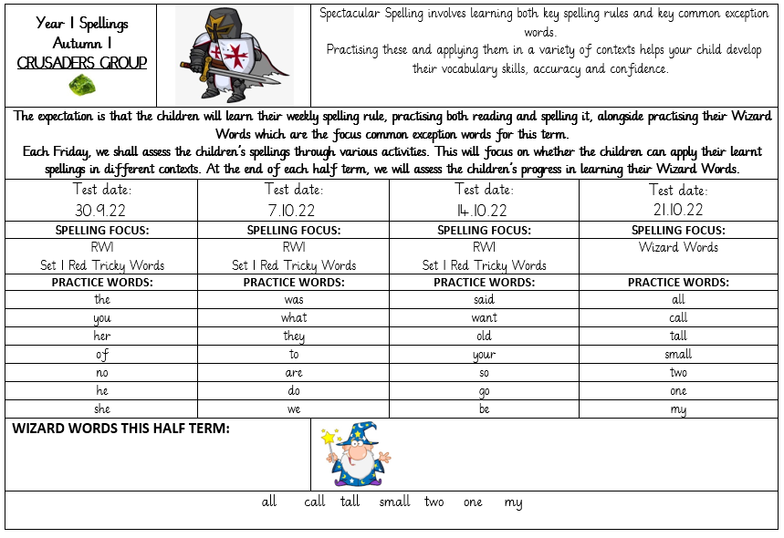
Spelling Sheet

Slide 11
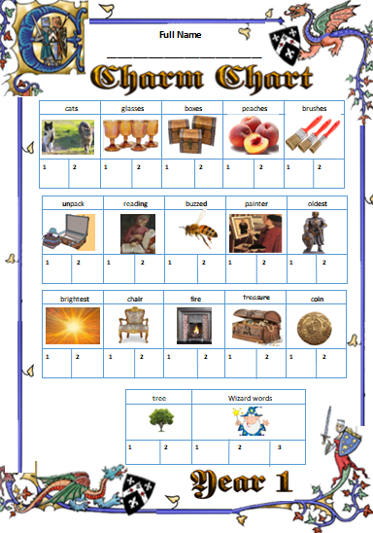
Charm Chart

Slide 12
Maths
Key Skills
Number: place value, addition, subtraction, division, multiplication and fractions.
Measurement: length, mass, weight, capacity, volume, time, money, sequencing events, days of the week, months of the year.
Geometry: shape (2D and 3D), position and direction.
Daily key skills sessions – consolidation of quick recall facts.
KIRF

Slide 13
Science
 | Autumn 1 | Autumn 2 | Spring 1 | Spring 2 | Summer 1 | Summer 2
Science | Materials | Materials | Seasonal Change | Animals including humans | Animals including humans | Plants
Children will learn about:
Plants, identifying and naming plants and looking at their basic structure such as: leaves, stem, roots and flower.
Animals including humans, identifying and naming a range of animals and understanding how and why they are grouped.
Everyday materials, looking at their properties. Distinguishing between an object and the material it is made from.
Seasonal changes, observing changes across the four seasons and looking at different types of weather.

Slide 14
Topic
 | Autumn 1 | Autumn 2 | Spring 1 | Spring 2 | Summer 1 | Summer 2
Topic | The Queen in Black (History) | Moon Zoom (D&T) | Colour Chaos (Art) | Towers, Turrets and Tunnels (British Values) | Towers, Turrets and Tunnels (British Values) | NSEW (Geography)
At the beginning of each new unit the children will take part in a WOW day to immerse them in their new learning and engage and excite them. They will also have an Express day at the end of the unit to share their learning.

Slide 15
Friday Afternoon - Enrichment
On a Friday the children finish at 1.50pm.
Some children will attend enrichment clubs in school.
Those children going home are encouraged to access the brain booster and curious challenge each week.
These can be found on the school website under Children and then Feel-Good Friday.
Please feel free to send in pictures of your children completing these activities as we would love to see the fabulous things the children do.

Slide 16
Healthy Schools
The children have 2 PE lessons a week – where possible this is one indoor session and one outdoor session. (Please ensure your child has an indoor and outdoor kit)
PE days - See the half-termly newsletter or year group page on the website for these on a half-termly basis
Please ensure that any earrings are covered or removed on PE days.
Please ensure that all items in your child’s PE kit are named and that PE kits are kept in a purple or black drawstring bag.
Other Curriculum Opportunities

Slide 17
PSHE & SMSC
The children complete an RE lesson every week where they learn about different faiths.
In Year 1 children will focus on the creation story, Christmas, Jesus as a friend, Palm Sunday, Shabbat, Rosh Hashanah and Yom Kippur.
The children complete a PSHE lesson every week where they focus on their feelings, relationships and how to support themselves and others.
Other Curriculum Opportunities

Slide 18
Personal Development
Music
In Year 1 the children will study a range of genres including reggae, hip hop and classical. They will learn to find the pulse and find out how rhythm and pitch work together. They will also look at the history of music.
Computing
In Year 1 the children will learn how to keep themselves safe online, program Beebots to follow simple routes and learn how to log-on independently.
Other Curriculum Opportunities

Slide 19
This Year’s Assessments
In Year 1, the children will complete a phonics assessment in June. This is a test of the children’s ability to read words and to segment and blend unfamiliar words.

Slide 20
1) Reading– it is crucial your child reads regularly. This can just be a small amount but will really help them develop their skills and widen their vocabulary and understanding. It is very helpful if you can ask them to discuss their reading or ask them specific questions about what they have read. It is also important your child reads for pleasure or hears stories read to them which they enjoy alongside their specific targeted reading books. Stickers are given at different points for reaching specific milestones as noted in the children’s reading diaries.
WE EXPECT EVERY CHILD TO READ AT LEAST 3 TIMES PER WEEK FOR A MINIMUM OF 10 MINUTES EACH TIME AND FOR THIS TO BE NOTED IN THEIR READING DIARIES.
English Homework - Reading
Notes:
Jon

Slide 21
English Homework - Spelling
2) Spellings - it is vital your child practices these to help them develop their vocabulary skills, accuracy and confidence when writing/decoding. All children will be in a spelling group linked to their quest castle. Each week they will focus on a spelling rule and have a list of words which use that rule to help them practice. Children will be given an activity to apply a selection of these on a Friday and will be rewarded for learning the key rule with a charm on their spelling quest sheet.
Alongside this, they will have wizard words which are common exception words they should practice throughout the term ready for their wizard word activity to test these at the end of term.
We expect every child to practice in different ways at least 3 times per week.

Slide 22
3) KIRFs – Key Instant Recall Facts.
Each half term, we choose a different focus and ask you to help us to encourage your child to learn their instant recall facts. We test the children at the start and the end of the half term and hope to see an improvement.
We expect every child to practice their KIRF at regular intervals throughout the week resulting in a minimum of 15 minutes practice with this.
Maths Homework
Notes:
Jon

Slide 23
Topic Home Learning Projects
1) A choice of suggested cross curricular tasks will be sent home at the beginning of each topic. Please encourage your child to complete as many tasks as possible ensuring a minimum of one per country to ensure they travel around the world each half term.
We encourage all children to bring in their work for their class to celebrate on a Friday. Each piece of completed work will be rewarded with one entry into the big prize draw. Each child who travels around the world within the half term will receive 10 additional entries for the Big Prize Draw. The more entries your child gets the more chance they have of winning in our end of the year big prize draw.
Optional
half-termly activities –
Topic Home Learning
Notes:
Jon

Slide 24
Optional half-termly activities –
Life Skills
2) Life Skills Activities – A focus life skill will be set each half term and your child is encouraged to try and show this during the half term. We encourage all children to bring in evidence of this for their class to celebrate on a Friday. Each half term a child will be chosen as the life skills champion for the class. The winner will receive a gold star pin badge.

Slide 25
3) Curious Challenges and Brain Boosters – As part of our Feel-Good Friday, a suggested Curious Challenge and Brain Booster are set each week for your child to choose to complete at home if they wish. We also set one Deeper Thinking Question each week. These all focus on good Mental Health.
We encourage all children to bring in evidence of this for their class to celebrate on a Friday. Each half term a child will be chosen as the Mental Health Champion for the class. The winner will receive a smiley face pin badge ☺
Curious Challenges and Brain Boosters
Notes:
Jon

Slide 26
Further Information
Please ensure that all items from home are named so they can be returned should your child misplace them.
Reading books should be in school every day. Books will be changed every Friday. Please ensure the reading diary has been signed.
Please ensure your child has their water bottle in school every day with water in. They may bring in a separate drink for lunchtimes.
Should you have any queries or need to speak to your child’s teacher, please email using the class email address or ring the school office and request for a telephone call home. You can also contact the parent liaison lead should you prefer or have any whole school concerns or feedback.

