Slide 1


Reception Curriculum Evening

Slide 2

VALLEY'S VISION
GROWING AND LEARNING TOGETHER TO BE THE BEST WE CAN BE!
We always…
ASPIRE for excellence
ENJOY learning
ACHIEVE success
CHALLENGE ourselves further.
Notes:
Jon

Slide 3
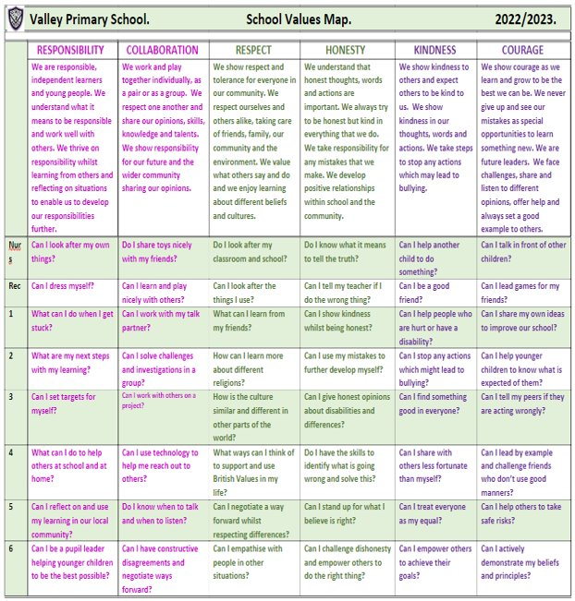
Valley Values
Notes:
David

Slide 4

Valley Life Skills
Valley Primary School. Life Skills Challenges.
 | MENTAL HEALTH MANAGEMENT SKILLS | PHYSICAL HEALTH MANAGEMENT SKILLS | TIME MANAGEMENT SKILLS | DECISION MAKING SKILLS | HOME MANAGEMENT SKILLS | INTERPERSONAL SKILLS
 | We have feelings and thoughts about ourselves and the world around us. These can affect how we cope with life’s challenges and stresses. | We promote growth in confidence and awareness of control. This supports communication and language using large and small movements and gestures to convey messages to others. | We show good time management. This process helps us organise and plan how to divide our time between specific activities. Good time management enables us to work smarter – not harder – so that we get more done in less time. | We promote effective decision making. This involves choosing between possible solutions to a problem. Decisions can be made through either an intuitive or reasoned process or a combination. | We promote good home management skills. This affects how we manage challenges and activities at home. | We think of the behaviours and tactics we use to interact with others effectively. This involves choosing good behaviour when interacting with others.
Nurs | Can I tell people if I am feeling sad, happy, angry, glad or excited? | Can I wash my hands and dry them? | Can I focus on one activity until it is finished? | Can I choose between two options? | Can I put my dirty washing in the washing basket? | Can I share when I am taking turns with my friends?
Rec | Can I say what I am good at? | Can I pick up my rubbish and put it in the bin? | Do I know who to ask for help if I am stuck on a task? | Do I know how to make a decision? | Can I tidy my room? | Can I be a good friend?
1 | Do I know who to go to if I need help? | Can I eat 5 portions of fruit and vegetables per day? | Can I say how I am organised? | Do I know who to go to in school or at home to help me with my decision? | Can I share my toys with a person at home? | Can I work as part of a team?
2 | Can I say what I am most proud of? | Do I know what a balanced diet is? | Can I be good with my time management? | Do I ask a friend if I am stuck? | Do I know how I can help my parents at home? | Do I know the behaviour I should show in class?
3 | Can I say what I enjoy most about being in the classroom? | Do I help myself to relax? | Do I know how to improve my time management? | Can I use my mistakes to further develop my decisions? | Can I recycle things which I have finished with at home? | Do I understand the kind gestures I can use to everyone?
4 | Can I say what I am good at and justify it? | Can I say why exercising is important? | Do I know the different types of equipment I can use to keep track of time? | Do I have the skills to identify what is going wrong and solve this? | Can I set home targets? | Do I understand why good manners are so important?
5 | Do I know why it is important to be a good role model and friend? | Can I have a balanced diet? | Can I give an example of when I show good time management? | Do I choose the easiest choice or the quickest choice? Why? | Do I know how I can be a good role model at home? | Can I help others to behave better?
6 | Can I be a positive role model and friend? | Do I know why it is imperative to wash and dry my hands? | Do I understand why good time management is important? | Can I describe a time when I made a great decision fast? | Can I justify which skills are important and why? | Can I challenge myself at school?
Notes:
David

Slide 5
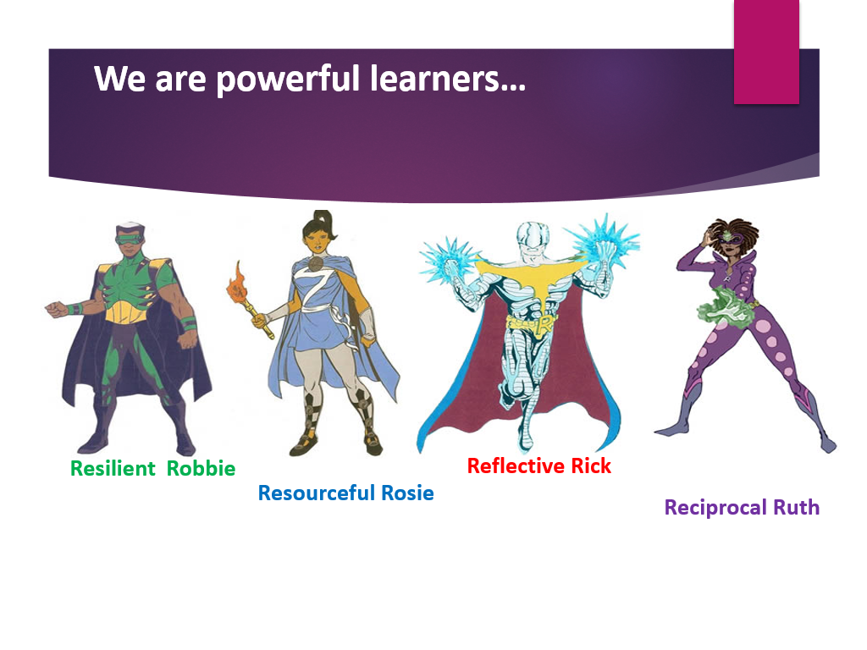

Slide 6
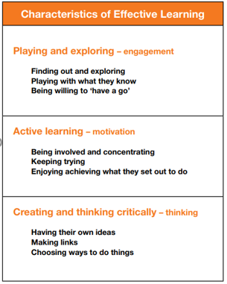
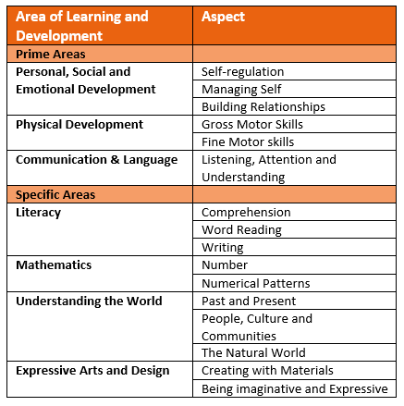
The EYFS Curriculum

Slide 7
Reception
Team
Mrs Sharp
Mrs Ward
Mrs Collett
Mrs Landeau
Mrs Brookes
Miss Brown

Slide 8
A typical morning in Reception
On arrival, each child orders their lunch (please look at the menu on the school website each morning and help your child to decide what they are going to order)
Early morning task
Activate
Power of Reading
Free flow sessions between all rooms (Creating, Imagining and Exploring) and outside. During this time children can complete an adult led activity linked to our Power of Reading book, Rainbow challenges and they can look through their Learning Journals. There is also continuous provision available which is enhanced or changed each week in response to observations
Self-service snack and milk (provided by school)
Phonics carpet session.

Slide 9
A typical afternoon in Reception
Carpet focus: Maths
Squiggle whilst you wiggle
Free flow session across rooms and outside offering continuous provision throughout the afternoon alongside an adult led group activity that has a Maths focus
Carpet focus: RE, Jigsaw, Music or Topic
Singing and story
Home time.

Slide 10
Personal, Social & Emotional Development
(P.S.E.D)
This is the part of the Curriculum that helps children to make relationships with the people around them and to develop their own self - confidence whilst managing their own feelings.
This is taught through Jigsaw scheme lessons that often include discussing scenarios that the children are familiar with. We then discuss these in real life situations as they occur. We encourage the children to initiate conversations whilst taking account of others that are involved in the conversation. The children will develop their confidence to ask questions and to have a go in new situations. They will learn how to manage their own feelings and begin to negotiate and solve problems with the other children around them.
PSED also includes children learning how to manage their own personal needs. The children will dress and undress themselves independently. This includes doing up fasteners and manipulating clothing that is inside out. The children will learn the key things that are required to stay healthy.

Slide 11
Communication
& Language
Over time, the children in Reception will be expected to concentrate for longer periods of time on one task. They will learn how to listen and respond appropriately. This may be through stories or instructions that involve more than one step. The children will be encouraged to comment and ask questions about what they have heard.
The children will be introduced to a wider vocabulary with words used in a variety of contexts. The children will be supported to use these new words appropriately. We will provide them with opportunities to develop their speech and language through story telling activities. During their play, they will be encouraged to use their own experiences and their imagination to develop the roles they are taking on.

Slide 12
Physical Development
Physical development includes bigger gross motor movements and smaller fine motor movements.
The children will be encouraged to experiment with movement and provided with resources that enables them to jump, climb, hop, skip and balance.
During Reception, children will begin to use a dominant hand and hold a pencil effectively. Children will have handwriting sessions and be shown the correct way to form each letter.
The children will also learn to use a variety of tools safely and competently such as paintbrushes, scissors and cutlery.
They will begin to show accuracy and care when drawing.
PE lessons: (PE kits will stay in school for the half term)
Tuesday – Peake
Thursday - Aston
Friday - Grylls

Slide 13
Literacy
Reading
The children will initially bring home a library book for you to read to them. Hearing as many stories as possible will support the children ready to read for themselves as they will understand the functions of reading and text. They are also bringing home a sheet that shows you which sound they learned in phonics that day. Reading books will follow at a later date and initially will be picture books for you to talk about the pictures which will then move onto books with words. It is beneficial if the children read the book several times as this will aid their fluency so that they are not sounding out every word.
Writing
Children will follow a similar process with their writing. They will initially use their own marks to convey meaning and then learn how to write some letter shapes. They will use these letters to build words and eventually will write simple sentences.

Slide 14
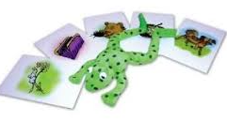

Literacy:
Phonics
Phonics
Phonics is the key to reading and writing as it breaks words down into the individual sounds. We teach phonics using the Read Write Inc system. The Reception children have started the Set 1 sounds and later in the year they will learn the Set 2 sounds. The children are taught the sound of the letter and how to sound out words. We call this Fred Talk. How to say the sounds
You can buy your own set of flashcards from Amazon. Link to Amazon
Once the children have learned the sound that each letter makes, they learn how to put the sounds together through oral blending and then how to read words and spell. They will then bring home a Read Write Inc reading book that includes the sounds that they know. They will also bring home a book that is a similar level but from a different publisher so that they are exposed to a variety of books.

Slide 15
Mathematical Development
The children will explore aspects of Maths through a variety of experiences to develop a deep understanding of each area.
Children will develop a deep understanding of numbers within 10. They will learn to subitise (recognize quantities without counting) to 5 and automatically recall number bonds to 5 and then 10. They will count confidently beyond 10. They will count, match numbers to amounts, use the language of fewer and more and solve problems that involve halving, doubling and sharing.
Children will use everyday language to talk about size, weight, capacity, position, distance, time and money to compare quantities and objects and to solve problems. They will recognise, create and describe patterns. They will explore characteristics of everyday objects and shapes and use mathematical language to describe them.

Slide 16
Reception Curriculum Themes
 | Autumn 1 | Autumn 2 | Spring 1 | Spring 2 | Summer 1 | Summer 2
Topic | All About Me | Toys | Monsters | Our Garden |  | Safari Adventures
Notes:
Natasha

Slide 17
We will have carpet sessions where we will explore our topic through class discussions, stories and research.
This will then be followed up with learning opportunities during continuous provision.
Understanding of the World
The children will learn about their environment and make comparisons between their lives and those of others.
They will look at similarities between things and events in the past compared to now.
They will use and create simple maps.
They will make observations linked to the seasons and the natural world.
Other Curriculum Opportunities
Notes:
Jon

Slide 18
Expressive Arts and Design
The children will experiment with resources to create colour and textures.
They will explore music through dance, singing and the use of musical instruments.
They will have opportunities to perform songs, rhymes, poems and stories with their peers in a variety of situations.
Once they have explored and experimented with a range of resources, they will use them to represent their thoughts and feelings and then explain the processes they used.
They will develop their skills to recount, adapt and invent narratives in their play making use of props and resources available.
Other Curriculum Opportunities
Notes:
Jon

Slide 19
ENGLISH
Reading books
We expect every child to read at least 3 times per week for a minimum of 10 minutes each time and this to be noted in their reading diaries.
Phonics
We expect every child to practice their sounds daily, using the sheet sent home.
Red words
We expect every child to practice their red words at least 3 times per week for a minimum of 5 minutes.
Homework
Notes:
Jon

Slide 20
MATHS
KIRF – Key Instant Recall Facts
We expect every child to practice their KIRF at regular intervals throughout the week.
Real Life Maths
Each break, a practical holiday activity focusing on Real Life Maths will be set following their learning in Maths in class.
Homework
Notes:
Jon

Slide 21
WIDER CURRICULUM AND LIFE SKILLS
Topic Home Learning Projects
Topic home learning will be set on TEAMS each half term. Children are encouraged to complete a minimum of one task a week, travelling across all the continents. Each piece completed will receive one entry into an end of year prize draw. Each child who travels around the world in a half term will receive 10 additional entries. We encourage all children to bring in their work for their class to celebrate each Friday.
Life Skills Activities
We encourage all children to bring in evidence of this for their class to celebrate each Friday.
Curious Challenges and Brain Boosters
We encourage all children to bring in evidence of this for their class to celebrate on a Friday.
Homework
Notes:
Jon

Slide 22
TARGETED WORK
There may be times where targeted tasks are set for particular children or within particular topics. You will be notified of these through ParentPay or your child’s MS Teams account.
COMPETITIONS
Periodically, competition activities may be introduced related to special events or activities. You will be notified of these through ParentPay, your child’s MS Teams account or the school newsletter.
Homework
Notes:
Jon

Slide 23
Please send a coat every day as our curriculum means that we go outside in all weathers.
Please supply a pair of named wellies for your child that can stay in school.
Please write your child’s name on all of their belongings so that any lost items can be returned.
Snack is provided in school with free milk, until your child’s 5th birthday, and fruit. Please do send a named water bottle every day.
All children need to bring their purple book bag (not a ruck sack) to school every day.
PE kits (black pumps, black shorts and white T-shirt) in a plain black or purple drawstring bag stay in school for the half term.
Please take some time to look at the school website which includes a wealth of information and photographs of the children in school. https://www.valleyprimaryschool.co.uk/
It is updated regularly so please check it on a
regular basis.
Further Information
Notes:
Jon

Slide 24
A few ways you can help your child succeed at school
A regular bed time
Challenge them
Limit screen time
Read to your child every day
Encourage independence
Look at the ideas at https://hungrylittleminds.campaign.gov.uk/

Slide 25
Alternative things to ask your child instead of ‘How was school?’
What made you smile today?
Who did you sit with at lunch?
What was the hardest rule to follow today?
Tell me something you know today that you didn’t know yesterday?
Which rooms did you work in?
Did anything funny happen today?
What kind thing did you do today?
Who was kind to you today?

Slide 26
Thank you
Should you have any queries or need to speak to your child’s teacher, please email using the class email address or ring the school office and request for a telephone call home.
You can also contact the parent liaison lead should you prefer or have any whole school concerns or feedback.
Notes:
Jon

