Slide 1
Nursery Curriculum Evening

Slide 2
VALLEY'S VISION
GROWING AND LEARNING TOGETHER TO BE THE BEST WE CAN BE!
We always…
ASPIRE for excellence
ENJOY learning
ACHIEVE success
CHALLENGE ourselves further.
Notes:
Jon

Slide 3
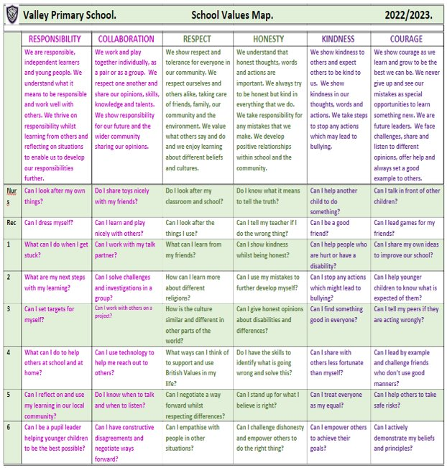
Valley Values
Notes:
David

Slide 4
Valley Life Skills
Valley Primary School. Life Skills Challenges.
 | MENTAL HEALTH MANAGEMENT SKILLS | PHYSICAL HEALTH MANAGEMENT SKILLS | TIME MANAGEMENT SKILLS | DECISION MAKING SKILLS | HOME MANAGEMENT SKILLS | INTERPERSONAL SKILLS
 | We have feelings and thoughts about ourselves and the world around us. These can affect how we cope with life’s challenges and stresses. | We promote growth in confidence and awareness of control. This supports communication and language using large and small movements and gestures to convey messages to others. | We show good time management. This process helps us organise and plan how to divide our time between specific activities. Good time management enables us to work smarter – not harder – so that we get more done in less time. | We promote effective decision making. This involves choosing between possible solutions to a problem. Decisions can be made through either an intuitive or reasoned process or a combination. | We promote good home management skills. This affects how we manage challenges and activities at home. | We think of the behaviours and tactics we use to interact with others effectively. This involves choosing good behaviour when interacting with others.
Nurs | Can I tell people if I am feeling sad, happy, angry, glad or excited? | Can I wash my hands and dry them? | Can I focus on one activity until it is finished? | Can I choose between two options? | Can I put my dirty washing in the washing basket? | Can I share when I am taking turns with my friends?
Rec | Can I say what I am good at? | Can I pick up my rubbish and put it in the bin? | Do I know who to ask for help if I am stuck on a task? | Do I know how to make a decision? | Can I tidy my room? | Can I be a good friend?
1 | Do I know who to go to if I need help? | Can I eat 5 portions of fruit and vegetables per day? | Can I say how I am organised? | Do I know who to go to in school or at home to help me with my decision? | Can I share my toys with a person at home? | Can I work as part of a team?
2 | Can I say what I am most proud of? | Do I know what a balanced diet is? | Can I be good with my time management? | Do I ask a friend if I am stuck? | Do I know how I can help my parents at home? | Do I know the behaviour I should show in class?
3 | Can I say what I enjoy most about being in the classroom? | Do I help myself to relax? | Do I know how to improve my time management? | Can I use my mistakes to further develop my decisions? | Can I recycle things which I have finished with at home? | Do I understand the kind gestures I can use to everyone?
4 | Can I say what I am good at and justify it? | Can I say why exercising is important? | Do I know the different types of equipment I can use to keep track of time? | Do I have the skills to identify what is going wrong and solve this? | Can I set home targets? | Do I understand why good manners are so important?
5 | Do I know why it is important to be a good role model and friend? | Can I have a balanced diet? | Can I give an example of when I show good time management? | Do I choose the easiest choice or the quickest choice? Why? | Do I know how I can be a good role model at home? | Can I help others to behave better?
6 | Can I be a positive role model and friend? | Do I know why it is imperative to wash and dry my hands? | Do I understand why good time management is important? | Can I describe a time when I made a great decision fast? | Can I justify which skills are important and why? | Can I challenge myself at school?
Notes:
David

Slide 6
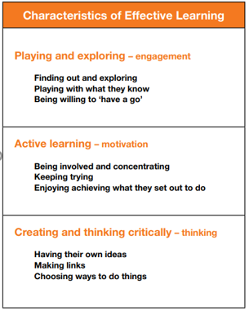
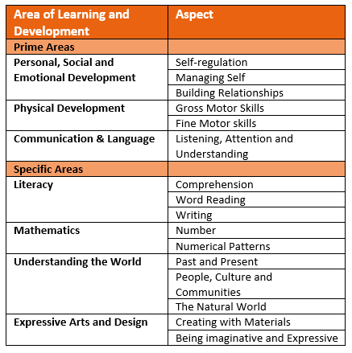
The EYFS Curriculum

Slide 7
Nursery Team
Mrs Churchard
Mrs Coldrick
Mrs Ashton
Mrs Carter

Slide 8
A Typical Day in Nursery
On arrival, Whittle class order their lunch (please look at the menu on the school website each morning and help your child to decide what they are going to order.)
Action songs and nursery rhyme of the week.
Carpet session – Phonics, Power of Reading or Maths.
Free flow session – children can move between both rooms and outside.
Carpet session – PSED, Music, Story or Topic.
15 hour (Starley) children go home and 30 hour (Whittle) children go to lunch.
Carpet session followed by free flow with focused extra learning opportunities.
Eventually, we will move to rolling snack, children will be able to access the snack table during free flow sessions throughout the day.
Story time before home time.

Slide 9
Personal, Social & Emotional Development (P.S.E.D)
The EYFS curriculum has three main Prime areas – PSED, Communication & Language and Physical Development.
In Nursery nearly every activity involves an aspect of PSED. The children will be given a variety of opportunities to play with their peers to develop relationships. They will be encouraged to take turns and share the resources.
The children will be shown how to select their own resources and take responsibility to carry out tasks. They will be encouraged to have a go on their own but also develop the skills to know when to ask for help.

Slide 10
Communication & Language
The children will develop their listening skills in Nursery by listening to stories. They will listen to many of these stories several times. As they become familiar with the stories they will join in with repeated phrases.
As the children speak, they will be encouraged to extend their sentences using ‘and’ and ‘because’.
They will be asked to explain what is happening and anticipate what will happen next in stories and in real life situations.
The children will develop their ability to describe their own feelings.
During the year, Nursery children will expand their vocabulary using words that reflect the experiences the have had.

Slide 11
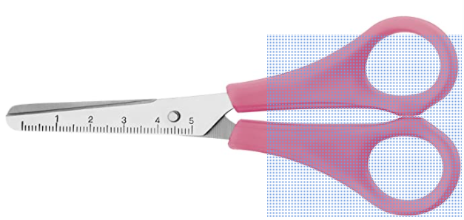
Physical Development
The children will have their P.E. lesson on a Wednesday, but they will continue to develop physically throughout each day. The PE kit requirement for Nursery is a pair of pumps that can be kept in school in their purple drawstring bag. They will access the outdoor area every day so please ensure that they have a coat in school every day.
They will develop their skills to move in a variety of ways whilst negotiating obstacles and learn how to catch a large ball and climb equipment safely. They will learn how to keep healthy and safe.
Physical development also includes fine motor skills. The children will explore a selection of pre-writing activities such as threading, mark making, using children’s tweezers and they will use children’s safety scissors.
You can purchase a pair of scissors like the ones used in school from Amazon. Amazon safety scissors

Slide 12
Literacy
As well as the Prime areas, the EYFS curriculum includes four Specific areas – Literacy, Maths, Understanding the World and Expressive Arts and Design.
Reading
The children will listen to stories one to one with an adult, in small groups and with their whole class. They will be encouraged to look at books independently handling them with care. Each child will bring home a library book each week that we would like you to read to your child several times. This will help them to understand that writing conveys meaning in readiness for them to become confident readers in the future.
Please point out print in your every-day activities such as shop names and brand names on boxes etc.
Writing
The children will be encouraged to use marks in their play to represent their ideas. They will learn how to write their name.

Slide 13
Literacy: Phonics
Phonics
The children in Nursery will take part in phonic sessions with their teacher. The sessions will concentrate on developing children's speaking and listening skills and lay the foundations for the phonic work which starts in Reception. The emphasis during Nursery is to get children attuned to the sounds around them and ready to begin developing oral blending and segmenting skills required for reading and writing.
Throughout the year the children will explore:
Environmental sounds
Instrumental sounds
Body percussion
Rhythm and rhyme
Alliteration
Vocal sounds.
In the summer term the children will begin to orally blend and segment words. This will prepare the children to break words into sounds e.g. cat = c-a-t. This will prepare children for learning to read and write words in Reception.

Slide 14
Mathematical Development
The children will be exposed to numbers and patterns in their play.
Nursery children will explore patterns in a variety of situations. They will create, continue and find the errors in patterns.
The children will develop a deep understanding of numbers up to 5 and learn how to count beyond 5. They will explore how to represent the numbers using fingers, marks on paper and objects. The children will count objects and be shown that it is not just objects that can be counted e.g. claps, jumps etc. They will be shown that if a set of objects is shared the total will remain the same.
Nursery children will look for shapes in the environment and begin to describe them and look for similarities between shapes. They will use shapes in their play that are suitable for the task asked of them. Through play the children will begin to use language linked to position, capacity and measure.

Slide 15
Nursery Curriculum Themes
 | Autumn 1 | Autumn 2 | Spring 1 | Spring 2 | Summer 1 | Summer 2
Topic | Me, Myself and I | Our Community and its People | Opposites | British Countryside |  | We’re all going on a summer holiday
Notes:
Natasha

Slide 16
Understanding of the World
The children will explore aspects of their familiar world including their own family and the natural environment
They will look at their own life and their family history
They will talk about how things work
They will develop an understanding of why we need to show care and concern for living things and the environment.
Expressive Arts and Design
The children will explore music, dance, ring games, singing, rhymes and rhythms
They will learn about colours and how colours can change
They will join construction pieces together to create and build
The children will develop their imagination and use resources independently to enhance their play
They will develop their own creative ideas selecting their own resources
Other Curriculum Opportunities
Notes:
Jon

Slide 17
MATHS
KIRF – Key Instant Recall Facts
• We expect every child to practice their KIRF at regular intervals throughout the week.
Real Life Maths
• Each half-term holiday, a practical activity focusing on Real Life Maths will be set following their learning in Maths in class.
Homework
Notes:
Jon

Slide 18
WIDER CURRICULUM AND LIFE SKILLS
Topic Home Learning Projects
• Topic home learning will be set on TEAMS each half term. Children are encouraged to complete a minimum of one task a week, travelling across all the continents. Each piece completed will receive one entry into an end of year prize draw. Each child who travels around the world in a half term will receive 10 additional entries. We encourage all children to bring in their work for their class to celebrate each Friday.
Life Skills Activities
• We encourage all children to bring in evidence of this for their class to celebrate each Friday.
Curious Challenges and Brain Boosters
• We encourage all children to bring in evidence of this for their class to celebrate on a Friday.
Homework
Notes:
Jon

Slide 19
TARGETED WORK
• There may be times where targeted tasks are set for particular children or within particular topics. You will be notified of these through ParentPay or your child’s MS Teams account.
COMPETITIONS
• Periodically, competition activities may be introduced related to special events or activities. You will be notified of these through ParentPay, your child’s MS Teams account or the school newsletter.
Occasionally, we may send an extra homework, this will be a letter in their bag or via ParentPay and will be something that will support their independence or learning at school, for example practising putting on their coat or collecting Autumn treasures etc.
Homework
Notes:
Jon

Slide 20
Please send a coat every day as our curriculum means that we go outside in all weathers.
Please supply a pair of named wellies for your child that can stay in school.
Please write your child’s name on all of their belongings so that any lost items can be returned.
There is no need to supply a snack for your child. However, please send a named water bottle every day.
All children need to bring their purple book bag (not a ruck sack) to school every day.
Please take some time to look at the school website which includes a wealth of information and photographs of the children in school. https://www.valleyprimaryschool.co.uk/
It is updated regularly so please check it on a
regular basis.
Further Information
Notes:
Jon

Slide 21
Reception Team
Mrs Sharp
Mrs Ward
Mrs Collett
Mrs Landeau
Miss Brown
Mrs Brookes

Slide 22
A few ways you can help your child succeed at school
A regular bed time
Challenge them
Limit screen time
Read to your child every day
Encourage independence
Look at the ideas at https://hungrylittleminds.campaign.gov.uk/

Slide 23
Alternative things to ask your child instead of ‘How was school?’
What made you smile today?
Who did you sit with at lunch?
What was the hardest rule to follow today?
Tell me something you know today that you didn’t know yesterday?
Which rooms did you work in?
Did anything funny happen today?
What kind thing did you do today?
Who was kind to you today?

Slide 24
Thank you
Should you have any queries or need to speak to your child’s teacher, please email using the class email address:
s52whittlen@valley.solihull.sch.uk
s52starleyn@valley.solihull.sch.uk
or ring the school office and request for a telephone call home.
You can also contact the parent liaison lead should you prefer or have any whole school concerns or feedback.
Notes:
Jon

