Slide 1


EYFS
Curriculum
Evening

Slide 2
EYFS Team
Nursery:
Mrs Shabir -Teacher
Mrs Carter - TA
Mrs Ashton - TA
Reception:
Mrs Byron - Aston
Miss Goymer - Grylls
Mrs Sayer / Mrs Churchard - Peake
Miss Brown - HLTA

Slide 3

Encouraging Brilliant Behaviour

Slide 4

VALLEY'S VISION
GROWING AND LEARNING TOGETHER TO BE THE BEST WE CAN BE!
We always…
ASPIRE for excellence
ENJOY learning
ACHIEVE success
CHALLENGE ourselves further.
Notes:
Jon

Slide 5
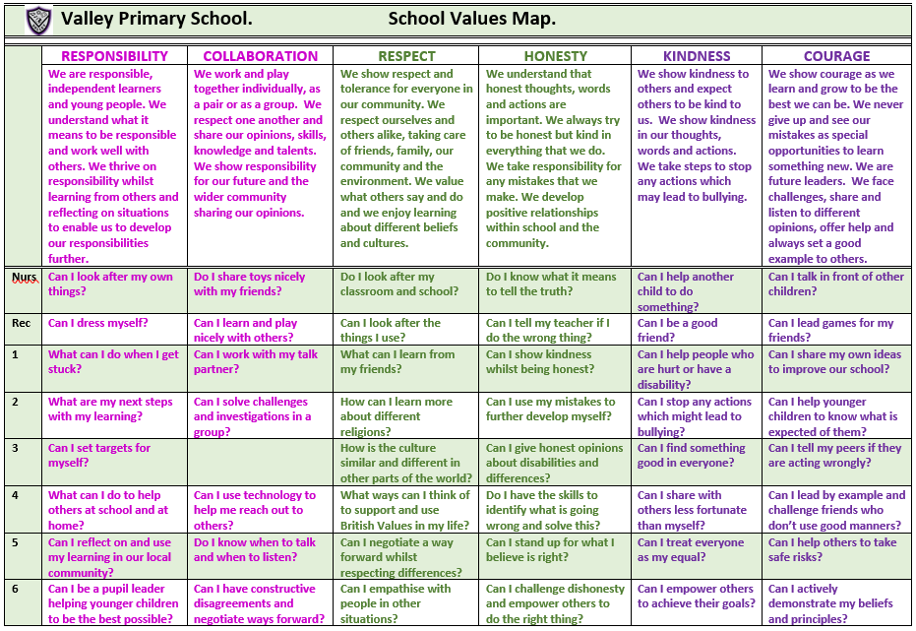
Valley Values
Notes:
David

Slide 6

Valley Life Skills
Valley Primary School. Life Skills Challenges.
 | MENTAL HEALTH MANAGEMENT SKILLS | PHYSICAL HEALTH MANAGEMENT SKILLS | TIME MANAGEMENT SKILLS | DECISION MAKING SKILLS | HOME MANAGEMENT SKILLS | INTERPERSONAL SKILLS
 | We have feelings and thoughts about ourselves and the world around us. These can affect how we cope with life’s challenges and stresses. | We promote growth in confidence and awareness of control. This supports communication and language using large and small movements and gestures to convey messages to others. | We show good time management. This process helps us organise and plan how to divide our time between specific activities. Good time management enables us to work smarter – not harder – so that we get more done in less time. | We promote effective decision making. This involves choosing between possible solutions to a problem. Decisions can be made through either an intuitive or reasoned process or a combination. | We promote good home management skills. This affects how we manage challenges and activities at home. | We think of the behaviours and tactics we use to interact with others effectively. This involves choosing good behaviour when interacting with others.
Nurs | Can I tell people if I am feeling sad, happy, angry, glad or excited? | Can I wash my hands and dry them? | Can I focus on one activity until it is finished? | Can I choose between two options? | Can I put my dirty washing in the washing basket? | Can I share when I am taking turns with my friends?
Rec | Can I say what I am good at? | Can I pick up my rubbish and put it in the bin? | Do I know who to ask for help if I am stuck on a task? | Do I know how to make a decision? | Can I tidy my room? | Can I be a good friend?
1 | Do I know who to go to if I need help? | Can I eat 5 portions of fruit and vegetables per day? | Can I say how I am organised? | Do I know who to go to in school or at home to help me with my decision? | Can I share my toys with a person at home? | Can I work as part of a team?
2 | Can I say what I am most proud of? | Do I know what a balanced diet is? | Can I be good with my time management? | Do I ask a friend if I am stuck? | Do I know how I can help my parents at home? | Do I know the behaviour I should show in class?
3 | Can I say what I enjoy most about being in the classroom? | Do I help myself to relax? | Do I know how to improve my time management? | Can I use my mistakes to further develop my decisions? | Can I recycle things which I have finished with at home? | Do I understand the kind gestures I can use to everyone?
4 | Can I say what I am good at and justify it? | Can I say why exercising is important? | Do I know the different types of equipment I can use to keep track of time? | Do I have the skills to identify what is going wrong and solve this? | Can I set home targets? | Do I understand why good manners are so important?
5 | Do I know why it is important to be a good role model and friend? | Can I have a balanced diet? | Can I give an example of when I show good time management? | Do I choose the easiest choice or the quickest choice? Why? | Do I know how I can be a good role model at home? | Can I help others to behave better?
6 | Can I be a positive role model and friend? | Do I know why it is imperative to wash and dry my hands? | Do I understand why good time management is important? | Can I describe a time when I made a great decision fast? | Can I justify which skills are important and why? | Can I challenge myself at school?
Notes:
David

Slide 7

We are powerful learners…
Resilient Robbie
Resourceful Rosie
Reciprocal Ruth
Reflective Rick

Slide 8
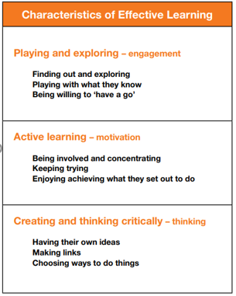
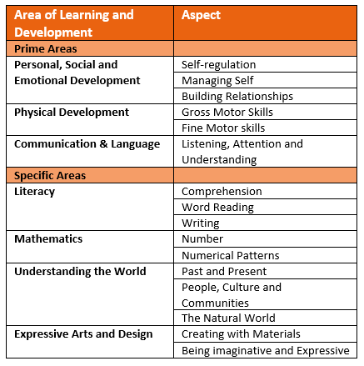
The EYFS Curriculum

Slide 9
A Typical Day in Nursery
Registration & activate
Free flow sessions between both classrooms. During this time children can complete an adult led activity linked to a specific area of learning for that week. There is also continuous provision available which is enhanced or changed each week in response to observations
Carpet focus: Power of Reading/ Maths/ Phonics
Snack time in family groups and story time
Free flow sessions between both classrooms and outside
Carpet focus: Topic/R.E/Jigsaw/Phonics/Music
Lunchtime for 30 hours Nursery or home time for 15 hours Nursery
Carpet focus: Topic/Life skills/Maths
Free flow sessions in one classroom and outside
Storytime
Hometime for 30 hours Nursery
Every Tuesday, each family group will visit the library and have a PE lesson in the hall starting from Tuesday 14th October 2025

Slide 10
A Typical Day in Reception
Registration and name writing
Assembly
RWI Phonics
Free flow sessions between all rooms (Creating, Imagining and Exploring) and outside. During this time children can complete an adult led activity linked to phonics. There is also continuous provision available which is enhanced or changed each week in response to observations
Self-service snack and milk (provided by school)
Carpet focus: Maths
Lunch
Carpet focus: Power of Reading
Free flow session across rooms and outside offering continuous provision throughout the afternoon alongside an adult led group activity that has a Maths focus
Carpet focus: RE, Jigsaw, Music or Topic
Singing and story
Home time.
Every Wednesday, each class will visit the library and have a PE lesson in the hall

Slide 11
Friday afternoon Enrichment
On a Friday, Nursery children finish at 1.40pm. Reception children finish at 1.50pm.
Some Reception children will attend enrichment clubs in school.
Those children going home are encouraged to access the brain booster and curious challenge each week.
These can be found on the school website under Children and then Feel-Good Friday or on the Year Group Page under Life Skills Activities.
Please feel free to send in pictures of your children completing these activities to the class email address as we would love to see the fabulous things the children do.

Slide 12
Nursery
Personal, Social & Emotional Development (P.S.E.D)
The EYFS curriculum has three main Prime areas – PSED, Communication & Language and Physical Development.
In Nursery nearly every activity involves an aspect of PSED. The children will be given a variety of opportunities to play with their peers to develop relationships. They will be encouraged to take turns and share the resources.
The children will be shown how to select their own resources and take responsibility to carry out tasks. They will be encouraged to have a go on their own but also develop the skills to know when to ask for help.

Slide 13
Reception
Personal, Social & Emotional Development (P.S.E.D)
This is the part of the Curriculum that helps children to make relationships with the people around them and to develop their own self - confidence whilst managing their own feelings.
This is taught through Jigsaw scheme lessons that often include discussing scenarios that the children are familiar with. We then discuss these in real life situations as they occur. We encourage the children to initiate conversations whilst taking account of others that are involved in the conversation. The children will develop their confidence to ask questions and to have a go in new situations. They will learn how to manage their own feelings and begin to negotiate and solve problems with the other children around them.
PSED also includes children learning how to manage their own personal needs. The children will dress and undress themselves independently. This includes doing up fasteners and manipulating clothing that is inside out. The children will learn the key things that are required to stay healthy.

Slide 14
Nursery
Communication & Language
The children will develop their listening skills in Nursery by listening to stories. They will listen to many of these stories several times. As they become familiar with the stories they will join in with repeated phrases.
As the children speak, they will be encouraged to extend their sentences using ‘and’ and ‘because’.
They will be asked to explain what is happening and anticipate what will happen next in stories and in real life situations.
The children will develop their ability to describe their own feelings.
During the year, Nursery children will expand their vocabulary using words that reflect the experiences they have had.

Slide 15
Reception
Communication & Language
Over time, the children in Reception will be expected to concentrate for longer periods of time on one task. They will learn how to listen and respond appropriately. This may be through stories or instructions that involve more than one step. The children will be encouraged to comment and ask questions about what they have heard.
The children will be introduced to a wider vocabulary with words used in a variety of contexts. The children will be supported to use these new words appropriately. We will provide them with opportunities to develop their speech and language through storytelling activities. During their play, they will be encouraged to use their own experiences and their imagination to develop the roles they are taking on.

Slide 16
Nursery
Physical Development
The children will have their P.E. lesson on a Tuesday, but they will continue to develop physically throughout each day. The PE kit requirement for Nursery is for them to come into school wearing the Valley P.E kit and have a pair of pumps that can be kept in school in their purple drawstring bag.They can wear black trainers to school that day. They will access the outdoor area every day so please ensure that they have a coat in school every day.
They will develop their skills to move in a variety of ways whilst negotiating obstacles and learn how to catch a large ball and climb equipment safely. They will learn how to keep healthy and safe.
Physical development also includes fine motor skills. The children will explore a selection of pre-writing activities such as threading, mark making, using children’s tweezers and they will use children’s safety scissors.
You can purchase a pair of scissors like the ones used in school from Amazon. Amazon safety scissors

Slide 17
Reception
Physical Development
Physical development includes bigger gross motor movements and smaller fine motor movements.
The children will be encouraged to experiment with movement and provided with resources that enables them to jump, climb, hop, skip and balance.
During Reception, children will begin to use a dominant hand and hold a pencil effectively. Children will have handwriting sessions and be shown the correct way to form each letter.
The children will also learn to use a variety of tools safely and competently such as paintbrushes, scissors and cutlery.
They will begin to show accuracy and care when drawing.
PE lessons: (Reception children must come to school wearing their PE kit)
Wednesday – Grylls
Wednesday - Aston
Wednesday - Peake

Slide 18
Nursery
Literacy
As well as the Prime areas, the EYFS curriculum includes four Specific areas – Literacy, Maths, Understanding the World and Expressive Arts and Design.
Reading
The children will listen to stories one to one with an adult, in family groups and with their year group. They will be encouraged to look at books independently handling them with care. Each child will bring home a library book each week that we would like you to read to your child several times. This will help them to understand that writing conveys meaning in readiness for them to become confident readers in the future.
Please point out print in your everyday activities such as shop names and brand names on boxes etc.
Writing
The children will be encouraged to use marks in their play to represent their ideas. They will learn to write their name and start to write simple words using their phonics as the year progresses.

Slide 19
Nursery
Phonics
Phonics
The children in Nursery will take part in phonics sessions with their family group teacher. The sessions will concentrate on developing children's speaking and listening skills and lay the foundations for the phonic work which starts in Reception. The emphasis during Nursery is to get children attuned to the sounds around them and ready to begin developing oral blending and segmenting skills required for reading and writing.
Throughout the year the children will explore:
Environmental sounds
Instrumental sounds
Body percussion
Rhythm and rhyme
Alliteration
Vocal sounds.
In the summer term, the children will begin to orally blend and segment words. This will prepare the children to break words into sounds e.g. cat = c-a-t. This will prepare children for learning to read and write words in Reception.

Slide 20
Reception
Literacy
Reading
The children will initially bring home a library book for you to read to them. Hearing as many stories as possible will support the children to be ready to read for themselves as they will understand the functions of reading and text. They are also bringing home a sheet that shows you which sound they learned in phonics that day. Reading books will follow at a later date and initially will be picture books for you to talk about the pictures which will then move onto books with words. It is beneficial if the children read the book several times as this will aid their fluency so that they are not sounding out every word. WE EXPECT EVERY CHILD TO READ AT LEAST 3 TIMES PER WEEK FOR A MINIMUM OF 10 MINUTES EACH TIME AND FOR THIS TO BE NOTED IN THEIR READING DIARIES BY AN ADULT.
Writing
Children will follow a similar process with their writing. They will initially use their own marks to convey meaning and then learn how to write some letter shapes. They will use these letters to build words and eventually will write simple sentences.

Slide 21
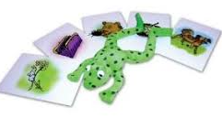

Literacy: Phonics in Reception
Phonics
Phonics is the key to reading and writing as it breaks words down into the individual sounds. We teach phonics using the Read Write Inc system. The Reception children have started the Set 1 sounds and later in the year they will learn the Set 2 sounds. The children are taught the sound of the letter and how to sound out words. We call this Fred Talk. How to say the sounds
You can buy your own set of flashcards from Amazon. Link to Amazon
Once the children have learned the sound that each letter makes, they learn how to put the sounds together through oral blending and then how to read words and spell. They will then bring home a Read Write Inc reading book that includes the sounds that they know.

Slide 22
ENGLISH
Reading books
We expect every child to read at least 3 times per week for a minimum of 10 minutes each time and this to be noted in their reading diaries.
Phonics
We expect every child to practise their sounds daily, using the sheet sent home. These sheets do not need to be sent back into school.
Red words
We expect every child to practise their red words at least 3 times per week for a minimum of 5 minutes.
Homework
Will begin at different points in the year
Notes:
Jon

Slide 23
Nursery
Mathematical Development
Maths Workshop on Tuesday 7th October at 8.45-9.15am
The children will be exposed to numbers and patterns in their play.
Nursery children will explore patterns in a variety of situations. They will create, continue and find the errors in patterns.
The children will develop a deep understanding of numbers up to 5 and learn how to count beyond 5. They will explore how to represent the numbers using fingers, marks on paper and objects. The children will count objects and be shown that it is not just objects that can be counted e.g. claps, jumps etc. They will be shown that if a set of objects is shared the total will remain the same.
Nursery children will look for shapes in the environment and begin to describe them and look for similarities between shapes. They will use shapes in their play that are suitable for the task asked of them. Through play, the children will begin to use language linked to position, capacity and measure.

Slide 24
Reception
Mathematical Development
The children will explore aspects of Maths through a variety of experiences to develop a deep understanding of each area.
Children will develop a deep understanding of numbers within 10. They will learn to subitise (recognise quantities without counting) to 5 and automatically recall number bonds to 5 and then 10. They will count confidently beyond 10. They will count, match numbers to amounts, use the language of fewer and more and solve problems that involve halving, doubling and sharing.
Children will use everyday language to talk about size, weight, capacity, position, distance, time and money to compare quantities and objects and to solve problems. They will recognise, create and describe patterns. They will explore characteristics of everyday objects and shapes and use mathematical language to describe them.

Slide 25
Nursery Curriculum Themes
 | Autumn 1 | Autumn 2 | Spring 1 | Spring 2 | Summer 1 | Summer 2
Topic | Me, Myself and I | Our Community and its People | Opposites | British Countryside |  | We’re all going on a summer holiday
Notes:
Natasha

Slide 26
Reception Curriculum Themes
 | Autumn 1 | Autumn 2 | Spring 1 | Spring 2 | Summer 1 | Summer 2
Topic | All About Me | Then and Now | Monsters | Our Garden Spring 2 – Plants Summer 1 - Minibeasts |  | Safari Adventures
Notes:
Natasha

Slide 27
We will have carpet sessions where we will explore our topic through class discussions, stories and research.
This will then be followed up with learning opportunities during continuous provision.
Understanding of the World
The children will learn about their environment and make comparisons between their lives and those of others.
They will look at similarities between things and events in the past compared to now.
They will use and create simple maps.
They will make observations linked to the seasons and the natural world.
Other Curriculum Opportunities
Notes:
Jon

Slide 28
Expressive Arts and Design
The children will experiment with resources to create colour and textures.
They will explore music through dance, singing and the use of musical instruments.
They will have opportunities to perform songs, rhymes, poems and stories with their peers in a variety of situations.
Once they have explored and experimented with a range of resources, they will use them to represent their thoughts and feelings and then explain the processes they used.
They will develop their skills to recount, adapt and invent narratives in their play, making use of props and resources available.
Other Curriculum Opportunities
Notes:
Jon

Slide 29
Nursery
P.E will begin from Tuesday 14th October
Children to come into school in their P.E kits every Tuesday
Please ensure that any earrings are covered or removed on PE days.
Pumps will be kept in school in a drawstring bag to change into for indoor sessions. PLEASE NAME ALL ITEMS.
Reception
Please ensure that any earrings are covered or removed on Wednesdays.
Please ensure that your child comes to school in their PE kit – plain black trainers, black bottoms (jogging bottoms or appropriate shorts depending on the weather), purple PE top and purple fleece.
Pumps will be kept in school in a drawstring bag to change into for indoor sessions. PLEASE NAME ALL ITEMS.
PE Reminders
Notes:
Jon

Slide 30
WIDER CURRICULUM AND LIFE SKILLS
Topic Home Learning Projects
A choice of suggested cross curricular tasks will be sent home at the beginning of each topic. Please encourage your child to complete some tasks. We encourage all children to bring in their work for their class to celebrate on a Wednesday. Class teachers will decide if a piece of work is worth a merit or a distinction. For a merit, 5 house points will be awarded and for a distinction 10 house points will be awarded.
Life Skills Activities
We encourage all children to bring in evidence of this for their class to celebrate each Wednesday.
Curious Challenges and Brain Boosters
We encourage all children to bring in evidence of this for their class to celebrate on a Wednesday.
Wider Curriculum Homework
Notes:
Jon

Slide 31
Please ensure that all items from home are named so they can be returned should your child misplace them.
Reading books should be in school every day. Books will be changed once a week so your child can read the book at least three times.
Please ensure your child has their water bottle in school every day with water in. They may bring in a separate drink for lunchtimes.
Please ensure that your child has a coat in school everyday as we go outside in all weathers.
Should you have any queries or need to speak to your child’s teacher, please email using the class email address or ring the school office and request for a telephone call home. You can also contact the parent liaison lead should you prefer or have any whole school concerns or feedback. Add bullet points
Further Information
Notes:
Jon

Slide 32
A few ways you can help your child succeed at school
A regular bed time
Challenge them
Limit screen time
Read to your child every day
Encourage independence
Look at the ideas at https://hungrylittleminds.campaign.gov.uk/

Slide 33
Alternative things to ask your child instead of ‘How was school?’
What made you smile today?
Who did you sit with at lunch?
What was the hardest rule to follow today?
Tell me something you know today that you didn’t know yesterday?
Which rooms did you work in?
Did anything funny happen today?
What kind thing did you do today?
Who was kind to you today?

Slide 34
Thank you for taking the time to come to our Curriculum Evening Presentation. We hope you found it useful.
Does anyone have any questions?

