Slide 1


Year 1
Curriculum Evening

Slide 2
Year 1 Team
Bell - Mrs Hitchin
Lee - Mrs Gorman and Mrs Mullen
Shaw - Miss Ghani
HTLA - Mrs Hall
LSA - Mrs Kennedy

Slide 3

Encouraging Brilliant Behaviour

Slide 4

VALLEY'S VISION
GROWING AND LEARNING TOGETHER TO BE THE BEST WE CAN BE!
We always…
ASPIRE for excellence
ENJOY learning
ACHIEVE success
CHALLENGE ourselves further.
Notes:
Jon

Slide 5
Uniform
Winter Uniform:
Grey skirt, pinafore dress or trousers.
Purple and grey striped school tie (elastic ones best for Reception usually).
White shirt/ blouse (no polo shirts).
School logo V neck sweatshirt/ cardigan or plain purple V neck jumper/ cardigan.
Grey/ white socks or grey tights.
Black flat heeled shoes.
Purple, school logo or plain purple fleece (optional).
Purple, grey, black or white head scarf (optional).

Slide 6
Uniform
Summer Uniform (Summer Term and Autumn First Half term only):
Dress with purple check or smart grey shorts with short sleeved white shirt with logo or with purple and grey striped school tie (no polo shirts).
School logo V neck sweatshirt/ cardigan or plain purple V neck jumper/ cardigan.
Grey/ white socks.
Black flat heeled shoes.
Purple summer sun hat or cap (optional).
Purple, grey, black or white head scarf (optional).
N.B. All items of clothing, including shoes, MUST be clearly labelled with your child’s name.
Only stud earrings are permitted.

Slide 7
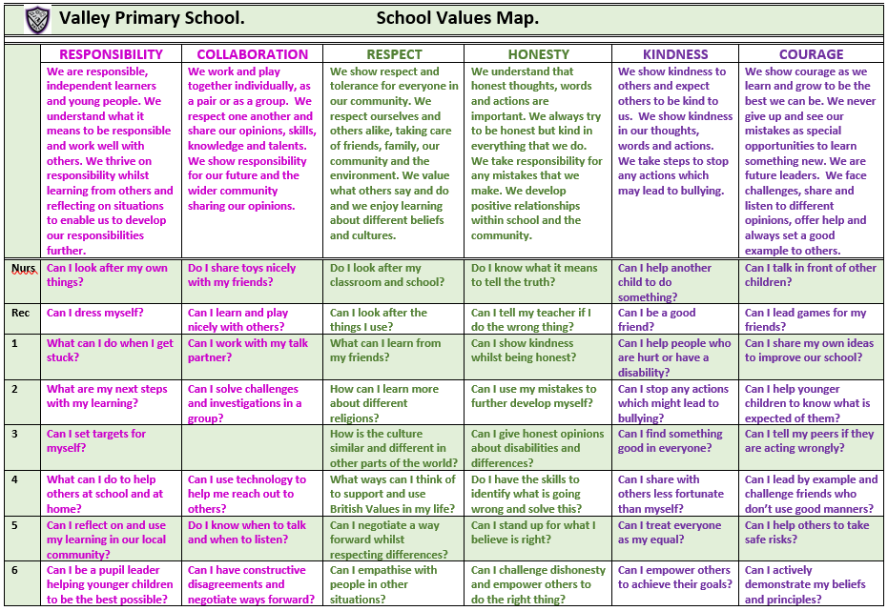
Valley Values
Notes:
David

Slide 8

Valley Life Skills
Valley Primary School. Life Skills Challenges.
 | MENTAL HEALTH MANAGEMENT SKILLS | PHYSICAL HEALTH MANAGEMENT SKILLS | TIME MANAGEMENT SKILLS | DECISION MAKING SKILLS | HOME MANAGEMENT SKILLS | INTERPERSONAL SKILLS
 | We have feelings and thoughts about ourselves and the world around us. These can affect how we cope with life’s challenges and stresses. | We promote growth in confidence and awareness of control. This supports communication and language using large and small movements and gestures to convey messages to others. | We show good time management. This process helps us organise and plan how to divide our time between specific activities. Good time management enables us to work smarter – not harder – so that we get more done in less time. | We promote effective decision making. This involves choosing between possible solutions to a problem. Decisions can be made through either an intuitive or reasoned process or a combination. | We promote good home management skills. This affects how we manage challenges and activities at home. | We think of the behaviours and tactics we use to interact with others effectively. This involves choosing good behaviour when interacting with others.
Nurs | Can I tell people if I am feeling sad, happy, angry, glad or excited? | Can I wash my hands and dry them? | Can I focus on one activity until it is finished? | Can I choose between two options? | Can I put my dirty washing in the washing basket? | Can I share when I am taking turns with my friends?
Rec | Can I say what I am good at? | Can I pick up my rubbish and put it in the bin? | Do I know who to ask for help if I am stuck on a task? | Do I know how to make a decision? | Can I tidy my room? | Can I be a good friend?
1 | Do I know who to go to if I need help? | Can I eat 5 portions of fruit and vegetables per day? | Can I say how I am organised? | Do I know who to go to in school or at home to help me with my decision? | Can I share my toys with a person at home? | Can I work as part of a team?
2 | Can I say what I am most proud of? | Do I know what a balanced diet is? | Can I be good with my time management? | Do I ask a friend if I am stuck? | Do I know how I can help my parents at home? | Do I know the behaviour I should show in class?
3 | Can I say what I enjoy most about being in the classroom? | Do I help myself to relax? | Do I know how to improve my time management? | Can I use my mistakes to further develop my decisions? | Can I recycle things which I have finished with at home? | Do I understand the kind gestures I can use to everyone?
4 | Can I say what I am good at and justify it? | Can I say why exercising is important? | Do I know the different types of equipment I can use to keep track of time? | Do I have the skills to identify what is going wrong and solve this? | Can I set home targets? | Do I understand why good manners are so important?
5 | Do I know why it is important to be a good role model and friend? | Can I have a balanced diet? | Can I give an example of when I show good time management? | Do I choose the easiest choice or the quickest choice? Why? | Do I know how I can be a good role model at home? | Can I help others to behave better?
6 | Can I be a positive role model and friend? | Do I know why it is imperative to wash and dry my hands? | Do I understand why good time management is important? | Can I describe a time when I made a great decision fast? | Can I justify which skills are important and why? | Can I challenge myself at school?
Notes:
David

Slide 9
A Typical Day in Year 1
8.30 - 8.45 - Registration and ECAR
8.45-9.15 - Assembly
9.15 - 10.15 - Reading and English
10.15 - 11.00 - RWI
11.00 - 11.10 - Play and Snack
11.10 - 12.10 - Maths
12.10 - 12.20 - Whole Class Phonics
12.20 - 13.05 - Lunch
13.05 - 13. 10 - Registration and Yogabugs
13.10-13.20 - ECAR
13.20 - 15.20 - Foundation Subject Lessons: Science, Topic, PE, RE, Music, Computing
13.20 - Home time
Feel Good Fridays include English and Maths skills sessions, Handwriting, KIRF and PSHE.

Slide 10
A Typical Day in Year 1
On a Friday, the children finish at 1.50pm.
Some children will attend enrichment clubs in school.
Those children going home are encouraged to access the brain booster and curious challenge each week.
These can be found on the school website under Children and then Feel-Good Friday or on the Year Group Page under Life Skills Activities.
Please feel free to send in pictures of your children completing these activities to the class email address as we would love to see the fabulous things the children do.

Slide 11
English
Each English lesson begins with the children having the opportunity to respond to any next steps and improve a sentence through upleveling work.
Power of Reading Year 1
We have twelve power of reading books we will study this year:
Traction Man
Pattan’s Pumpkin
Out and About
The Lonely Beast
The Last Wolf
Beegu
Lila and the Secret of the Rain
One Day on our Blue Planet in Savannah
Robot and the Bluebird
The Adventures of Egg Box Dragon
The Dark
Ten Things I Can Do To Help My World

Slide 12
English
Key Skills - Writing
We teach our English through these texts and the key skills for year 1 are:
-Capital letters, full stops, question marks, exclamation marks, conjunctions (and/because), spelling and adjectives
-Begin to use the suffixes –er, -ing, -ed, -est and the prefix –un
-Focus on speaking and listening, reading and writing
-Skills taught through different genres
-Designed to engage, interest and excite
-Handwriting – Letterjoin. Letter formation, size of letters and positioning.

Slide 13

English
Key Skills - Phonics
Phonics
-Read Write Inc
-Daily sessions (45 mins long) – speed sound and storybook session.
- Include storybook focus at their level in order to develop their fluency and expression skills through reading with a partner and with an adult.
-Children grouped by ability and assessed each half term.
Phonics Workshops (9:45 – 10.30am)
Tuesday 3rd November 2026

Slide 14
Spellings
In Year 1 we focus on spellings throughout phonics sessions and English lessons. We provide opportunities for children to practise these spellings through dictated sentences.
In Year 1 we need to practise reading and spelling a variety of ‘tricky words’.
These are words that are hard to sound out and need to be read and spelt by sight.
We will send home a sheet of the focus ‘tricky words’ for that half term.
Practising these and applying them in a variety of contexts helps your child develop their vocabulary skills, accuracy and confidence.

Slide 15
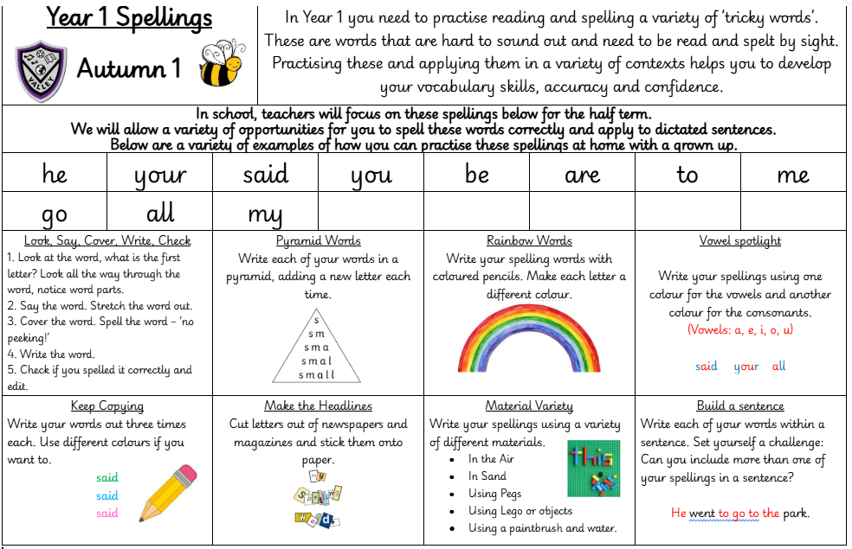
Spelling Sheet

Slide 16
Maths
We follow the White Rose Maths scheme and use this to teach the main areas:
Number: place value, addition, subtraction, division, multiplication and fractions.
Measurement: length, mass, weight, capacity, volume, time, money, sequencing events, days of the week, months of the year.
Geometry: shape (2D and 3D), position and direction.
Daily key skills sessions – focus on depth of understanding and knowledge of numbers and number bonds within 10.
KIRF information sheets are given out at the beginning of each half term.

Slide 17
Maths
Key Skills
All Maths lessons start with opportunities for retrieval practice.
These sessions focus on the areas of place value, addition and subtraction and shape.
Maths skills sessions are also planned into the day. These include:
Counting and recognising numbers
Mental addition and subtraction
Recognising shapes
They are designed to enable children to practise skills from the previous and current year and to build children’s confidence in applying the skills taught in lessons.
Each week they have a KIRF session, which supplements the practice they are doing at home and enables them to develop the skill further.

Slide 18
Science
Year 1
 | Autumn 1 | Autumn 2 | Spring 1 | Spring 2 | Summer 1 | Summer 2
Science | Materials | Materials | Seasonal Change | Animals Including Humans |  | Plants
Children will learn about:
Plants: identifying and naming plants and looking at their basic structure such as: leaves, stem, roots and flower.
Animals including humans: identifying and naming a range of animals and understanding how and why they are grouped.
Everyday materials: looking at their properties. Distinguishing between an object and the material it is made from.
Seasonal changes: observing changes across the four seasons and looking at different types of weather.
Children will take part in practical investigations to gain a deeper understanding of concepts.
Notes:
Natasha

Slide 19
Topic
At the beginning of each new unit the children will take part in a WOW day to engage and immerse them in their new learning and engage and excite them. They will also have an Express day at the end of the unit to share their learning.
Art, D&T, Geography and History are taught through Topic, with a different focus each half term.
 | Autumn 1 | Autumn 2 | Spring 1 | Spring 2 | Summer 1 | Summer 2
Topic | Moon Zoom | Colour Chaos | Fire Fire | Towers and Turrets |  | North, South, East, West
At the end of each unit the children will take part in an EXPRESS activity where they will be given the opportunity to share their learning in a variety of ways.
Notes:
Natasha

Slide 20
PE – in PE children will take part in Gymnastics, Dance, Footwork skills, Throwing and Catching skills and Athletics.
The children have 2 PE lessons a week on a Monday and Wednesday
Please ensure that any earrings are covered or removed on PE days.
Please ensure that your child comes to school in their PE kit – plain black trainers, black bottoms (jogging bottoms or appropriate shorts depending on the weather), purple PE top and purple fleece.
Other Curriculum Opportunities
Notes:
Jon

Slide 21
RE: The children complete an RE lesson every week where they learn about different faiths.
In Year 1 children will focus on the creation story, Christmas, Jesus as a friend, Palm Sunday, Shabbat, Rosh Hashanah and Yom Kippur.
PSHE: We use the jigsaw scheme to help us teach the children about responsibility, hopes and dreams, making healthy choices, getting on and falling out and growing-up.
The children will have a PSHE assembly each week and will complete a follow up PSHE activity where they focus on their feelings, relationships and how to support themselves and others.
Other Curriculum Opportunities
Notes:
Jon

Slide 22
Computing – In computing, the children will have the opportunity to learn how to keep themselves safe online, program Bee bots to follow simple routes and learn how to log-on independently.
Music – The children will have the opportunity to learn to play the recorder this year. They will need their own recorders for these sessions.
We use the Charanga scheme of work where the children will study a range of genres including reggae, hip hop and classical. They will learn to find the pulse and find out how rhythm and pitch work together. They will also look at the history of music.
We will also provide opportunities to develop eco-awareness and outdoor skills throughout the curriculum.
Other Curriculum Opportunities
Notes:
Jon

Slide 23
Year 1 Core Package for all children.
This will be offered free of charge for all children who have completed the relevant local visit permissions form.
Experience 1:
Local Educational Visit to Elmdon Park
Link to Curriculum: Topic Curriculum, North, South, East and West, Geography focus.
Planned timing: Summer Second Half Term.
Experience 2:
In School Experience: Pantomime
Link to Curriculum: English
Planned timing: Autumn Second Half Term.
Valley PTFA, following our recent fundraising events, are looking to fund Experience Two. Many thanks to the PTFA for all their hard work and for funding what we hope will be a lovely experience for our children.
Trips and Visits
Notes:
Jon

Slide 24
Year 1 Optional Package for children.
This will be charged and is completely optional. An alternative offer which meets the curriculum objectives in a different way within school will be offered for any children not opting to participate in this package.
Experience 1:
Topic based Educational Visit to Dudley Castle
Link to Curriculum: Topic, Castles, History focus.
Planned timing: Spring Second Half Term.
Experience 2:
In School Experience: Jewish Visitor from a Synagogue
Link to Curriculum: RE
Planned timing: Summer First Half Term.
The cost for this package will be £42 or £21 for *pupil premium entitled children.
This can be paid in two instalments.
Trips and Visits
Notes:
Jon

Slide 25
Instalment one will be a deposit of £21 and confirmation you wish to opt into this package for your child and must be received by 14th September 2026. For children entitled to pupil premium funding, this payment will be £10.50.
Instalment two will be a further £21 and can be paid at the same time or at any point prior to 1st February 2027 to suit parents regardless of the date of the trip. For children entitled to pupil premium funding, the second payment will also be £10.50.
By paying instalment one and consenting to the trip, you agree to pay the full amount by 1st February 2027.
*For further information about pupil premium funding, please contact the school office / visit our website.
The optional trip package is available on your Parent Pay account.
If any families would like to opt in to this package but are unable to for financial reasons, please arrange to speak to a member of SLT before 14th September 2026 and we will do our best to help. We are keen for no child who wishes to go to be unable to for financial reasons.
Please note, part of this package will rely on sufficient numbers of volunteers so could be cancelled should we be unable to achieve this nearer the time. If part of this package is cancelled however, the full relevant refund will be given.
Trips and Visits
Notes:
Jon

Slide 26
In Year 1, the children must complete a phonics assessment in June. This is a test of the children’s ability to read words and to segment and blend unfamiliar words.
A good way to prepare is to start early and build a regular routine practising reading real and alien words and encouraging your child to orally sound out the word and blend them together.
•We will provide more information at the Year 1 Phonics Workshops.
This Year’s Assessments
Notes:
Jon

Slide 27
Reading– it is crucial your child reads most nights. This can just be a small amount but will really help them develop their skills and widen their vocabulary and understanding.
It is very helpful if you can ask them to discuss their reading or ask them specific questions about what they have read.
Stickers are given at the end of every double page completed in their reading diaries alongside a house point. This year, we are continuing to give extra house points for every multiple of 10 books read. E.g 10 books = 10 house points, 20 books = 20 house points, 30 books = 30 house points etc. This should be recorded on the inside covers of the reading diaries.
WE EXPECT EVERY CHILD TO READ AT LEAST 3 TIMES PER WEEK FOR A MINIMUM OF 10 MINUTES EACH TIME AND FOR THIS TO BE NOTED IN THEIR READING DIARIES BY AN ADULT.
English
Homework
Notes:
Jon

Slide 28
Spellings - It is vital your child practises these to help them develop their vocabulary skills, accuracy and confidence when writing. Please ensure that children can read these ‘tricky words’ before learning to spell them.
WE ASK EVERY CHILD TO PRACTISE AT LEAST 3 TIMES PER WEEK FOR A MINIMUM OF 5 MINUTES EACH TIME. ​
Phonics practice- Your child will bring home a phonics sheet to practice reading the sounds they have been focusing on in their phonics session. Please sign to say they have practiced these sounds and then return them to school to get a stamp on their Phonics Reward Chart. They will then receive certificates and house points for 10, 50 and 100 stamps.
English
Homework
Notes:
Jon

Slide 29
3) Numbots – An optional activity will be set for the children to complete in order to practice and apply skills taught in school. Children will be moved up the zone board for doing this and be celebrated in assembly on a Friday.
4) KIRFs – Key Instant Recall Facts.
Each half term, we choose a different focus and ask you to help us to encourage your child to learn their key instant recall facts. We will be testing the children every Tuesday through 5 questions to ascertain how the children are progressing with their learning. We use the 6 second rule set by the government for the Times Tables Test to define whether recall is instant, so please do encourage your child to answer quickly.
Again, we will be moving children up the zone board if they get all questions correct.
WE ASK EVERY CHILD TO SPEND 3 x 10 MINUTES EACH WEEK ON THEIR KIRF AT REGULAR INTERVALS, PLUS COMPLETE ONE OF THE CHALLENGES FROM THE KIRF SHEET.
Maths
Homework
Notes:
Jon

Slide 30
Topic Home Learning – A choice of suggested cross curricular tasks will be sent home at the beginning of each topic. Please encourage your child to complete as many tasks as possible. We encourage all children to bring in their work for their class to celebrate on a Wednesday. Each piece of completed work will be rewarded with house points and may be shown in Phase assembly.
Class teachers will decide if a piece of work is worth a merit or a distinction. For a merit, 5 house points will be awarded and for a distinction 10 house points will be awarded.
Wider Curriculum Homework
Notes:
Jon

Slide 31
2) Life Skills Activities – A focus Life Skill will be set each half term and your child is encouraged to try and demonstrate the skill during the half term. We encourage children to bring in evidence of this for their class to celebrate and each half term, a child will be chosen as life skill champion and receive a gold star badge.
3) Curious Challenges and Brain Boosters – As part of our Feel-Good Friday, a suggested Curious Challenge and Brain Booster are set each week for your child to choose to complete at home. You can encourage your child to complete these tasks during our early Friday finish or during the weekend and bring photographs or artistic creations/ notes from these into school on a Wednesday to show in Phase Assembly.
Wider Curriculum Homework
Notes:
Jon

Slide 32
Please ensure that all items from home are named so they can be returned should your child misplace them.
Reading books should be in school every day. Books will be changed every Friday. Please ensure the reading diary has been signed.
Please also ensure your child has their Library book ready to change on their Library day.
Please ensure your child has their water bottle in school every day with water in. They may bring in a separate drink for lunchtimes.
Should you have any queries or need to speak to your child’s teacher, please email using the class email address. You can also contact the parent liaison lead should you prefer or have any whole school concerns or feedback. Add bullet points
Further Information
Notes:
Jon

Slide 33
Thank you for taking the time to come to our Curriculum Evening Presentation. We hope you found it useful.
Does anyone have any questions?

