Slide 1

Welcome to our Year 3
Maths Workshop

Slide 2


Expectations for Year 3:
The principal focus of mathematics teaching in lower key stage 2 is to ensure that pupils become increasingly fluent with whole numbers and the four operations, including number facts and the concept of place value. Pupils will develop efficient written and mental methods and will perform calculations accurately with increasingly large whole numbers.

Slide 3
Number and Place Value
Pupils will be taught to:
count from 0 in multiples of 4, 8, 25, 50 and 100; find 10 or 100 more or less than a given number
recognise the place value of each digit in a three-digit number (hundreds, tens, ones)
compare and order numbers up to 1000
identify, represent and estimate numbers using different representations
read and write numbers up to 1000 in numerals and in words
solve number problems and practical problems involving these ideas.

Slide 4
Today we are going to focus on the 4 calculations:
Addition
Subtraction
Multiplication
Division

Slide 5
Addition facts
One of the key skills for adding and subtracting is beginning to know facts quickly.
We call these our number bonds.
They are the pairs of number that make up a number.
Knowing these helps children to add more quickly and spot patterns in addition.
We can also apply these number bonds to bigger numbers e.g. 6 +4 is 10, 60 + 40 is 100 and 600 + 400 is 1000.

Slide 6
Column Addition
Children will learn how to add numbers up to 3 digits using the column method, including exchanges.
Example: 457 + 236 = 693
4 5 7
+ 2 3 6
6 9 3
1

Slide 7
Let's try one together!
385 + 542 =
Now have a go at these with a grown up:
741 + 392 =
248 + 753 =

Slide 8
Column Subtraction
Children will learn how to subtract numbers up to 3 digits using the column method, including exchanges.
Example: 738 - 254 =
7 3 8
- 2 5 4
4 8 4
6
1

Slide 9
Let's try one together!
883 - 457 =
Now have a go at these with a grown up:
726 - 395 =
648 - 253 =

Slide 10
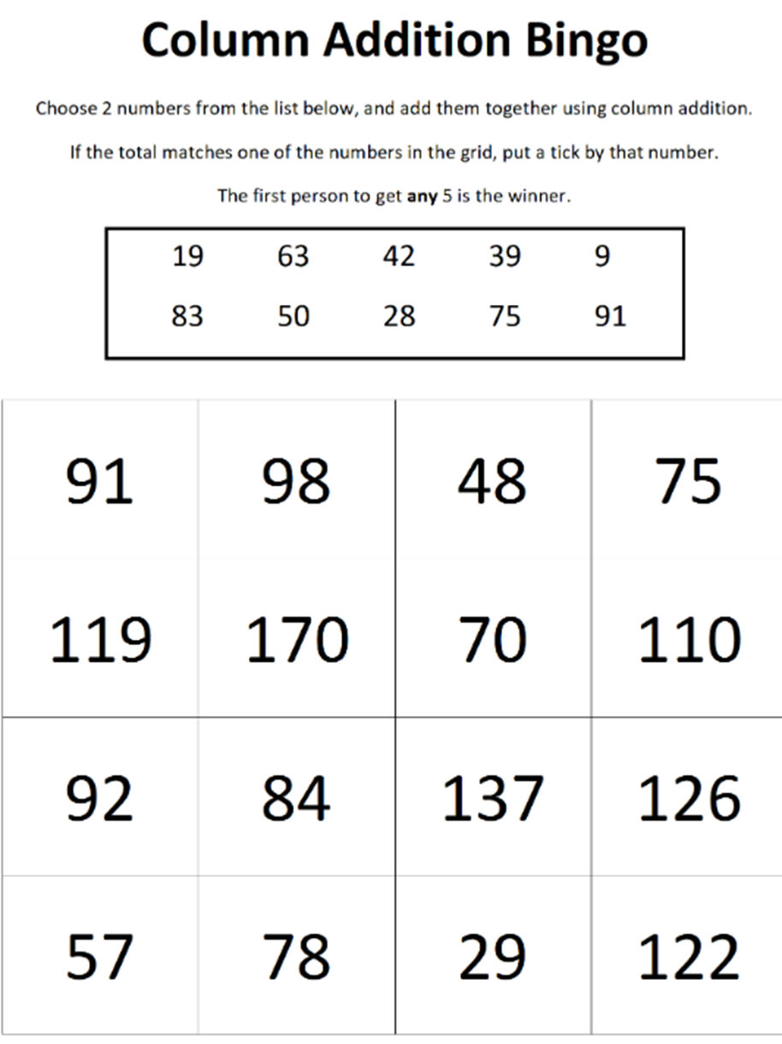

Slide 11



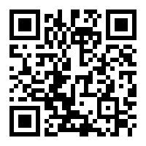
You can support your child’s addition and subtraction through playing Maths games online games online too!
Column Addition
Number bonds
Column Subtraction
Hit the button – number bonds

Slide 12
Multiplication and Division
Children will not have progressed on to formal written methods in these calculations yet. Learning will be focussed on mental methods, including times tables, inverse operations and problem solving, and linking to this to other areas of maths such as measure and fractions.

Slide 13
Times Tables
Children in Year 3 are expected to be able to use multiples of
2, 3, 4, 5, 8, 10, 50 and 100.
It is important that children practice their times tables as often as possible! Any help you can provide at home makes a huge difference.
By the end of Year 4, children are expected to know all of their multiplication facts up to 12.

Slide 14
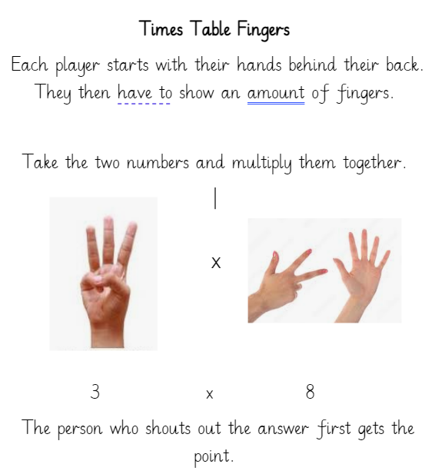

Slide 15




You can support your child's multiplication and division through playing Maths games onlines!
Table Tennis
Times Tables Truckers
Puppy food - division
Array Builder

Slide 16


General sites for all Maths (and English) skills!
Topmarks and
ICTgames

Slide 17
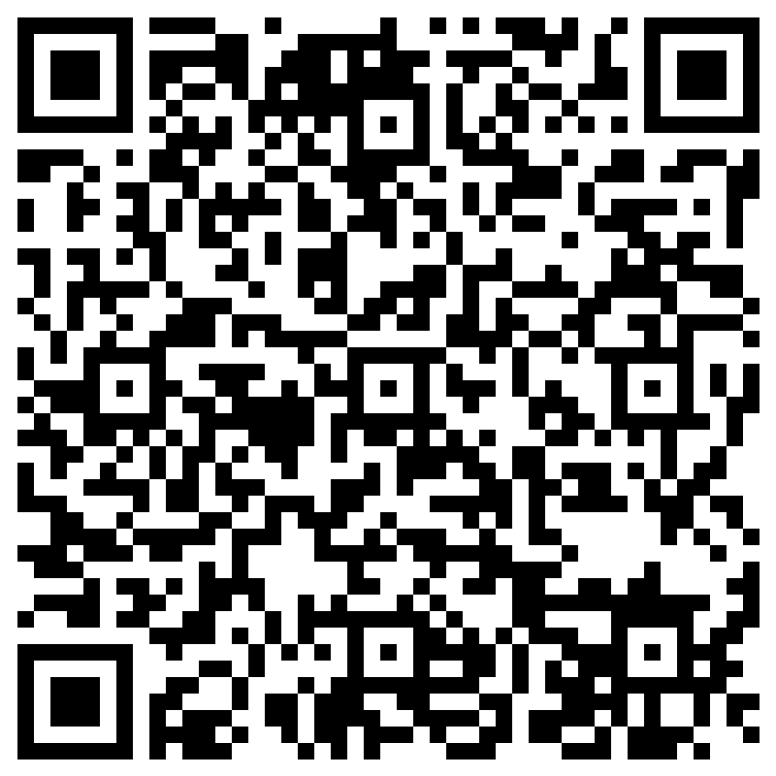
Please complete the survey!

Slide 18

Thank you for coming to our Year 3 maths workshop!
We hope you have enjoyed it.

