Slide 1
Year 2 Maths Skills Workshop
January 2025

Slide 2


Housekeeping
To keep our children safe, please do not have phones out or take photos during the workshop.

Slide 3
During this session…
We will teach an example of a maths skills session with the children.
This will be at a slower pace compared to normal as we will discuss specific arithmetic strategies and activities with you.
We will provide additional information on the interactive whiteboard for you whilst we are teaching.

Slide 4
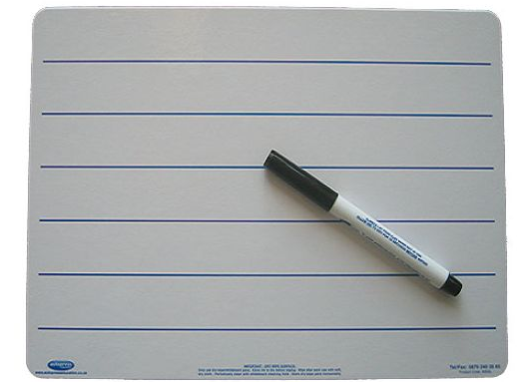
A typical Maths Skills session in year 2
This is a very pacy session and all children are engaged.
Use whiteboards so that children can edit, show their strategies and self-correct their work
Most importantly, the sessions are fun!

Slide 5
How Maths skills works at Valley
At the start of each maths lesson, children have a True or False question to answer after looking at their next steps in their book
They then begin their Maths skills session.
Children work to answer the questions either on their own or with a partner.
The children will mainly work on their whiteboards but some sessions are on the iPads.

Slide 6
What is a Maths skills session?
Maths skills is a part of the maths session where children practise their mental maths skills, KIRF target work and consolidate previous learning.
This is split into three parts in year 2: a True or False question, a Maths Skills Quiz and their main Maths Skills session.
The aim of this session is to increase their mental maths speed and accuracy as well as recapping on previous learning.

Slide 7
True or False
The children have a True or False question to answer when they have finished checking their next steps from the day before.
They then come to the carpet and we discuss the children's responses.
The children give their explanations and verbal reasoning for their answers.
This encourages verbal reasoning skills.

Slide 8
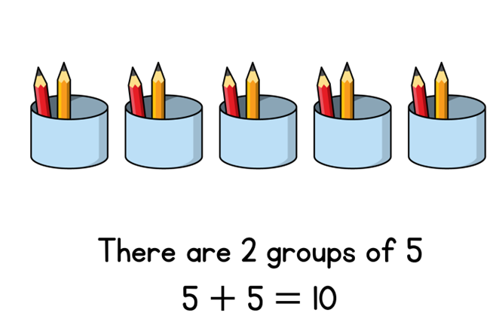
True or False

Slide 9
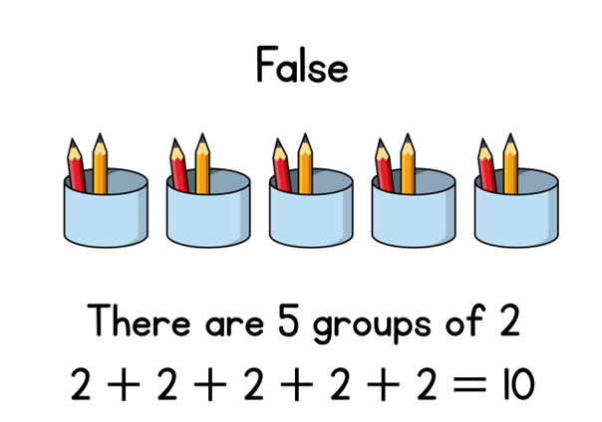

Slide 10
Maths Quiz
These are designed to recap on current and previous learning
The children work through each question independently
The teacher then models the correct answer and possible strategies the children could have used.

Slide 11
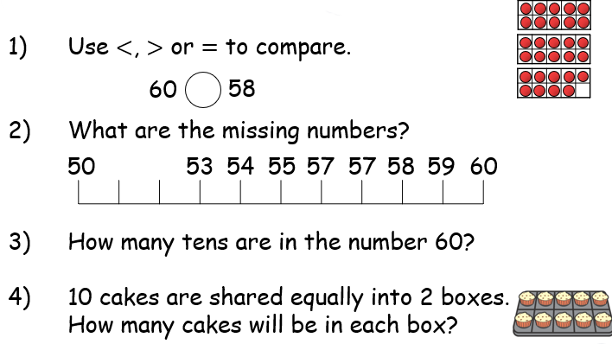
Maths Skills - Quiz

Slide 12
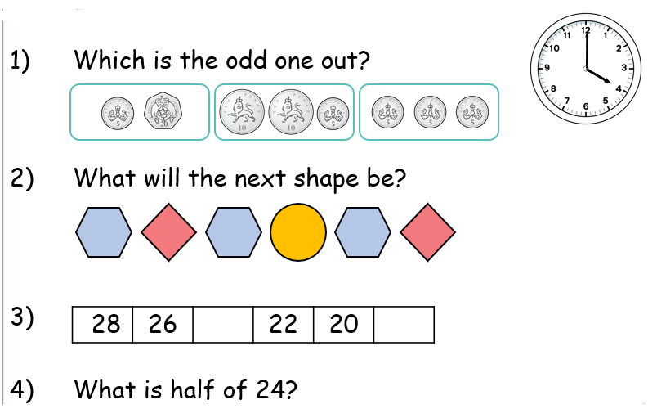
Maths Quiz

Slide 13
Maths Skills – Mastering Number
These happen four days a week
In this session, children recap on previous skills.
These help develop the number fact knowledge
We use resources such as rekenreks
There are a mixture of videos and mental maths activities

Slide 14
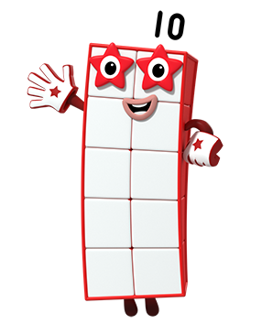
Hello! I am Ten!
Image © 2021 Alphablocks Ltd. All rights reserved. Mastering Number 2021/22 ncetm.org.uk

Slide 15
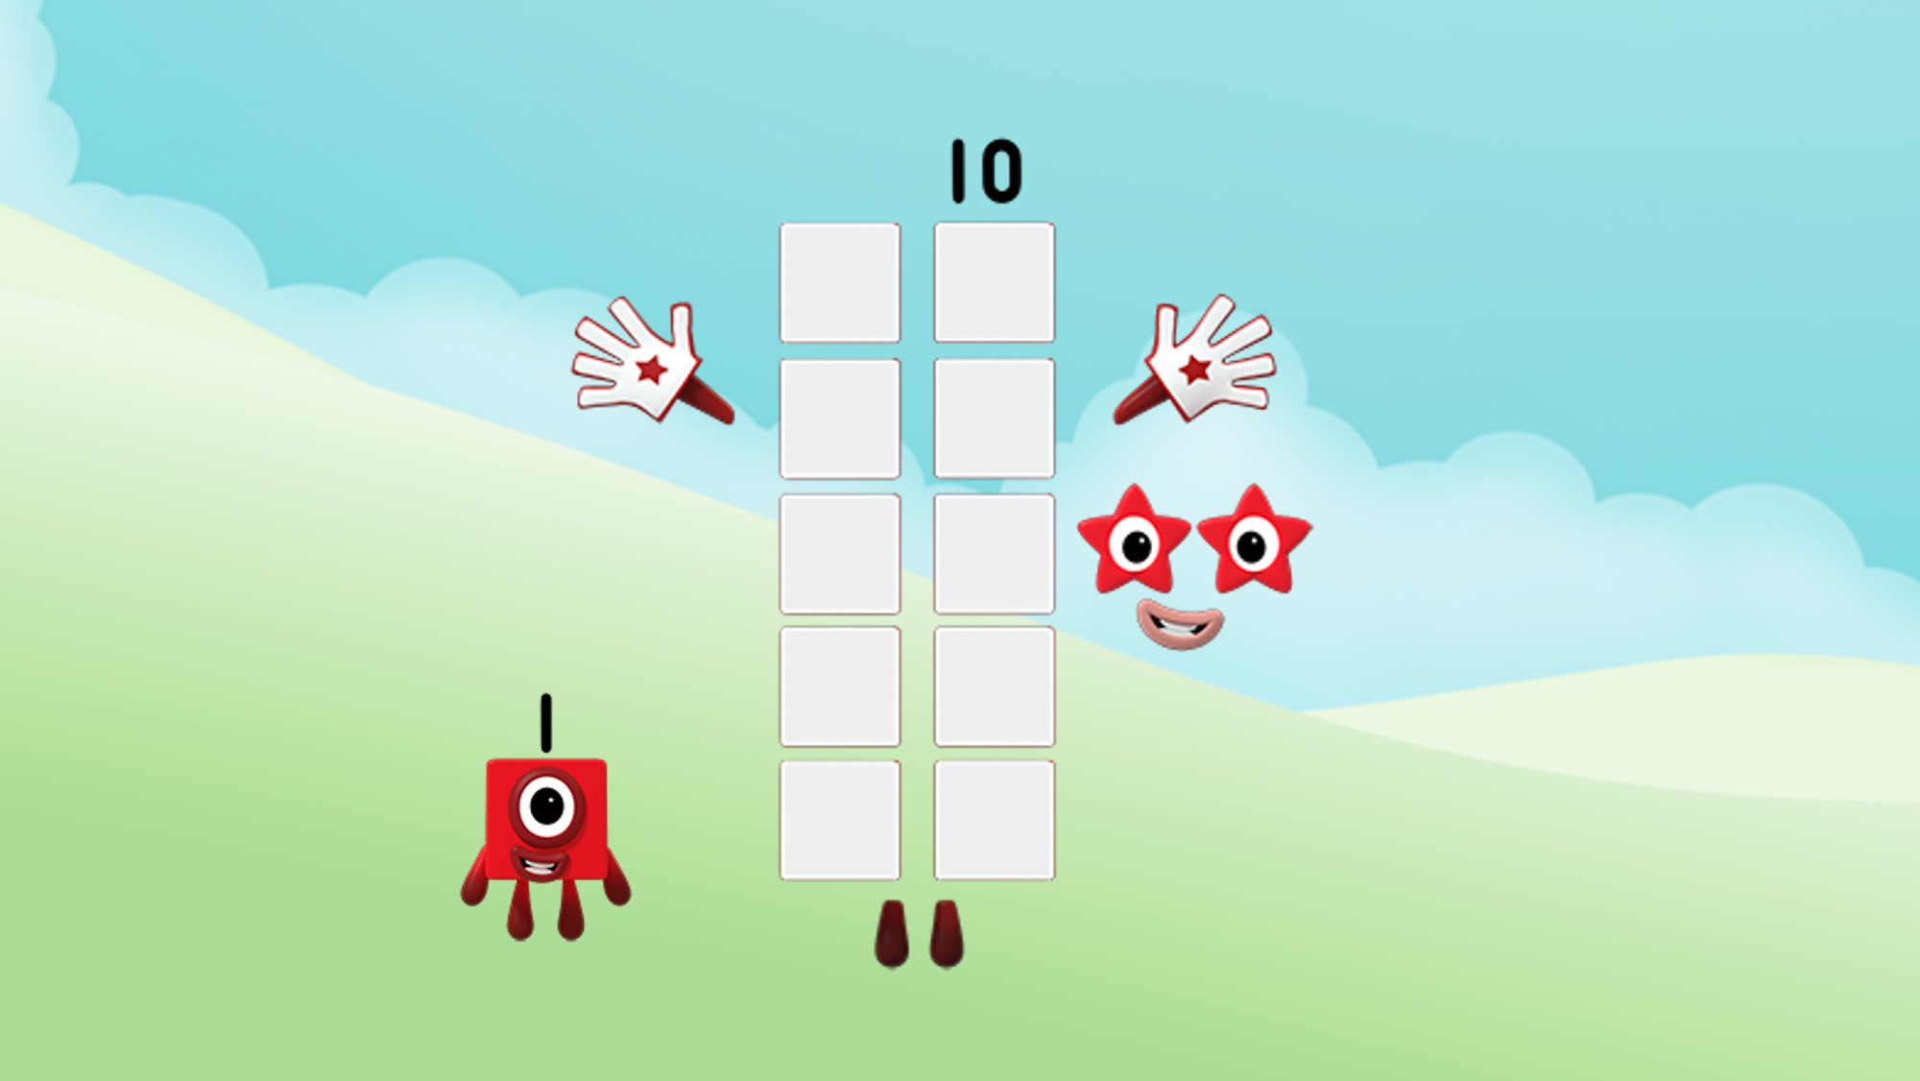
You can say I am ten 1s!
Image © 2021 Alphablocks Ltd. All rights reserved. Mastering Number 2021/22 ncetm.org.uk

Slide 16
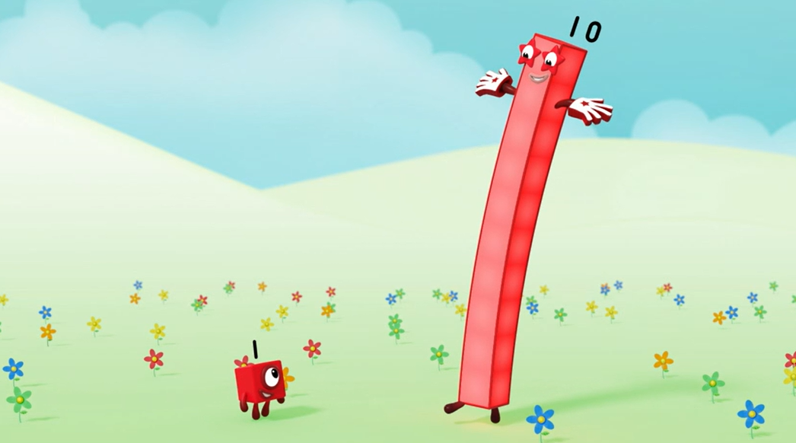
Look at the faces of a dice. Find one in your home or on the internet. What do you notice?
You can say I am one 10!
Image © 2021 Alphablocks Ltd. All rights reserved. Mastering Number 2021/22 ncetm.org.uk

Slide 17
I can also be a part of other numbers!
Image © 2021 Alphablocks Ltd. All rights reserved. Mastering Number 2021/22 ncetm.org.uk

Slide 18
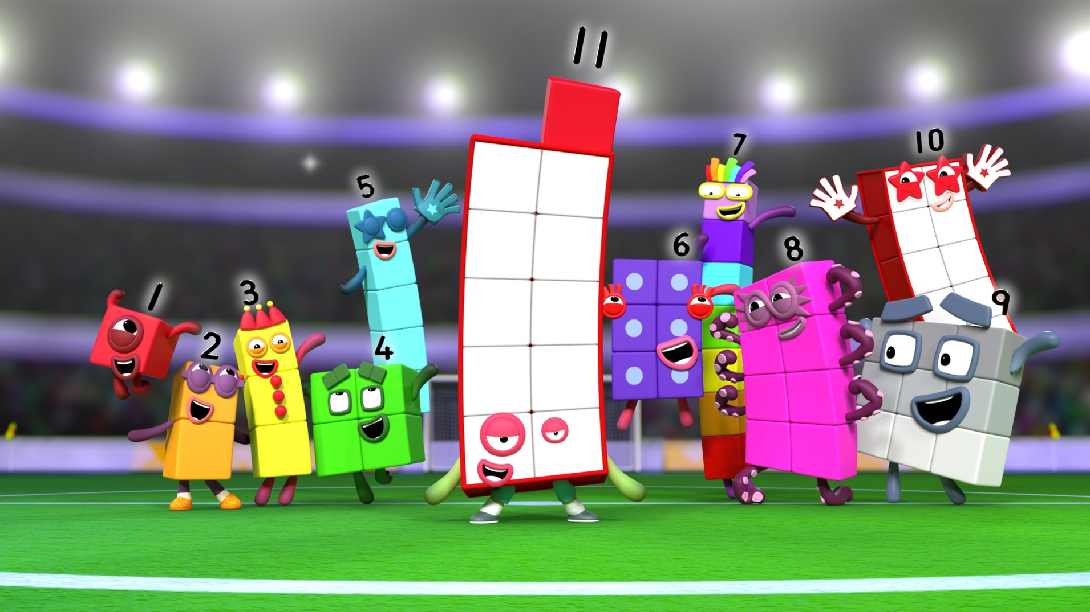
Numberblocks
Series 3, Episode 21: Eleven
Video © 2021 Alphablocks Ltd. All rights reserved. Mastering Number 2021/22 ncetm.org.uk

Slide 19
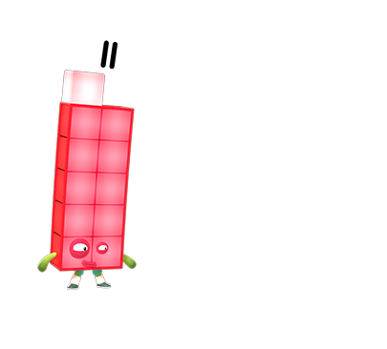
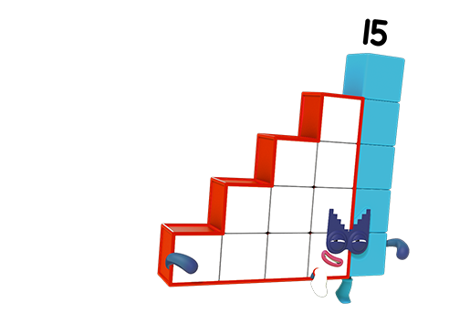
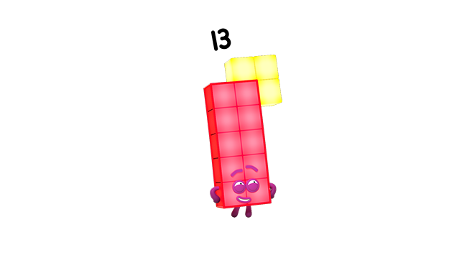
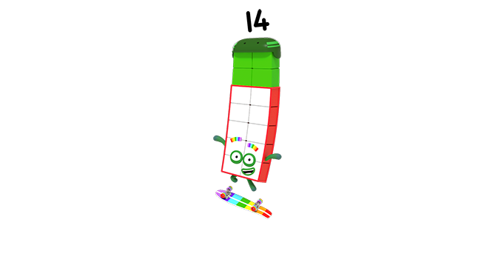
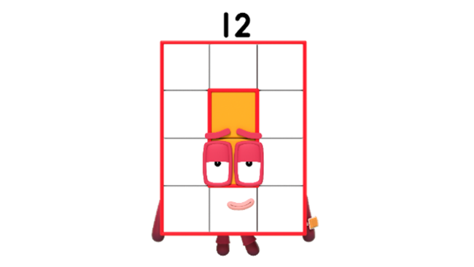
Can you see that 10 is a part of me and my friends?
Images © 2021 Alphablocks Ltd. All rights reserved. Mastering Number 2021/22 ncetm.org.uk

Slide 20
Use your rekenrek to help you say what 10 needs to make other numbers!
Image © 2021 Alphablocks Ltd. All rights reserved. Mastering Number 2021/22 ncetm.org.uk

Slide 21
10 needs _____ to make _____ ;
_____ is made of 10 and _____ .
Image © 2021 Alphablocks Ltd. All rights reserved. Mastering Number 2021/22 ncetm.org.uk

Slide 22
10 needs _____ to make _____ ;
_____ is made of 10 and _____ .
Image © 2021 Alphablocks Ltd. All rights reserved. Mastering Number 2021/22 ncetm.org.uk

Slide 23
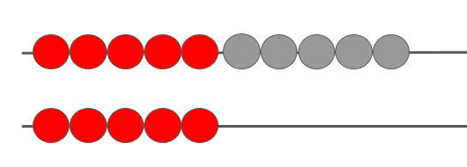
How can we ‘see’ 10 and 5 in 15?
10
5
10
5
Mastering Number 2021/22 ncetm.org.uk

Slide 24
Maths Skills – KIRF targets
These happen once a week.
The children practise the KIRF targets for this half term (2 times tables for Spring 1).
The children have a quiz at the start of the half-term to check starting knowledge.
The children complete a quiz at the end of the half-term to see their progress.

Slide 25
KIRF: Double facts to 20.
Double 3 =
Double 5 =
Double 8 =
How can we work it out?
Challenge – What other doubles to 20 can you think of?

Slide 26
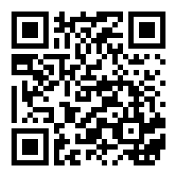
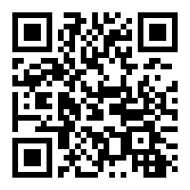
Toy Shop Money Game (GBP) – Topmarks
Coins Game for 4-10 year olds (topmarks.co.uk)

Slide 27
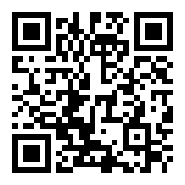
Hit the Button - Quick fire maths practise for 6-11 year olds (topmarks.co.uk)

Slide 28
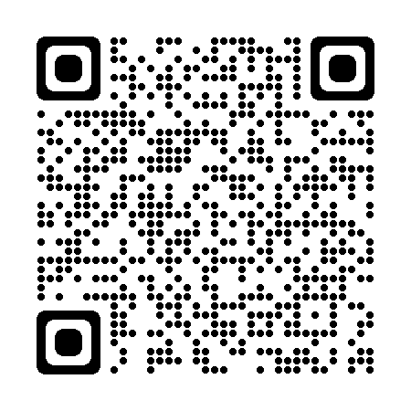
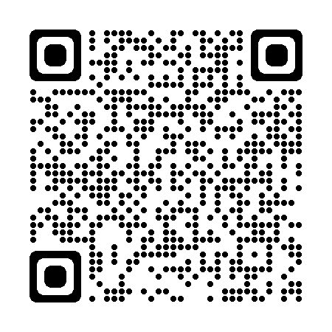
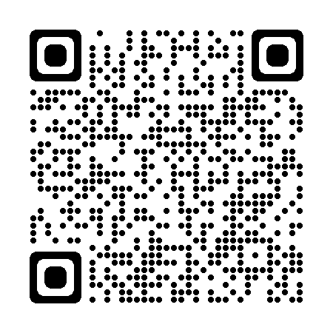
How you can help at home
Practise times tables using TTRS for 30 minutes per week
Encourage the children to play mental maths games on line using websites such as:
    Topmarks - https://www.topmarks.co.uk/Search.aspx?q=maths
    ICT games - https://ictgames.com/mobilePage/index.html
    White rose parent resources - https://whiterosemaths.com/parent-resources
Ask the children to explain what they have learnt each day and model their strategies to you.

Slide 29
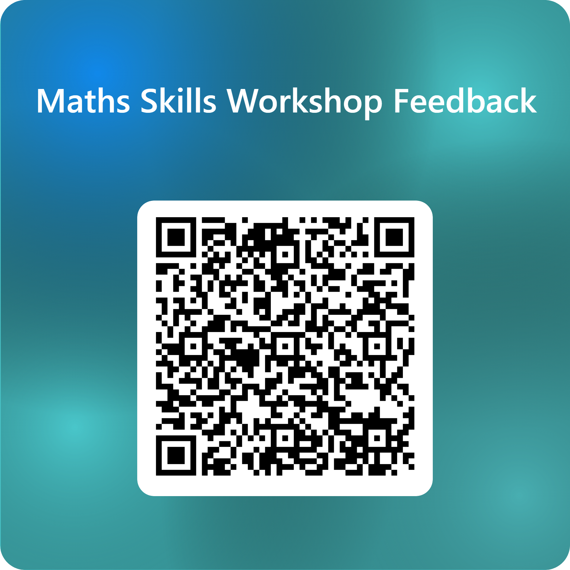
Questions?
Thank you so much for coming! We hope you found this helpful and informative.
We would appreciate your feedback. Please could you complete the online feedback form by scanning the QR code on your phone or tablet later.

